Slide 1
Comparative research methods

Slide 2
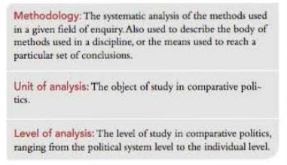


Slide 3
Comparison is one of the oldest tools of political science, found in the work of Aristotle. Some have even argued that the scientific study of politics is unavoidably comparative (Almond, 1996; Lasswell 1968), and that 'comparison is the methodological core of the scientific study of politics' (Powell., 2014).

Slide 4
The 'method' is usually taken to mean the study of a few carefully selected cases using a middle level of analysis (rather than the more intensive analysis possible with a few cases, or the more abstract analysis necessary with many cases) but it can take different forms according to the number of cases being studied.

Slide 5
Comparative research methods
The methods available for the comparative study of politics and government are many and varied. The choice among them depend on a combination of the research question being asked-

Slide 6
the time and resources available,
the method with which the researcher is most comfortable,
and the epistemological preferences of the researcher; that is, how they believe that understanding is best acquired.

Slide 7
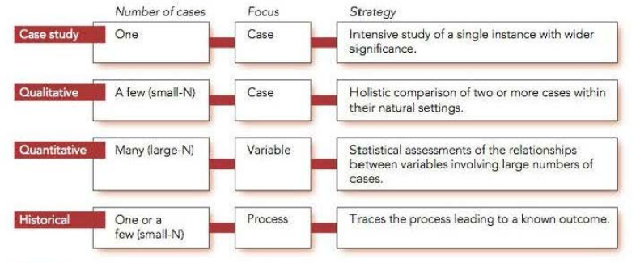
Case study method

Slide 8
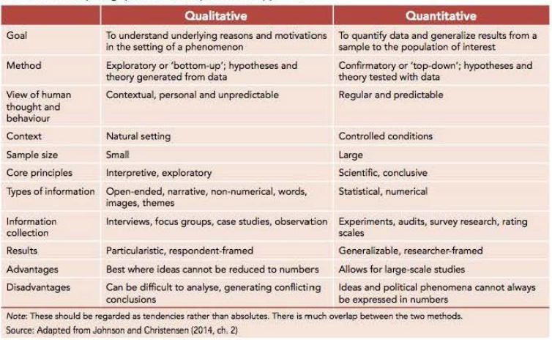

Slide 9
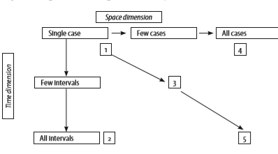

Slide 10
There is a huge literature discussing the pros and cons of quantitative versus qualitative approaches. It is routinely dealt with in current social science research methodology texts.

Slide 11
It is also reflected in debates among comparativists about the respective merits of large surveys in many countries, in-depth comparisons of few countries, and single-country case studies – an issue to be discussed in the next section.

Slide 12
Mixed methods
Triangulation: two or more different research strategies are used to investigate the same phenomenon so that findings or insights from one strategy can be corroborated by the other(s); specifically quantitative and qualitative approaches are used in parallel.

Slide 13
Facilitation: more than one approach is used, but one of them is dominant and different techniques may be used sequentially (for example a qualitative study to generate hypotheses before a quantitative study is undertaken).

Slide 14
Complementarity: different approaches are integrated rather than used in parallel or sequentially, as when researchers shift repeatedly from the one to the other.

