Slide 1
Case studies in
Comparative politics

Slide 2
The Importance of Comparison
When a scientist conducts an experiment the purpose is to hold as many factors as possible constant, in order to permit a single independent variable to operate upon a single dependent variable.
Unfortunately (or fortunately), the real world of politics is not that sterile and controlled, and there are a host of seemingly extraneous factors that influence the way people vote, or policies are made, or interest groups lobby.
.

Slide 3
Real countries present both problems and benefits for comparative politics. The benefits are obvious. Within those real countries occur the real, complex and convoluted sequences of events that are of so much interest to the student of the subject.
On the other hand, the complexity of real political life means that variables come to the researcher in large bundles of factors that are almost inextricably intertwined.

Slide 4
The real world of comparative government is therefore the laboratory for political scientists to determine what works and what does not, as well as to demonstrate important theoretical relationships among variables.
It is a laboratory in which the 'experiments' are designed by other people - politicians, civil servants, interest group leaders - for their own purposes and not for those of social scientists.
Therefore, the difficult but yet crucial task for the comparative analyst is to devise the methods necessary to construct meaningful theoretical and analytic statements about government and politics within those complex and largely unplanned settings.

Slide 5
Forms of Comparative Analysis
On the one hand, there are studies of an individual country that are labelled 'comparative'. (Democratic countries :US -UK)
At the other end of the spectrum are studies in which individual countries are submerged in a multitude of other countries, and become 'data points' in a statistical analysis much more than they are vital political entities. (regional studies)
‘At times comparativists will emphasise similarities, at times differences.’

Slide 6
Another way to think about these fundamental trade-offs in comparative analysis is to contrast configurative and statistical methods of analysis.
In the configurative approach, the primary purpose is the thorough description of a case or cases, so that the consumer of the research will be capable of comprehending the logic of political life in that limited number of settings.

Slide 7
That understanding of the case will be, however, rather deep, or 'thick', and would include a number of aspects of social and political life found in those systems.
The anthropologist Clifford Geertz ( 1973) used the phrase 'thick description' to describe interpretative work in his discipline. By this, he meant using detailed description as the precursor of interpretation and theory development in the social sciences.

Slide 8
The descriptions generated in a configurative analysis tend to range across institutional and micro-political 'variables', rather than just on the specifics of a case.
One of the more interesting, and confounding, features of comparative analysis from the configurative perspective is that researchers from different countries may apply their own particular national lens to the same data.

Slide 9
Statistical explanation has a fundamentally different purpose. It attempts to test propositions about the relationship among political variables across countries and in a variety of settings.
Further, statistical explanations tend to leave unmeasured a number of factors that might be central to the more descriptive and convoluted explanations provided through configurative analysis.
To the extent that cultural factors are a part of the statistical explanation, they tend to be included only as residual explanations, and to appear only when all other measured factors prove inadequate to explain the dependent variable in question.
In fairness, there have been some attempts to measure cultural factors more explicitly, and to include them in the statistical models. For example, the wealth of data coming from the World Value Study is used increasingly to both describe national political cultures and to attempt to explain other political phenomena

Slide 10
Quantity and Quality
Conducting either style of social research properly depends upon the same issues of research design, each is prey to the same potential errors, and each requires interpretation that goes beyond their available data.

Slide 11
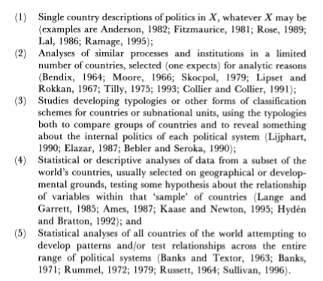
Types of Comparative Studies
At least five types of studies are classified as being components of comparative politics.

Slide 12
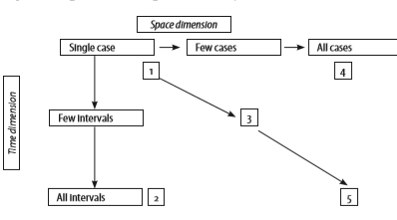

Slide 13
The Case Study
The case-study remains by far the most common method of research in political science in general, and more particularly in comparative politics.
Any time a researcher investigates a single instance of a phenomenon within a single setting, we call that exercise a case-study.
But, it must be said that case studies are often conducted poorly, and without sufficient understanding of the theoretical and methodological issues involved in doing proper case-research.
A single case, if properly constructed and researched, can be used to expand the analytic knowledge of political science and to illuminate, and even test directly, theories commonly used in the discipline.

Slide 14
Conducting Case-Research
Ultimately, all cases must be constructed. That is, even if it is evident from the beginning what it may be a case of, the case itself must still be socially constructed by the researcher.
That scholar must decide what the boundaries are for the case, what the relevant questions are, and what the relevant evidence is.
In particular, if the research is to be of any real utility for the discipline generally then the researcher must develop or adapt a conceptual framework into which the case can be fitted, and with which to make it more comparable to other, similar cases.

Slide 15
What cases it will be similar to will be defined by the conceptual framework is chosen and how the researcher constructs the case, and that construction does not occur naturally.
Even when the strategy of deviant case-analysis is being used, there must be some regularity of other cases assumed, or demonstrated, in order to argue that the one case actually is a deviant.

Slide 16
Issues in Case-Study Research
The standard issues of maximising experimental variance, minimising error variance and controlling extraneous variance arise very clearly in case-study research.
The Role of the Case Researcher: Further, in comparative analysis, the role of the researcher becomes even more of an issue, given that he or she is a product of a particular political and intellectual culture, and almost inevitably brings that set of values to bear on the research.

