Slide 1
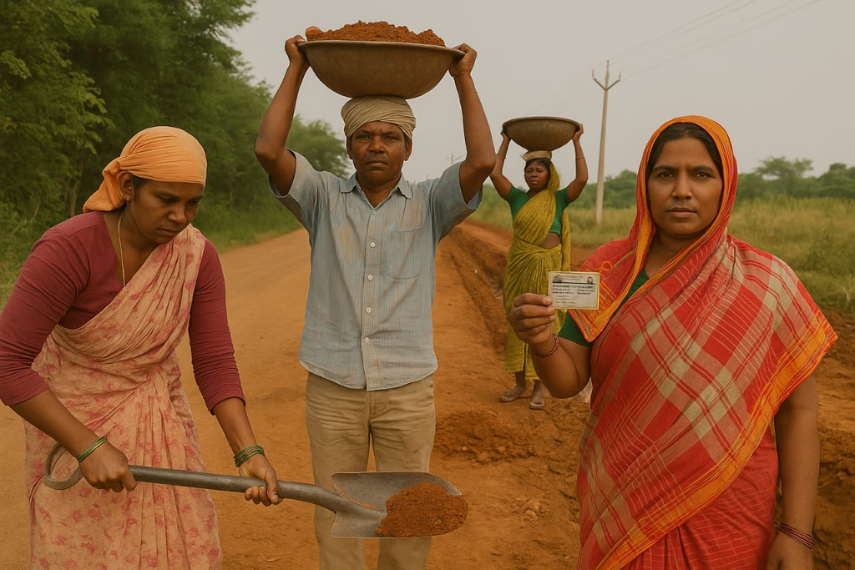
Public Policy and Administration in India
Employment : MGNREGA
Presented by Saurav Boruah
Department of Political Science

Slide 2

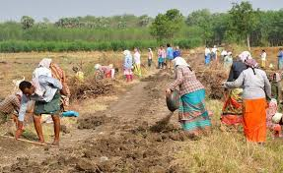
MGNREGA
Mahatma Gandhi National Rural Employment Guarantee Act(MGNREGA), enacted in 2005, is a landmark social security measure by the government of India.
Objective: To enhance livelihood security in rural areas by providing at least 100 days of guaranteed wage employment in a financial year to every household whose adult members volunteer to do unskilled manual work.

Slide 3
Key features of MGNREGA
  Registration: (a) Any adult in a rural household can apply for unskilled work to gram panchayat. (b) The unit of registration is a household. (c)Each household is entitled to 100 days of employement evey year.
  Job Card: A Job card is issued within 15 days of registration, valid for 5 years.
  Unemployment Allowance: If employment is not provided with 15 days, he/she will be entitled to a daily unemployment allowance.
  Work provision: (a) Work within 5km radius; if work is beyond 5 kms, extra wages of 10 per cent are payable to meet transportation etc. (b) At least one-third of workers must be women. (c)Contractors and use of labour displacing machinary are prohibited.
  Wages: (a) Payment based on worksite measurement. (b) Payment should be done on a weekly basis, via bank/post office account.
  Planning & execution: (a) Gram Sabha plans and approves work. (b) 50% of work by cost executed by Gram Panchayats.

Slide 4
Categories of Permissible Works
  Category A: Natural resource management.
1.Irrigation canals, desilting water bodies. 2.water conservation, watershed management. 3. addorestation and land development.
  Catergory B: Individual assests for vulnerable Groups.
1. land improvement, irrigation for marginalized groups. 2. support for livestock, fisheries and housing. 3. Horticulture and farm forestry.
  Category c: common infrastructure for Self Help Groups.
1. infrastructure for bio fertilizers, storage. 2. common worksheds for livelihood activities.
  Category D: Rural Infrastructure
1. Sanitation, rural road connectivity. 2. Disaster mitigation, drainage, and flood control. 3. Gram panchayat buildings , storage, anganwadis
Your paragraph text

Slide 5
Significant Achievement of MGNREGA
  Employement Generation: provides wage employment to 5 crore rural household annually, covering nearly one fourth of household in the country.
  Financial Inclusion: over 9.3 crore bank/post office account opened. 80% MGNREGA payments are digital,ensuring transparency.
  Inclusive Growth: high participation from SC/ST communities(40-60%), reduced distress migration.
  Women empowerment: women participation rate consistently above 40%; improve economic and social standing.
  sustainable development: 53 % works focus on water conservation and eco- restoration, improving land productivity.
  Boost to Agriculture: Improved irrigation through water assets; changes in chopping patterns and expansion in cultivation.

Slide 6
Challenges in Implementation of MGNREGA
  Corruption: Cases of embezzlement and manipulation of records; e.g., corruption charges against officials.
  Limited Job Opportunities: Only 100 days of work per person per year — often insufficient to meet livelihood needs.
  Lack of Awareness: Many rural citizens are unaware of their rights and entitlements under MGNREGA.
  Bureaucratic Delays: Delayed payments and inefficiencies in administration hinder timely benefit delivery.
  5. Quality of Work: Work often criticized for not meeting local needs or maintaining adequate standards.
  Limited Financial Inclusion: Inadequate access to banking services in some states (e.g., Bihar) affects wage transfers.

Slide 7
Key Initiatives to Strengthen Implementation
  Expansion of Permissible Works
a.New categories of work added, especially in agriculture and land development.
b. Focus on improving rural livelihoods and durable asset creation.
c. Benefits SC/ST, small & marginal farmers, and Forest Rights Act beneficiaries.
  Realistic Labour Budgeting
a. Bottom-up participatory planning encouraged.
b. Aims to minimize the gap between projections and actual employment.
  Improve Demand Registration
a. Work application made accessible via mobile phones, IVRS, call centers, and kiosks.
b. Facilitates demand registration for illiterate and marginalized workers.

Slide 8
  Enhanced Inclusion
a. Targeted efforts to increase women participation through individual bank accounts and special outreach.
b. Provision of work for particularly vulnerable groups like the elderly and disabled.
  Organizing Labour Groups
a. States encouraged to form labour groups to collectively voice demands and improve awareness of rights.
  Electronic Fund Management System (e-FMS)
A. Direct credit of wages to workers' accounts via Core Banking System.
B.Reduces delays and curbs fund leakages.
C. Implemented in major states and extended to others.

Slide 9
  Expenditure-Based Fund Release (e-FRS)
A. Funds now released based on actual, not projected, expenditure.
B. Ensures timely availability and prevents fund shortages or hoarding.
  ICT & e-Governance Initiatives
A. MIS Portal (www.mgnrega.nic.in): Real-time, transparent data from 2.5 lakh panchayats.
B. NREGA Soft: Comprehensive software for job registration, fund tracking, social audit, and grievance redressal.
C. Aadhaar Integration: Biometric authentication introduced to ensure secure wage payments.
  Technology Deployment
A. Use of mobile devices for real-time data collection and wage processing.
B. fast and secure fund transfer to post offices and banks.

Slide 10
Thank You

