Slide 1
Research design

Slide 2
Research Design
A research design is the arrangement of conditions for collection and analysis of data,
Research design is the conceptual structure within which research is conducted; it constitutes the blueprint for the collection, measurement and analysis of data..
Simply, Decisions regarding what, where, when, how much, by what means concerning an inquiry or a research study constitute a research design.
Design for a home by an engineer before construction resembles research design.

Slide 3
Splitting the research design
Sampling Design deals with the method of selecting items to be observed for the given study.
Observational Design relates to the conditions under which the observations are to be made;
Statistical Design concerns with the question of how many items are to be observed and how the information and data gathered are to be analyzed;
Operational Design deals with the techniques by which the procedures specified in the sampling, statistical and observational designs can be carried out.

Slide 4
Importance and features of Research Design
Reduces inaccuracy.
Maximisation of reliability and efficiency.
Specifies the sources and types of information relevant to the research problem.
Specifies which approach will be used for gathering and analyzing the data.
Includes the time and cost budgets since most studies are done under these two constraints.
Eliminates bias and marginal errors.

Slide 5
Feature of a Good Research Design
characterized by adjectives like flexible, appropriate, efficient, economical and so on.
the design which minimizes bias and maximizes the reliability of the data collected and analyzed is considered a good design.
The design which gives the smallest experimental error is supposed to be the best design in many investigations.
Similarly, a design which yields maximal information and provides an opportunity for considering many different aspects of a problem is considered most appropriate design.
A research design appropriate for a particular research problem involves:(i) the means of obtaining information;(ii) the availability and skills of the researcher and his staff, if any;(iii) the objective of the problem to be studied;(iv) the nature of the problem to be studied; and(v) the availability of time and money for the research work.

Slide 6
Types of Research design
. Research design in case of exploratory research studies,
Research design in case of descriptive and diagnostic research studies,
Research design in case of hypothesis-testing research studies

Slide 7
Exploratory research studies
main purpose of such studies is that of formulating a problem for more precise investigation or of developing the working hypotheses from an operational point of view.
emphasis in such studies is on the discovery of ideas and insight.
must be flexible enough to provide opportunity for considering different aspects of a problem under study.

Slide 8
Method for Exploratory research studies
Survey Concerning Literature: researcher should review and build upon the work already done by others, but in cases where hypotheses have not yet been formulated, his task is to review the available material for deriving the relevant hypotheses from it.
Experience Survey means the survey of people who have had practical experience with the problem to be studied. object is to obtain insight into the relationships between variables and new ideas relating to the research problem, may be through interview.
the analysis of ‘Insight-Stimulating’ Examples, especially in unfamiliar areas, involves intensive study of selected instances to derive hypotheses. Examples like reactions of strangers, marginal individuals, those in transition, or from different social strata are often valuable, emphasizing the significance of sharp contrasts or striking features in this hypothesis formulation method.

Slide 9
Research design in case of descriptive and diagnostic research studies:
concerned with describing the characteristics of a particular individual, or of a group.
diagnostic research studies determine the frequency with which something occurs or its association with something else.
the researcher must be able to define clearly, what he wants to measure and must find adequate methods for measuring it along with a clear cut definition of ‘population’ he wants to study.
Since the aim is to obtain complete and accurate information in the said studies, the procedure to be used must be carefully planned. The design in such studies must be rigid and not flexible.
methods like observation, questionnaires, interviewing, examination of records, etc are used.

Slide 10
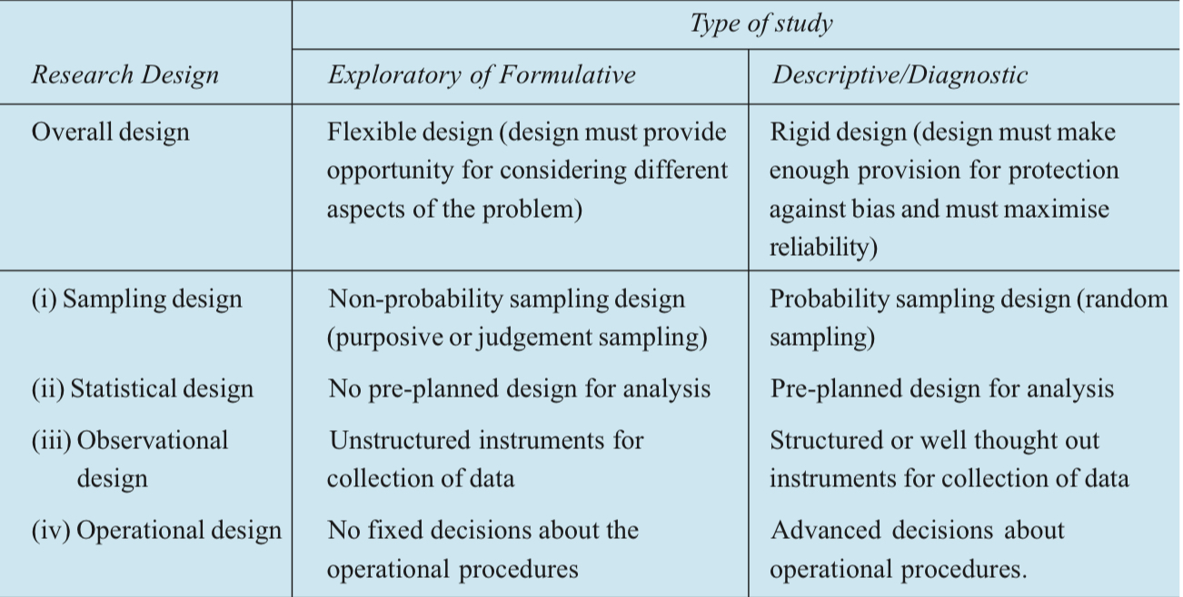
The Differences Between Exploratory and Descriptive Research Design

Slide 11
Research Design in Case of Hypothesis-testing Research Studies
Also known as Experimental studies.
Researcher tests the hypotheses of causal relationships between variables.
To achieve unbiased and reliable results and draw inferences about causality, experiments are commonly used. Hence, when we talk of research design in such studies, we often mean the design of experiments.

Slide 12
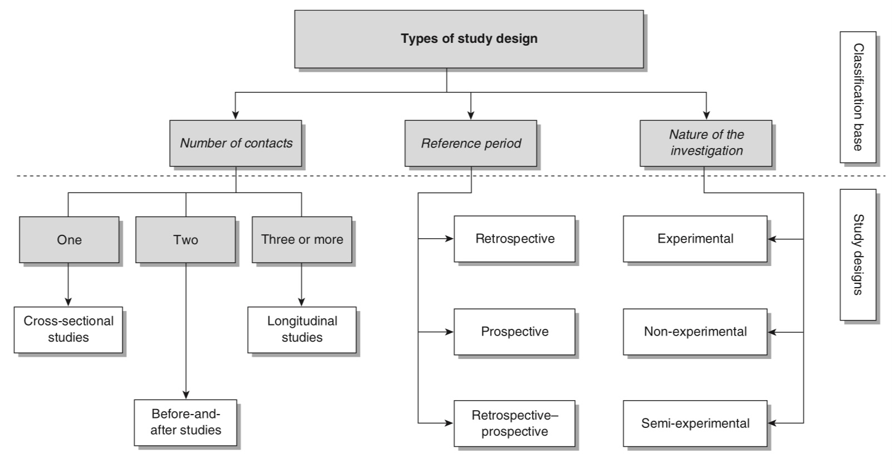
Research Design in Quantitative approach

Slide 13
Research Design based on Number of contact
Cross sectional study: suited to studies aimed at finding out the prevalence of a phenomenon by taking a cross-section of the population. They are useful in obtaining an overall ‘picture’ as it stands at the time of the study.
before-and-after design (also known as the pre-test/post-test design) is that it can measure change in a situation, phenomenon or attitude. It is an appropriate design for measuring the impact or effectiveness of a programme
Longitudinal Studies are more helpful to determine the pattern of change in relation to time. Longitudinal studies are also useful when you need to collect factual information on a continuing basis over a period of time.

Slide 14
Research Design Based on Reference Period
Retrospective study design investigate phenomenon of the past, either on the basis of the data available for that period or on the basis of respondents’ recall of the situation.
Prospective studies refer to the likely prevalence of a situation or outcome of an event in the future. Experiments are usually classified as prospective studies.
Restrospective- Prospective Studies Retrospective-prospective studies examine past trends and project into the future. Data is initially collected retrospectively from existing records, and the study population is then followed to assess the impact of an intervention.

Slide 15
Research Design Based on Nature of Investigation
Experimental study involves the researcher introducing the intervention that is assumed to be the ‘cause’ of change, and waiting until it has produced the change.
Non- Experimental Study consists of the researcher observing a phenomenon and attempting to establish what caused it. In this instance the researcher starts from the effect(s) or outcome(s) and attempts to determine causation.
In the former case the independent variable can be introduced, controlled or manipulated, whereas in the latter this cannot happen as the assumed cause has already occurred. the researcher retrospectively links the cause to the outcome.
Semi-Experimental Study has the properties of both experimental and non-experimental studies
Experimental study designs have been categorised as: the after-only experimental design; the before-and-after experimental design; the control group design; the double-control design; the comparative design; the ‘matched control’ experimental design; the placebo design.

Slide 16
Study Design in Qualitative Research
Case Study
Oral History is amethod of data collection than a study design; an approach to study perceptions, experiences and accounts of an event or gathering historical knowledge as viewed by individuals.
Focus Groups/Group Interviews Both are facilitated group discussions in which a researcher raises issues or asks questions that stimulate discussion among members of the group. It is of low cost.
Participant Observation

Slide 17
References
Kothari,C.R.(2004).Research Methodology Methods and Techniques. New Delhi: New Age International Publishers
Kumar,R.(1999).Research Methodology A Step-by-Step guide for beginner.SAGE

Slide 18
Thank You

