Slide 1





Sampling in Quantitative Research
Research Methodology

Slide 2
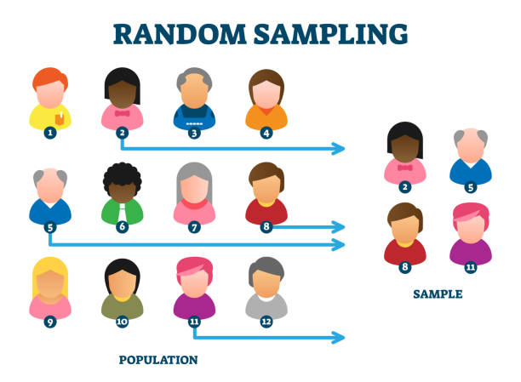

What is Sampling in Quantitative Research?
Sampling in quantitative research is the process of selecting representable units or individuals from a large population to represent that population
It involves identifying and choosing a sample that accurately reflects the characteristics of the entire population under study.
Quantitative research usually takes into account techniques based on probability theory.

Slide 3
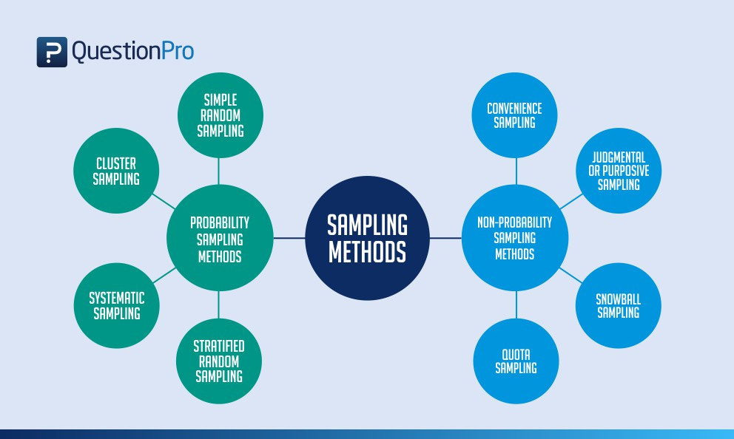


Slide 4

what is probability sampling method?
Probability Sampling in quantitative research is a sampling method that involves randomly selecting a sample, or a method where every member of the population has a known chances of being selected for inclusion in the sample
This approach ensures that the samplle is representative of the population and allows for the calculation of statistical measures of precision and accuracy.

Slide 5
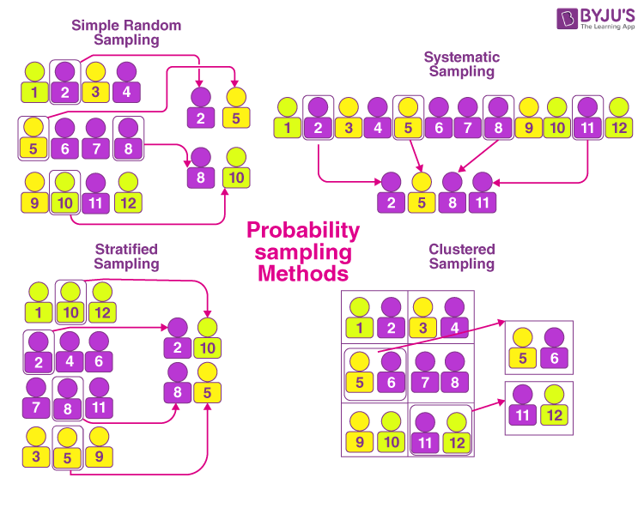
Types of Probability Sampling Method
Simple Random Sampling is the method in which each member of the population has an equal chance of being chosen for the study.
Systematic Sampling is a type of probability sampling method in which sample members from a largerpopulation are selected according to a random starting point but with a fixed, periodic interval.
Stratified sampling is a method of obtaining a representative sample from a population that researchers have devided into relatively similar sub populations.
In Cluster Sampling, the population is devided into groups, or clusters, based on some criterion, such as geographic location and a random sample of clusters is selected.

Slide 6
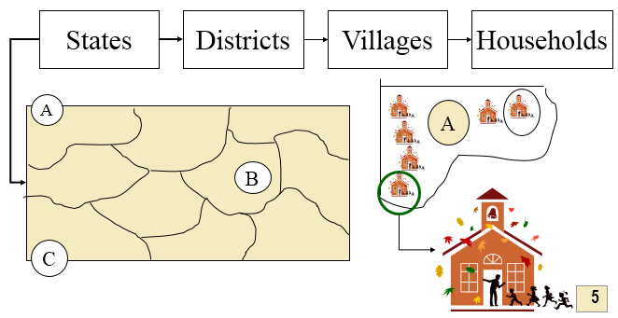
5. In multistage sampling or multi stage cluster sampling the researcher draw a sample from a population using smaller and smaller groups( units) at each stage. It’s often used to collect data from a large, geographically spread group of people in national surveys.

Slide 7
Pros of Probability Sampling
Cons of Probability Sampling
Representativeness
Generalization
Statistical Inference
Reduce Bias
Precision
Resource Intensive
Complexity
Sampling Frame Issues
Limited Applicability
Difficulty in Accessing Population

Slide 8

Source:
Kumar R.(2011). Research Methodology: A step- by-Step Guide for Beginners. SAGE Publications.
Social Research Methodology by Alan Bryman(2016)

