Slide 1
Political Theory II
Department of political science
Unit : Amartya Sen
Presented by Parlina Kalita

Slide 2
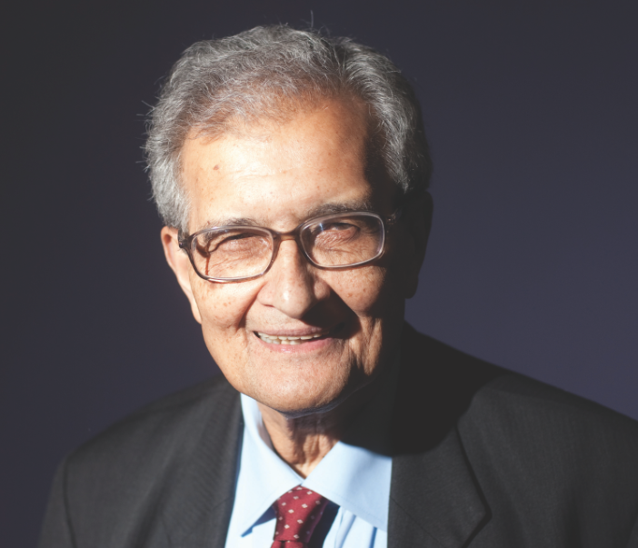
Philosophy of Amartya Sen
Amartya Sen (born 1933) is an Indian economist, philosopher, and Nobel Laureate whose work has profoundly influenced fields such as welfare economics, development studies, ethics, and political philosophy.
His contributions go beyond traditional economics, focusing on freedom, justice, human capabilities, and social choice.
Educated at Presidency College (Calcutta) and Trinity College (Cambridge), Sen became one of the most respected global intellectuals.
He is best known for his role in developing the Capability Approach, which shifted the focus of development from mere economic growth to what people are actually able to do and be — their real freedoms and opportunities.

Slide 3
Sen has also contributed significantly to discussions on democracy, justice, inequality, and famine, often blending rigorous economic analysis with deep moral and philosophical insights.
His interdisciplinary approach makes him a unique thinker who bridges economics with ethics and public policy.
Some of his most influential books include Poverty and Famines, Development as Freedom, The Idea of Justice, and Identity and Violence.

Slide 4
Amartya Sen’s Capability Approach
The Capability Approach is Amartya Sen’s most influential contribution to philosophy and development economics. It offers an alternative way of evaluating well-being, poverty, and development — focusing not just on income or resources, but on what people are actually able to do and be in their lives.
Core Concepts of the Capability Approach
1. Capabilities vs. Functionings
Functionings are the things a person achieves — like being healthy, educated, or having a job.
Capabilities are a person’s real opportunities or freedoms to achieve those functionings.
👉 Example: Being well-nourished is a functioning; having access to food and being free from hunger is part of your
capability to be well-nourished.
2. Freedom as Development Sen defines development as the expansion of people’s capabilities — their real freedom to live the kind of life they value. Economic growth matters only if it leads to greater freedom and opportunity.
3. Critique of Traditional Metrics Sen criticizes measures like GDP or income levels for being too narrow. A country may have high GDP, but if people lack access to education, healthcare, or civil rights, they are not truly "developed."

Slide 5
4. Focus on Individual Differences Different people need different resources to achieve the same capabilities due to factors like age, gender, health, or social context. So, equal income doesn’t always mean equal opportunity.
5. Importance of Agency Sen emphasizes agency — the ability to pursue goals one values and has reason to value. It’s not just about well-being but also about empowerment and participation in shaping one’s own life.

Slide 6
Amartya Sen’s Perspective on Justice
Amartya Sen presents a distinctive and practical approach to justice in his influential book The Idea of Justice (2009). He moves away from traditional theories that focus on creating a perfectly just society and instead emphasizes reducing injustice in the real world.
Key Elements of Sen’s Perspective on Justice
Critique of Transcendental Theories of Justice Sen criticizes philosophers like John Rawls, who focus on ideal or "perfect" models of a just society.
Instead of asking “What is a perfectly just society?”, Sen asks:“How can we reduce injustice here and now?”
His approach is comparative, not ideal — focused on making society less unjust, even if perfect justice is unreachable.
2. Realization-Focused Approach Sen prioritizes actual outcomes and improvements in people’s lives over abstract principles. Justice is about what actually happens, not what should ideally exist.

Slide 7
3. Importance of Capabilities Justice, for Sen, should be assessed in terms of people’s capabilities — their real freedoms to lead lives they value. A just society enables all individuals to access basic capabilities like:
Education
Health
Political participation
Economic opportunity
4. Plurality and Public Reasoning Sen argues that justice has no single model — different societies may value different things. Therefore, justice must be approached through public reasoning, dialogue, and democratic debate.
5. Focus on Agency and Participation A just society must enable people to be agents of change, not just passive recipients of welfare. Participation, voice, and empowerment are central to Sen’s view of justice.

Slide 8
📘 Key Differences from Rawls
Aspect | John Rawls | Amartya Sen
Focus | Ideal theory (perfect justice) | Comparative justice (reducing injustice)
Method | Original position, veil of ignorance | Real-world capabilities and outcomes
Justice Concept | "Justice as fairness" | "Justice as capability expansion"
Key Concern | Distribution of goods | Expansion of real freedoms and opportunities

Slide 9
Conclusion
Amartya Sen’s philosophy offers a transformative view of development, justice, and human well-being. Through his Capability Approach, he shifts the focus from economic growth and resource distribution to what individuals are truly able to be and do — highlighting freedom, opportunity, and human dignity as the true measures of progress. His perspective on justice challenges idealized theories, emphasizing the need for practical, real-world solutions that reduce injustice through public reasoning and democratic participation. By integrating economics with ethics and social choice, Sen presents a deeply human-centered framework that continues to shape global thinking on development, equality, and rights.

Slide 10
5 sample UGC-NET-style questions based on Amartya Sen’s Capability Approach and his Perspective on Justice:
1.
Which of the following best describes Amartya Sen’s Capability Approach? A) Focus on income and wealth as indicators of well-being B) Focus on people’s freedoms and real opportunities to achieve valued functionings C) Emphasis on economic growth as the sole goal of development D) Prioritization of industrialization over social welfare
2.
In Sen’s view, what is the central measure of development? A) National income B) Access to technology C) Expansion of individual capabilities and freedoms D) Level of industrial output
3.
Amartya Sen criticizes which aspect of Rawls' theory of justice? A) Emphasis on liberty B) Use of the original position C) Ideal, transcendental approach to justice D) Focus on education as a human right

Slide 11
4.
Which of the following is not a key concept in Sen’s Capability Approach? A) Functionings B) Utility maximization C) Capabilities D) Freedom to achieve well-being
5.
According to Amartya Sen, how should justice be pursued? A) By designing a perfectly just society in theory B) Through market-based mechanisms C) By comparing real-world situations and reducing evident injustices D) By enforcing religious laws
Answers : 1) b 2) c 3) c 4) b 5) c

Slide 12
THANK YOU

