Slide 1
Political Theory II
Department of Political Science
Unit : Liberty and Toleration
Presented by Parlina Kalita

Slide 2
Unit 2 : Liberty and Toleration
The positive and negative liberty: Isaiah Berlin
A third concept of liberty : Quentin Skinner
Liberty, equality and justice : Interlinkage
Liberal Toleration

Slide 3
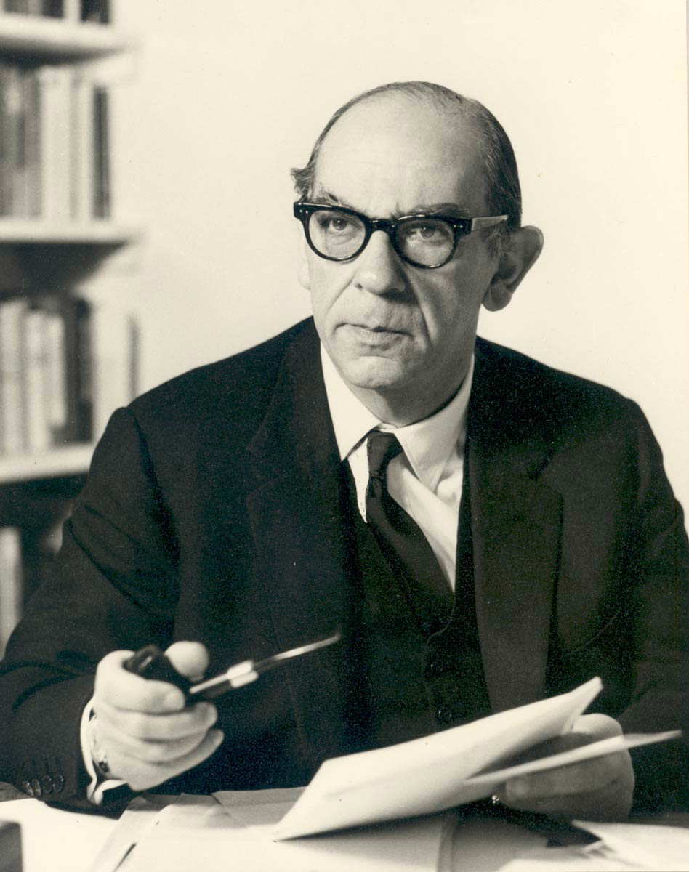
Philosophy of Isaiah Berlin
Isaiah Berlin (1909–1997) was a British philosopher, political theorist, and historian of ideas, known for his influential contributions to liberal political thought. Born in Riga (then part of the Russian Empire, now Latvia), Berlin moved to the UK with his family in 1921 to escape the turmoil of the Russian Revolution. He studied at Oxford, where he would spend most of his academic career.
Berlin is best known for his distinction between "negative" and "positive" liberty, outlined in his famous 1958 lecture *Two Concepts of Liberty. He argued that negative liberty—freedom from interference—is essential to protect individual autonomy, while positive liberty—the freedom to control one’s own life—can, if misused, justify authoritarianism in the name of "liberating" people.
Another central idea in Berlin’s work is value pluralism—the belief that human values are diverse, often conflicting, and cannot all be reconciled within a single system. Unlike relativism, Berlin's pluralism maintains that values can be objective, but they may still be in tension and require careful balancing in society.
Throughout his life, Berlin championed liberal democracy, individual freedom, and the importance of tolerating differing views. Though he didn’t produce a systematic philosophical system, his essays and lectures had a lasting impact on 20th-century political thought

Slide 4
Major Works by Isaiah Berlin:
Karl Marx: His Life and Environment (1939)
The Hedgehog and the Fox (1953)
Four Essays on Liberty (1969)
Includes the famous essay "Two Concepts of Liberty" (1958)
Russian Thinkers (1978)
Concepts and Categories: Philosophical Essays (1978)
Against the Current: Essays in the History of Ideas (1979)
Personal Impressions (1980)
The Crooked Timber of Humanity (1990)
The Sense of Reality: Studies in ideas and their history The Power of Ideas (1996)
Liberty (2002)

Slide 5
Isaiah Berlin, a 20th-century political philosopher, famously articulated the distinction between negative liberty and positive liberty in his influential 1958 lecture "Two Concepts of Liberty." This distinction remains one of the most important contributions to political theory in the modern era.
Negative Liberty
Definition: Freedom from interference by others.
Core Idea: A person is free to the extent that no one is interfering with their actions.
Question it answers: "What is the area within which a person or group is left to do or be what they are able to do or be, without interference?
"Focus: Absence of external constraints or coercion.
Examples: Freedom of speech (as freedom from censorship)Freedom of religion (as freedom from state-imposed religion)Economic freedom (freedom from excessive regulation or taxation)Berlin saw negative liberty as a central value in liberal democratic societies.

Slide 6
Positive Liberty
Definition: Freedom to control or direct one’s own life.
Core Idea: A person is free to the extent that they are their own master; they have the power and resources to realize their own potential.
Question it answers: "What or who is the source of control or interference that can determine someone to do this rather than that?
"Focus: Self-mastery, autonomy, self-realization.
Examples: A person overcoming addiction or ignorance to lead a rational, self-directed life. State education policies that empower citizens to participate fully in public life.
Berlin warned that positive liberty, though well-intentioned, can lead to authoritarianism. When a state or elite claims to know what’s best for an individual’s "true self" and acts in their name, it can justify coercion — e.g., forcing people to be “free.”

Slide 7
Berlin’s Central Concern:
Berlin wasn’t against positive liberty in principle but feared that in practice it had been used historically (e.g., in totalitarian regimes) to justify paternalism and control. He strongly advocated for negative liberty as a safeguard against tyranny
Criticism of Berlin’s concept of Positive & Negative Liberty :
Isaiah Berlin’s distinction between negative liberty (freedom from interference) and positive liberty (freedom to be one’s own master or to fulfill one’s potential) has been hugely influential but also widely critiqued. Here are some common criticisms of his concept:
Oversimplification of Liberty
Berlin’s binary framework is seen by some as too simplistic. Critics argue that liberty is more complex and multidimensional than just “negative” vs. “positive.” There can be many gradations and forms of freedom that don’t fit neatly into one of these two categories.

Slide 8
2. Ambiguity of Positive Liberty
Positive liberty, for Berlin, involves self-mastery and self-realization, but critics say it is vague and open to interpretation. Because of this ambiguity, positive liberty can be used to justify paternalism or authoritarianism — the idea that “true freedom” requires others to help or even coerce you into fulfilling your “real” self or true interests.
3. Potential for Authoritarianism
Berlin warned that positive liberty could justify totalitarianism, but critics point out that this is a real problem: the positive liberty ideal has historically been invoked by regimes to justify oppressive control in the name of “liberating” people or making them “truly free.” This raises doubts about the practical safety of positive liberty as a concept.
4. Neglect of Social and Economic Context
Some argue Berlin’s focus on individual liberty overlooks structural and social conditions that affect freedom. For example, negative liberty (freedom from interference) might mean little if people lack the economic resources or education to act freely. Critics from egalitarian or Marxist perspectives argue that real freedom requires positive conditions — like social equality and economic opportunity — which Berlin downplays.

Slide 9
5. Lack of Normative Guidance
Berlin is famously a value pluralist who does not advocate a clear normative ideal, instead emphasizing “choice” between incommensurable values. Some critics find this unsatisfactory, arguing that his framework doesn’t help decide when or how to balance positive and negative liberty or resolve conflicts between them.
Conclusion
Isaiah Berlin’s political philosophy offers a nuanced perspective on freedom, choice, and human values. His distinction between negative and positive liberty highlights the dangers of imposing ideals in the name of freedom, cautioning against the authoritarian potential of well-intentioned political systems. Through his concept of value pluralism, Berlin acknowledged the deep and often irreconcilable diversity of human values, arguing that no single ideology can fully capture the complexity of human life. Rather than offering clear-cut answers, Berlin urged humility, tolerance, and a recognition of moral conflict as a permanent part of political life. His work remains a powerful reminder of the importance of protecting individual freedoms in a world of competing truths.

Slide 10
5 objective-type questions (multiple choice) that are representative of what could be asked about Isaiah Berlin in the UGC NET exam
Isaiah Berlin is best known for his distinction between:
Liberalism and Conservatism B) Negative and Positive Liberty C) Natural Rights and Legal Rights
D) Capitalism and Socialism
2. Which one of the following books is written by Isaiah Berlin?
The Open Society and Its Enemies B) Two Concepts of Liberty C) The Road to Serfdom D) Anarchy, State and Utopia
3. Isaiah Berlin was a proponent of which of the following ideologies?
A) Marxism B) Libertarianism C) Value Pluralism D) Utilitarianism

Slide 11
4. According to Isaiah Berlin, positive liberty can lead to:
Anarchism B) Tyranny C) Capitalism D) Equality
5. Which of the following thinkers was critically examined by Isaiah Berlin in his essays?
A) Karl Marx B) G.W.F. Hegel C) Jean-Jacques Rousseau D) John Rawls
Answers - 1) B , 2) B , 3)C , 4) B , 5)C

Slide 12
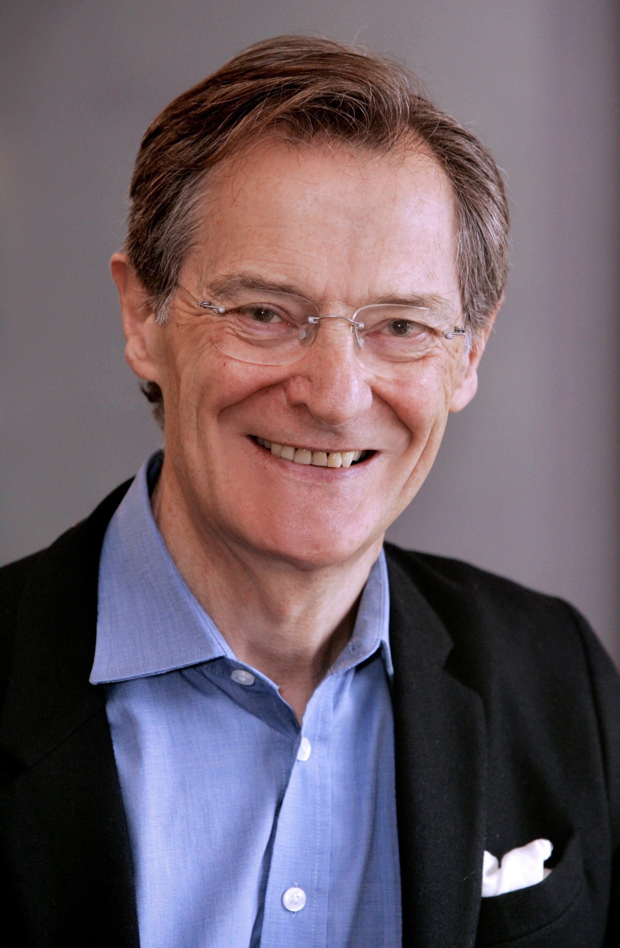
Philosophy of Quentin Skinner
Quentin Skinner is a prominent British intellectual historian and political theorist, widely regarded as one of the leading figures in the field of the history of political thought. Born in 1940, Skinner is best known for his influential work on the interpretation of classical political texts and the development of the methodological approach called the “Cambridge School” of intellectual history. Skinner’s approach emphasizes understanding political ideas by situating them within their historical context, focusing on the intentions of the authors and the specific language and concepts they used. This contextualist method challenged more ahistorical or purely theoretical readings of political philosophy.

Slide 13
Some of his key works include The Foundations of Modern Political Thought (co-authored with other scholars) and Visions of Politics, a multi-volume series that explores the history and methodology of political theory. Skinner’s scholarship has profoundly shaped modern interpretations of figures like Machiavelli, Hobbes, and Locke.
He has held prestigious academic positions, notably at the University of Cambridge, and has received numerous honors for his contributions to political thought and intellectual history.

Slide 14
Quentin Skinner on Third concept of Liberty
Quentin Skinner, a prominent intellectual historian and one of the founders of the Cambridge School of the history of political thought, is well known for identifying and reviving interest in what he calls the "third concept of liberty"—often referred to as "republican liberty" or "neo-Roman liberty."
The Three Concepts of Liberty Skinner contrasts three main concepts of liberty in Western political thought:
1.Negative Liberty (associated with Thomas Hobbes and later Isaiah Berlin):Defined as non- interference. You are free if no one actively prevents you from doing what you want. Freedom is the absence of external obstacles or constraints
2.Positive Liberty (associated with Jean-Jacques Rousseau and G.W.F. Hegel):Defined as self-mastery or self-realization.
You are free when your actions are determined by your rational will, not your base desires or external influences. Freedom here can justify intervention to help people become their "true" selves.

Slide 15
3.Republican Liberty (the "Third Concept" Skinner emphasizes):
Defined as freedom from domination, not just interference. Rooted in the civic humanist and neo-Roman tradition, especially thinkers like Cicero, Machiavelli, and English republicans like James Harrington and Algernon Sidney. You are unfree if you are subject to arbitrary power, even if that power is not actively interfering with you. A hallmark of freedom is independence from the will of others, especially from unchecked rulers or institutions.
Key Elements of Skinner’s Argument
Domination without interference: A slave with a benevolent master may not be interfered with, but still lacks liberty, because the master could interfere at any time. This illustrates why liberty is not just about non-interference.
The role of law: In this tradition, laws made by and for free citizens are not viewed as restrictions on liberty, but as guarantees of it. Being governed by laws we give ourselves (or by a republic) is different from being subject to arbitrary power.
Historical retrieval: Skinner argues that the modern liberal focus on negative liberty (especially in post-Enlightenment political thought) eclipsed this older tradition. He aims to recover it to inform debates on liberty today.

Slide 16
Criticisms of Skinner’s Third Concept of Liberty
While Skinner’s recovery of the republican tradition has been influential, it has also faced several criticisms. These can be grouped into conceptual, practical, and historical critiques:
Conceptual Ambiguity
Critics argue that “domination” can be vague or overly broad. How do we measure domination if it does not involve interference? The distinction between non-domination and non-interference is often less clear in practice than it is in theory .
Example: Is a benevolent employer who could fire you at any time a source of unfreedom, even if they never interfere?
2. Dependency on Institutional Frameworks
Skinner emphasizes that freedom requires republican institutions to prevent domination (e.g., checks and balances, civic virtue).
Critics say this makes liberty contingent on political arrangements, rather than being a natural or moral right.
Some also question whether these institutions actually succeed in preventing domination, especially in complex modern states.

Slide 17
3.Overlap with Positive Liberty
Some argue that republican liberty resembles positive liberty in that it emphasizes self-rule and civic participation.
This can risk reintroducing the problems of positive liberty (e.g., paternalism or coerced participation).
Conclusion
Quentin Skinner is a leading figure in the field of intellectual history and political theory, best known for his role in developing the "Cambridge School" approach to the history of ideas. His work emphasizes the importance of studying political texts within their historical context, arguing that meaning is shaped by the linguistic conventions and intentions of authors in specific political and social environments. By focusing on what political thinkers were doing with their words, rather than abstracting their ideas into timeless concepts, Skinner challenged traditional interpretations that treated thinkers like Hobbes or Machiavelli as contributors to a continuous philosophical tradition. Skinner’s methodological contributions have reshaped how scholars interpret historical texts, stressing the performative and rhetorical nature of political discourse. His emphasis on context, authorial intention, and linguistic analysis has opened new paths for understanding the evolution of political thought, especially concerning concepts like liberty, power, and the state. In sum, Skinner’s work remains essential for anyone studying the history of political ideas, not only for his theoretical insights but also for his rigorous methodological standards that continue to influence historical and political scholarship.

Slide 18
Liberty , Equality and Justice- Interlinkages
Liberty, Equality, and Justice are foundational principles in political philosophy and democratic governance. Though distinct, they are deeply interlinked, and any attempt to promote one often has implications for the others. Here's a breakdown of how they connect:
1. Definitions (Brief Overview)
Liberty: Freedom to act, think, and express oneself without unnecessary restraint.
Equality: The state of being equal, especially in status, rights, and opportunities.
Justice: Fair treatment and due reward in accordance with honor, standards, or law.
2. Interlinkages
A. Liberty and Equality
Mutual Support: True liberty cannot exist without equality, because if some have more power or privilege, others' freedoms are effectively limited.
Example: Freedom of speech means little to someone who lacks access to education (an issue of equality).
Tensions: In some cases, absolute liberty (especially economic) may lead to inequality (e.g., unregulated capitalism).
Balance needed: A society must strike a balance between personal freedom and policies that reduce inequality.

Slide 19
B. Equality and Justice
Justice Requires Equality: Justice implies treating equals equally and unequals unequally, based on relevant differences.
Distributive Justice: Resources and opportunities should be distributed fairly.
Social Justice: Equality in access to education, healthcare, etc., ensures justice.
Corrective Justice: Inequalities caused by historical injustices (e.g., discrimination) need to be addressed through affirmative actions.
C. Liberty and Justice
Justice Protects Liberty: A just society safeguards individual freedoms through fair laws and impartial institutions.
Liberty Within Justice: Liberty must operate within the bounds of justice—freedom does not include the right to harm or exploit others.
Example: Freedom of speech doesn’t justify hate speech that infringes on others' dignity or safety.

Slide 20
3. Triangular Relationship
Without Liberty, equality becomes oppression.
Without Equality, liberty becomes privilege.
Without Justice, both liberty and equality lose moral grounding.
Conclusion
Liberty, equality, and justice are not isolated ideals but interdependent pillars of a fair society. Promoting one should not come at the cost of the others; instead, sustainable social progress requires their harmonization.

Slide 21
Liberal Toleration
Liberal toleration is a core principle of liberal political philosophy, emphasizing the acceptance of diverse views, lifestyles, and beliefs within a society — even those one may disagree with — as long as they do not harm others or violate basic rights.
1. Definition
Liberal toleration is the willingness of individuals or the state to allow the expression and practice of different beliefs and behaviors — religious, moral, political, or cultural — without coercion or suppression, in the interest of preserving individual liberty and social peace.
2. Key Features of Liberal Toleration
Respect for Individual Autonomy: People should be free to live according to their own values.
Pluralism: Acceptance that society is made up of diverse and often conflicting beliefs and lifestyles.
Non-interference: The state should not interfere with personal beliefs unless they threaten public order or others' rights.
Moral neutrality of the state: The liberal state does not promote any particular conception of the "good life" but instead ensures a fair framework where people can pursue their own values.

Slide 22
3. Historical Roots
John Locke (17th century): A foundational thinker who argued for religious toleration, stating that the state should not impose religious beliefs because faith cannot be compelled.
John Stuart Mill (19th century): In On Liberty, he argued that freedom of thought and expression is essential, even for ideas that are unpopular or offensive.
4. Limits of Liberal Toleration
Liberal toleration is not absolute. There are boundaries:
The Harm Principle (Mill): Toleration ends where actions cause harm to others.
No Toleration for Intolerance: Tolerating those who seek to destroy tolerance (e.g. extremist ideologies that promote violence or hate) can undermine liberal values.
Legal Limits: Hate speech, violence, or practices that infringe on basic human rights (e.g., female genital mutilation) are not tolerated.
5. Challenges in Practice
Multiculturalism vs. Liberal Values: When cultural practices clash with liberal principles (e.g. gender equality), how far should toleration go?
Free Speech vs. Hate Speech: Where is the line between tolerating offensive views and protecting citizens from harm?
Moral Relativism vs. Universal Rights: Should all practices be tolerated equally, or are there universal moral limits?

Slide 23
6. Contemporary Relevance
Liberal toleration is central to debates on:
Freedom of religion and secularism
LGBTQ+ rights and religious objections
Immigration and cultural integration
Academic freedom and cancel culture
Internet regulation and speech platforms
Conclusion
Liberal toleration is about maintaining a delicate balance — allowing a diversity of beliefs and ways of life while protecting the basic rights and freedoms of all. It is both a moral ideal and a practical necessity in pluralistic, democratic societies.

Slide 24
THANK YOU

