Slide 1
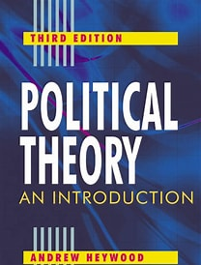
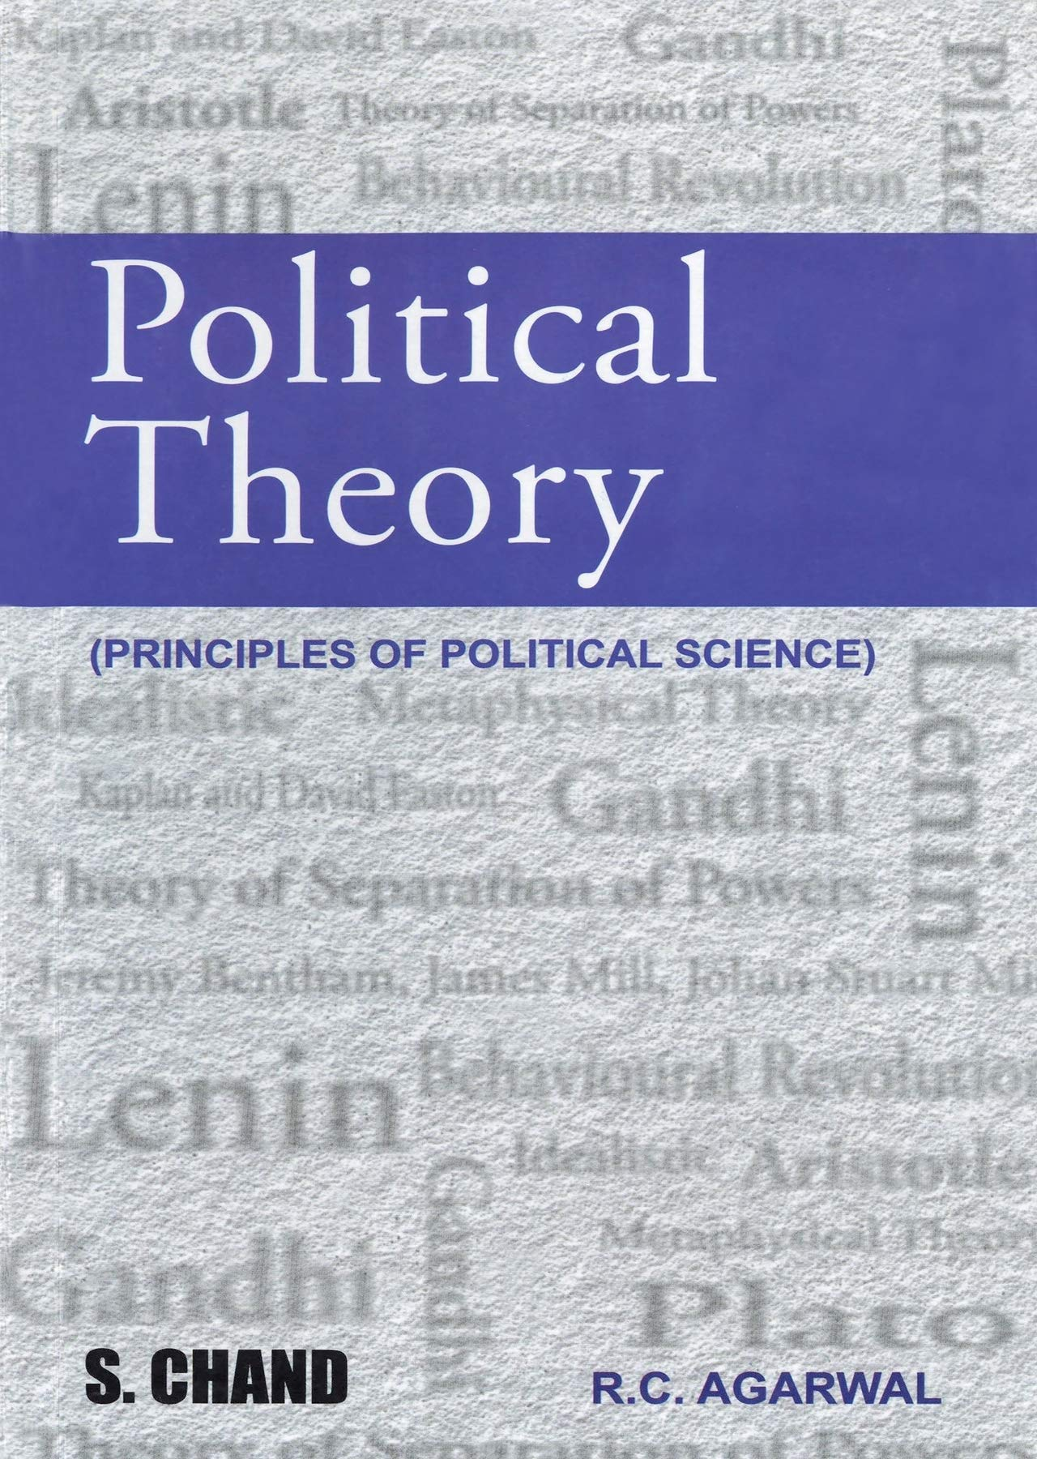
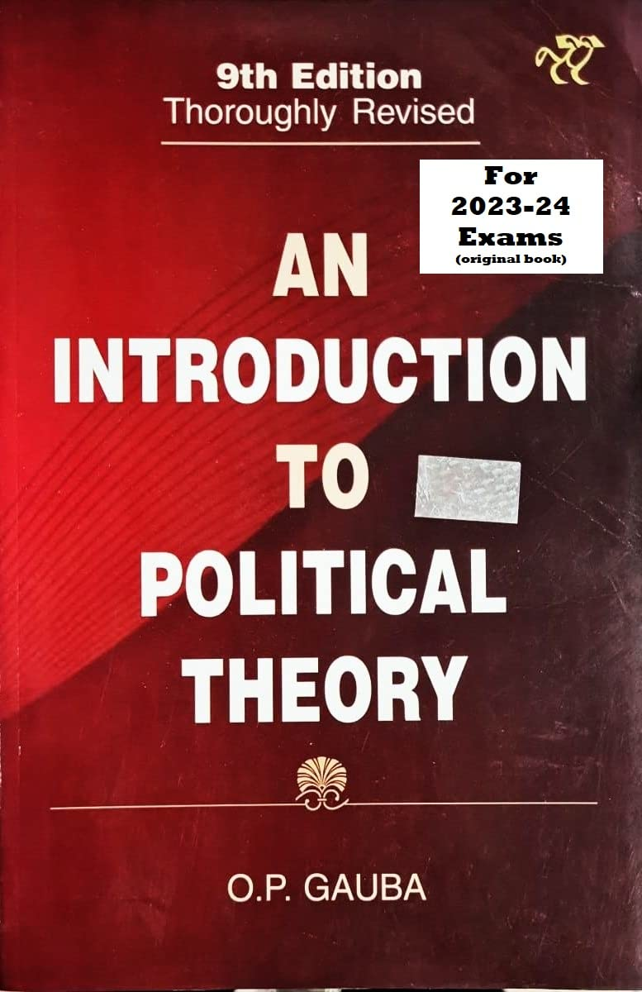
POLITICAL THEORY II
Department : Political Science
Unit : Equality And Justice
Topic – Rawls Theory Of Justice.
Presented By : Parlina Kalita
Presented By : Parlina Kalita

Slide 2
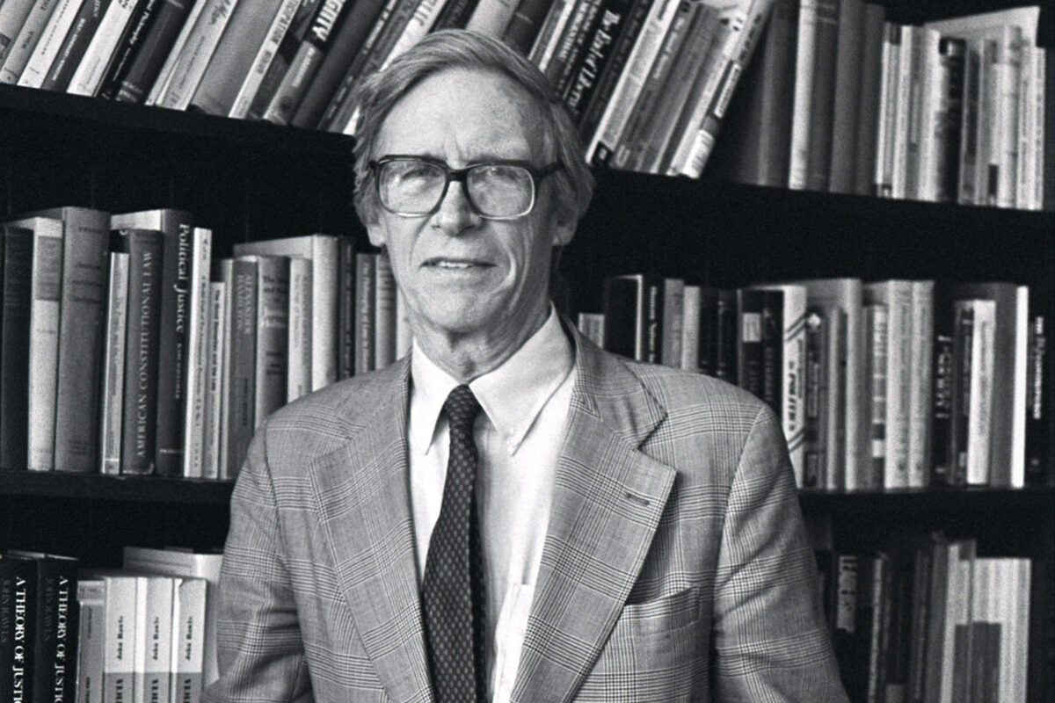
John Rawls: An Introduction
John Rawls (1921–2002) was one of the most influential political philosophers of the 20th century, best known for his work on Theories of Justice and liberalism. His landmark book, A Theory of Justice (1971), reshaped modern political thought by proposing a new framework for thinking about fairness and equality in society.
At the core of Rawls's philosophy is the concept of justice as fairness.
He introduced the idea of the “original position, a hypothetical social contract where individuals choose the principles of justice from behind a” veil of ignorance—unaware of their own place in society.
This thought experiment ensures impartiality, leading to two key principles: equal basic liberties for all, and social and economic inequalities arranged to benefit the least advantaged (the difference principle)
1921 -2002

Slide 3
Rawls’s ideas have had a major impact on debates about democracy, rights, and equality, offering a powerful alternative to utilitarianism. His later work, Political Liberalism (1993), focused on how a stable society can accommodate diverse moral, religious, and philosophical doctrines under a shared political conception of justice. Overall, Rawls remains a central figure in contemporary political philosophy, continuing to influence scholars, policymakers, and theorists around the world.
Here are the important works of John Rawls
1. A Theory of Justice
2. Political Liberalism
3. The Law of Peoples
4. Justice as Fairness: A Restatement
5. Collected Papers
6. Lectures on the History of Moral Philosophy
7. Lectures on the History of Political Philosophy

Slide 4
John Rawls’ Theory of Justice
  John Rawls’ Theory of Justice, outlined in his 1971 book "A Theory of Justice", is one of the most influential works in political philosophy in the 20th century. Rawls presents a model of justice that is meant to provide a fair and morally acceptable framework for the basic structure of society. His theory is a form of social contract theory and is centered around the concept of JUSTICE AS FAIRNESS
  The Original Position
  At the heart of Rawls’s theory is a hypothetical thought experiment: The Original Position Imagine a group of rational individuals who are tasked with designing the principles that will govern society. These individuals are behind a veil of ignorance.
  The Veil of Ignorance
  Behind this veil, individuals do not know their place in society—such as their race, gender, class, abilities, religion, or conception of the good life. They are rational and mutually disinterested (they don’t know whether they will be rich or poor, healthy or sick).This ensures fairness, as no one can design principles that advantage their own position. Purpose: To ensure impartiality and fairness in choosing the principles of justice.

Slide 5
3. Two Principles of Justice Based on what rational people would choose behind the veil of ignorance, Rawls argues they would adopt the following Two Principles of Justice:
First Principle: Equal Liberty“ Each person has an equal right to the most extensive scheme of equal basic liberties compatible with a similar scheme of liberties for others.”
This includes:
Freedom of speech
Right to vote
Freedom of conscience and religion
Right to personal property
Freedom from arbitrary arrest

Slide 6
Second Principle:
Social and Economic Inequalities Divided into two parts:
Fair Equality of Opportunity - Positions and offices must be open to everyone under conditions of fair equality of opportunity. This means:Not just formal equality (like legal equality), but actual equality in access (e.g., education, healthcare).People with similar talents and efforts should have similar life chances regardless of their background.
The Difference Principle - Inequalities are to be arranged so that they are to the greatest benefit of the least advantaged members of society.
Rawls accepts inequalities (like higher pay for doctors or CEOs), only if they improve the condition of the worst-off. For example, higher wages might incentivize skilled people to take challenging jobs, which in turn benefits society, including the poor.

Slide 7
4. Priority Rules -Rawls places a lexical priority between the principles: First principle (Liberty) takes priority over the second principle (Equality).Within the second principle, Fair Equality of Opportunity takes priority over the Difference Principle.
Implication: You cannot violate basic liberties for the sake of improving economic efficiency.
5. Justice as Fairness- Rawls calls his theory “justice as fairness” because: It is based on fair procedures (original position and veil of ignorance).It aims to create a society where inequalities are arranged fairly.

Slide 8
Criticism of Rawls theory of Justice
Some major criticisms include:
Too idealistic: Critics argue real-world conditions are too complex for Rawls' abstract model.
Difference Principle: Some believe it can justify too much inequality or not enough.
Cultural Bias: Critics say Rawls' assumptions reflect Western liberal ideals, not universally applicable.
Libertarian Critique (Nozick): Robert Nozick argues that Rawls infringes on individual property rights through redistribution.

Slide 9
Conclusion
John Rawls was a highly influential political philosopher best known for his theory of justice as fairness. His work, especially in A Theory of Justice (1971), reshaped modern liberal thought by proposing that a just society is one in which institutions are arranged to benefit the least advantaged and ensure equal basic liberties for all. Through his famous thought experiment—the "original position" behind a "veil of ignorance"—Rawls argued that rational individuals would choose principles of justice that promote fairness and equality, not personal gain. His ideas continue to inspire debates about democracy, equality, and the role of justice in public life. Overall, Rawls's philosophy offers a powerful framework for thinking about moral responsibility and the structure of a just society.

Slide 10
5 Sample UGC NET (Political Science) questions centered on John Rawls' Theory of Justice
1.Which of the following concepts are associated with John Rawls? A. Veil of ignorance B. Primary social goods C. Pure procedural justice D. Principles of organization
Options:
A, B, C only
B, C, D only
A, B, D only
B and C only
2. Consider the following statements regarding John Rawls’s theory of justice.
Justice is the first virtue of social institutions.
Justice is the first virtue of State institutions
In a just society, the rights secured by justice are not subject to political bargaining.
In a just society, the rights secured by justice are not subject to social obligation.

Slide 11
Rawlsian concept of justice is based on:
Distributive principle
Agreement principle
Difference principle
Joint method principle
4. The idea of "Justice as Fairness" in Rawlsian theory flows from:
A.Individual
B.Society
C.State
D.Nation
5. John Rawls believed in:
Difference principle
Entitlement principle
Egalitarianism
Libertarianism
Options:
A, B only
B, C only
A, C only
A, B, C, D

Slide 12
Answers 1) A,B,C 2) A& C 3) C 4) A 5) A& C

Slide 13
THANK YOU

