Slide 1
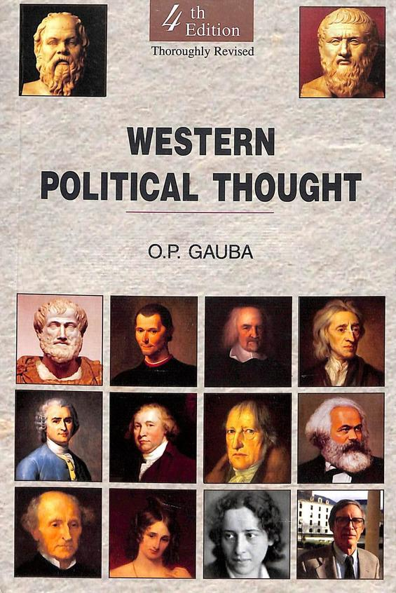
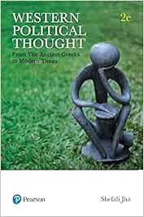
Western Political Thought
Department of Political science
Unit : J.S Mill
Presented by Parlina Kalita

Slide 2
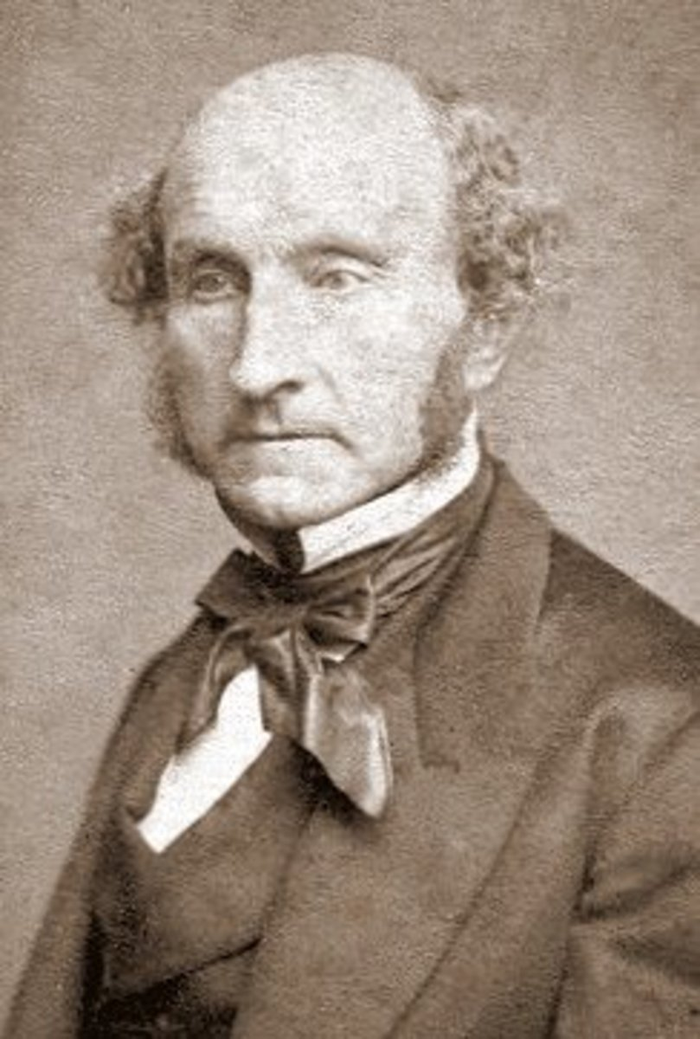
Philosophy of J.S Mill
John Stuart Mill (1806–1873) was a British philosopher, political economist, and one of the most influential thinkers in the history of liberal thought. He is best known for his contributions to utilitarianism, liberty, individual rights, and representative government.
As the son of James Mill and a student of Jeremy Bentham's ideas, Mill developed and refined classical utilitarian philosophy, emphasizing not just quantity of happiness but also the quality of pleasures.
Mill was a leading advocate of liberalism, freedom of speech, gender equality, and social reform, making his philosophy both theoretical and deeply engaged with real-world issues. He believed that a just society should maximize individual freedom while also promoting the greatest happiness for the greatest number.
1806–1873

Slide 3
His major philosophical works, such as Utilitarianism, On Liberty, and The Subjection of Women, continue to shape debates in ethics, politics, and social philosophy.
major works of John Stuart Mill
A System of Logic 2. Principles of Political Economy
Utilitarianism 4. Three Essays on Religion
5. On Liberty

Slide 4
J.S. Mill’s Concept of Liberty
John Stuart Mill’s concept of liberty is most clearly expressed in his famous work On Liberty (1859). In this work, Mill defends individual freedom as a cornerstone of a just and progressive society. His idea of liberty is rooted in the principles of liberalism, utilitarianism, and respect for individual autonomy.
If anyone is liberal , it is Mill
Key Aspects of Mill’s Concept of Liberty
1. Individual Liberty Mill argues that every person should have the freedom to act, think, and speak as they wish — as long as they do not harm others. This is known as the “harm principle.”
2. The Harm Principle
"The only freedom which deserves the name is that of pursuing our own good in our own way, so long as we do not attempt to deprive others of theirs."
Mill believes that state or society can only interfere with individual liberty to prevent harm to others, not to enforce morality or protect people from themselves.
3. Liberty of Thought and Expression Freedom of speech is essential, even for unpopular or offensive ideas. Mill argues that open debate leads to truth, understanding, and intellectual growth.

Slide 5
4. Liberty of Action People should be free to live as they choose — in lifestyle, behavior, and personal choices — as long as they do not harm others.
5. Importance of Individuality Mill sees individuality as a source of personal and social progress. A society that values conformity, he warns, will stagnate.
6. Limits of Authority Mill was deeply concerned about the “tyranny of the majority” — where public opinion or democratic majorities suppress individual freedom. He argued for strong protection of minority rights.
J.S. Mill’s concept of liberty emphasizes:
Freedom of thought, speech, and action
Non-interference unless harm is caused
Respect for individuality and diversity
A limited role for government and society in personal matters
His liberal philosophy continues to influence debates on freedom, rights, tolerance, and democracy today

Slide 6
J.S. Mill’s Concept of Representative Government
John Stuart Mill discusses his ideas on representative government in his work Considerations on Representative Government (1861). He believed that representative democracy is the most suitable form of government for modern societies because it balances individual liberty, popular participation, and effective governance.
Key Features of Mill’s Concept of Representative Government
Government by Discussion Mill emphasized that the main strength of representative government lies in open public debate. He believed discussion and criticism lead to better policies and political accountability.
2. Political Participation as Moral Development Mill argued that active participation in public affairs helps citizens develop intellectually and morally. It turns passive subjects into responsible, informed citizens.
3. The Role of Representation Mill supported a system where the people elect representatives to make laws and govern on their behalf. However, he stressed that representatives must be accountable and responsive to the people.

Slide 7
4. Plural Voting One of Mill’s controversial proposals was plural voting — where more educated or competent citizens would receive more than one vote, as he believed education and intelligence contribute to better decision-making. However, he still supported universal suffrage (eventually including women).
5. Protection of Minority Rights Mill was concerned about the "tyranny of the majority", where the majority could oppress minorities. He believed that a good representative system must protect minority voices and ensure diversity of opinion.
6. Separation of Powers and Decentralization Mill advocated for a balance of power between the central government and local bodies. He supported decentralization to encourage local participation and self-rule.
7. Role of Experts and Institutions He believed expert knowledge should guide legislation, and supported a second chamber (like a senate) composed of educated or experienced individuals to review laws passed by the lower house.

Slide 8
J.S. Mill’s Concept of Utilitarianism
John Stuart Mill refined and expanded utilitarianism, a moral and political philosophy originally developed by Jeremy Bentham. Mill’s version is best explained in his book Utilitarianism (1863).
Core Idea
Utilitarianism is the ethical theory that:
"The right action is the one that produces the greatest happiness for the greatest number."
Mill agreed with this basic idea but made important improvements to Bentham’s original version.
📘 Key Features of Mill’s Utilitarianism
1. Greatest Happiness Principle
Actions are right if they promote happiness (pleasure and absence of pain).
Wrong if they produce unhappiness (pain and deprivation of pleasure).

Slide 9
2. Quality of Pleasures
Unlike Bentham, who treated all pleasures equally, Mill introduced the idea of higher and lower pleasures.
Higher pleasures: of the mind (e.g., learning, creativity, moral development)
Lower pleasures: of the body (e.g., food, physical comfort)
Mill said higher pleasures are more valuable and should be prioritized.
"It is better to be a human being dissatisfied than a pig satisfied."
3. Rule vs. Act Utilitarianism
Mill leaned toward rule utilitarianism: follow general rules that tend to promote happiness in the long run, not just individual acts.
4. Individual Rights and Justice
Mill tried to reconcile utilitarianism with justice and individual rights.
He argued that protecting rights often promotes the greatest happiness overall.
5. Utilitarianism and Morality
For Mill, utilitarianism provides a standard of morality — actions and laws should be judged based on their consequences for general well-being.

Slide 10
J.S. Mill’s Concept of Subjection of Women
“All forms of slavery been abolished except the slavery of women. It is so universal, that it appears natural”
In The Subjection of Women, John Stuart Mill argued passionately for the legal, political, and social equality of women. He believed that the subordination of women was a remnant of outdated traditions, not a reflection of natural differences. His views were deeply rooted in liberal principles of individual liberty, equality, and justice.
Key Ideas in Mill’s Concept on the Subjection of Women
1. Equality Between the Sexes Mill believed that men and women are equal in capacity and potential. The belief in women’s inferiority was a product of social conditioning, not biology.
2. Subordination is Unjust and Arbitrary He compared the legal subordination of women, especially in marriage, to slavery, arguing it had no moral or rational justification in a modern, liberal society.

Slide 11
3. Equal Rights in Marriage Mill advocated for marriage as a partnership of equals, where both spouses have rights to autonomy, property, and decision-making.
4. Education and Economic Opportunity He demanded equal access to education and professions for women, believing their exclusion was both unjust and a waste of talent that harmed society’s progress.
5. Right to Vote and Participate in Civic Life Mill was one of the first male Members of Parliament in Britain to openly support women’s suffrage. He believed that women should have the right to vote, run for office, and take part in public and political affairs just like men. Denying this was, in his view, a violation of the core democratic principle of equal citizenship.
When women is in public sphere, men behave in more civilized manner, therefor improving the efficiency of men.
6. Political and Moral Development He argued that political participation helps individuals grow morally and intellectually. Women, like men, should be given that opportunity through full civic involvement.
7. Social Progress Through Gender Equality Mill believed the liberation of women would benefit not only women themselves but all of society, by promoting justice, freedom, and progress.

Slide 12
J.S. Mill as a Reluctant Democrat
John Stuart Mill is often described as a "reluctant democrat" because, although he supported representative government and democratic principles, he also had reservations about certain aspects of democracy. His views reflect both a strong belief in individual liberty and rational governance, but also a fear of majoritarianism, ignorance, and misuse of democratic power.
Why Is Mill Called a Reluctant Democrat?
1. Support for Representative Democracy Mill believed that representative government was the best form of rule for promoting liberty, political participation, and moral development. He defended popular sovereignty, arguing that all individuals should have a voice in government.
2. Fear of the “Tyranny of the Majority” Mill warned that democracy could become oppressive if the majority imposed its views on minorities. He feared conformity, social pressure, and the suppression of individuality.
3. Qualified Support for Universal Suffrage While Mill eventually supported women’s suffrage and universal voting rights, he initially proposed plural voting — giving more votes to educated or competent individuals. This reflects his concern that uneducated majorities could make poor political choices.

Slide 13
4. Emphasis on Education and Reason Mill believed that democracy could only function well in a society where citizens were well-educated, rational, and morally developed. Without this, he feared democratic institutions could fail.
5. Distrust of Mass Opinion and Populism Mill was cautious about mass movements and popular opinion dominating politics. He preferred reasoned debate and intellectual leadership over emotional or uninformed decision-making.
To protect democracy
With respect to western countries
His fear was turning democracy to mobocracy
Suggested
Weighted voting: everyone have the right to vote but who are educated and posses property should have more than one vote’
Plural voting: person should be given right to vote in all constituencies where he has property
Streghtening of house of lords
Proposiotional representation
Open ballot
Women should be given right to vote
2. With respect to colonies
Did not support democracy rather preferred despotism. It can be introduced only in civilized society. Thus for Mill democracy cannot be introduced anywhere anytime.
Hence we can call him reluctant democrate

Slide 14
Conclusion on J.S. Mill's Philosophy
John Stuart Mill emerges as a complex and forward-thinking liberal philosopher who made profound contributions to ethics, political theory, and social reform. Through his defense of utilitarianism, Mill refined the principle of the greatest happiness by emphasizing the quality of pleasures and aligning moral philosophy with individual rights and justice. In his advocacy for liberty, he championed the harm principle, defending individual freedom in thought, expression, and action as essential to human progress.
Mill’s views on representative government reflect both a commitment to democratic ideals and a cautious awareness of their limitations. His support for plural voting and concern over the tyranny of the majority mark him as a reluctant democrat—one who valued democracy but insisted it be grounded in education, reason, and protection of minorities.
In The Subjection of Women, Mill became one of the earliest male advocates for gender equality, calling for women’s full participation in social, political, and economic life—including the right to vote and equality in marriage. His call for justice, rational discourse, and moral development remains relevant, making him a key figure in both liberal thought and the early feminist movement.
Overall, Mill’s philosophy is a thoughtful balance between individual freedom and collective responsibility, emphasizing that true progress depends on empowering all individuals to develop their potential within a just and educated society.

Slide 15
5 sample UGC-NET-style questions based on the philosophy of John Stuart Mill
Which of the following principles is central to J.S. Mill’s concept of liberty? A) Principle of equality B) Harm principle C) Principle of authority D) Sovereignty of the state
In The Subjection of Women, J.S. Mill compares the condition of women in society to: A) Democracy B) Censorship C) Slavery D) Capitalism
Which of the following best describes Mill’s improvement of Bentham’s utilitarianism? A) Replacing pleasure with pain as a moral goal B) Rejecting the idea of the greatest happiness C) Emphasizing the quality of pleasures over quantity D) Supporting state control over individual desires

Slide 16
J.S. Mill is called a "reluctant democrat" because: A) He rejected representative government B) He proposed plural voting and feared majority tyranny C) He supported monarchy with limited rights D) He opposed public participation in politics
In Mill’s view, the best form of government is: A) Absolute monarchy B) Direct democracy C) Theocracy D) Representative government based on rational participation
Answers : 1) b 2)c 3)c 4)b 5)d

Slide 17
THANK YOU

