Slide 1
Political Theory II
Department of Political Science
Unit : Equality and Justice
Presented By : Parlina Kalita

Slide 2
Introduction to Liberal Equality
Liberal equality is a key concept in political philosophy that seeks to balance individual freedom with social justice. Rooted in the liberal tradition, it emphasizes the protection of individual rights, such as freedom of speech, religion, and property, while also recognizing the importance of fairness and equal opportunity in society. Unlike strict egalitarianism, liberal equality does not aim for complete equality of outcomes but rather focuses on ensuring that everyone has an equal chance to succeed, regardless of their background. Thinkers like John Rawls have played a major role in shaping this idea, particularly through the concept of the "difference principle," which suggests that inequalities are acceptable only if they benefit the least advantaged members of society. In modern democracies, liberal equality influences laws, education systems, and social policies by promoting both personal liberty and support for disadvantaged groups. It remains a central framework in debates about justice, rights, and the role of the state in reducing inequality.

Slide 3
Core Features of Liberal Equality
Equal Basic Rights and Liberties: Every individual is entitled to fundamental rights regardless of class, gender, race, or religion.Fair Equality of Opportunity: Individuals should have genuine chances to succeed, which may require compensating for social disadvantages (e.g., education access, anti-discrimination laws).Justifiable Inequalities: Liberal equality allows for inequality only when it serves a legitimate public good, particularly improving the conditions of the disadvantaged. Neutrality of the State: The state should not promote specific conceptions of the good life but should provide a framework for individuals to pursue their own goals.
Thinkers of Liberal equality and their major works
John Rawls – A Theory of Justice
Ronald Dworkin – Taking Rights Seriously
Amartya Sen – Development as Freedom
Martha Nussbaum – Creating Capabilities
Thomas Nagel – Equality and Partiality
Bruce Ackerman – Social Justice in the Liberal State
Philippe Van Parijs – Real Freedom for All
Michael Walzer – Spheres of Justice
G.A. Cohen – Rescuing Justice and Equality
Charles Taylor – Multiculturalism and "The Politics of Recognition"

Slide 4
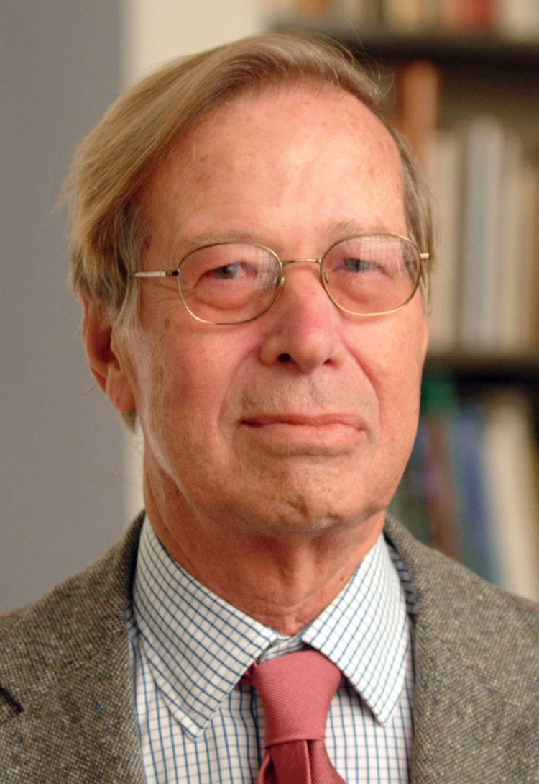
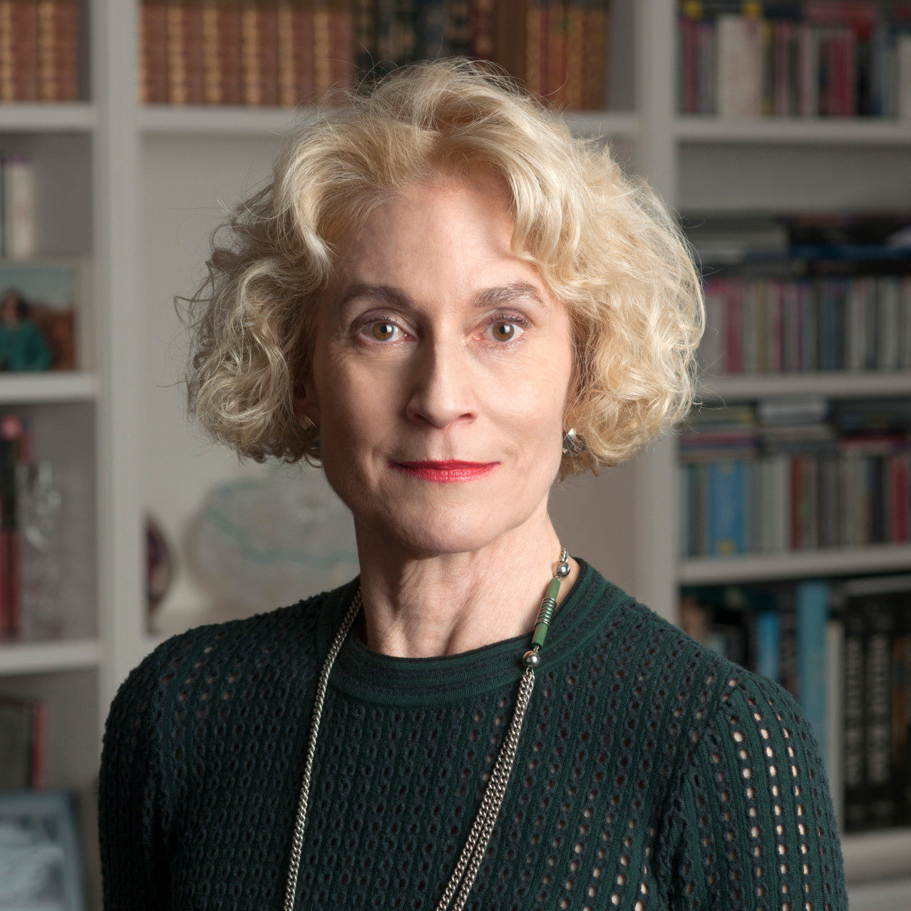
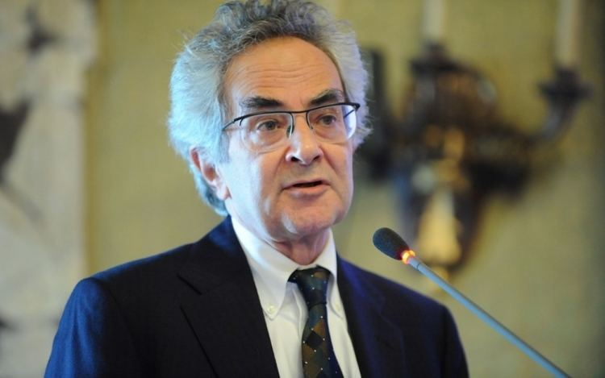
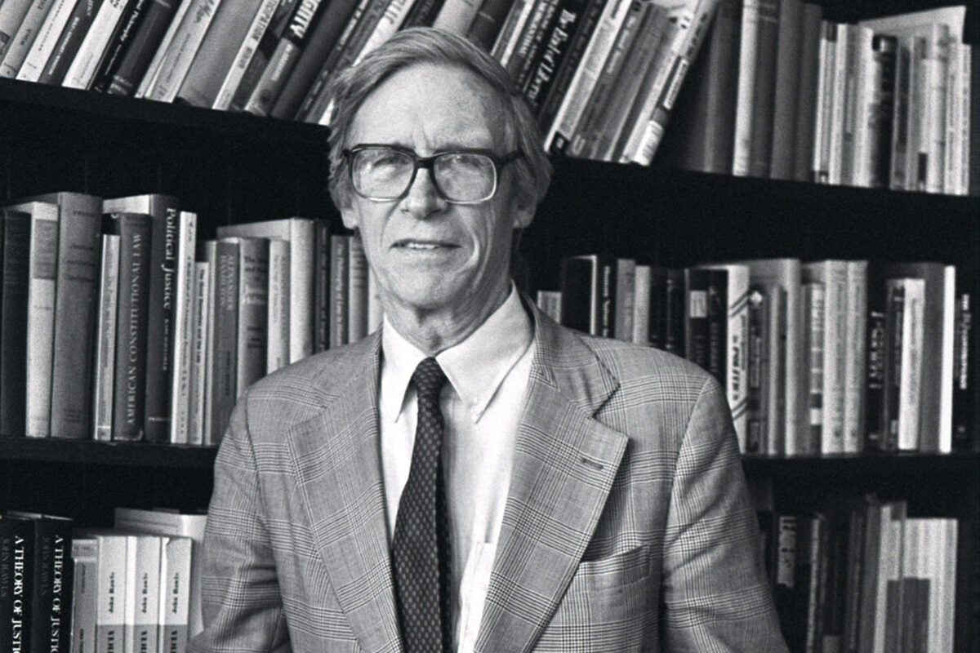
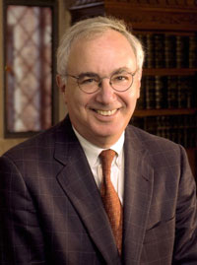
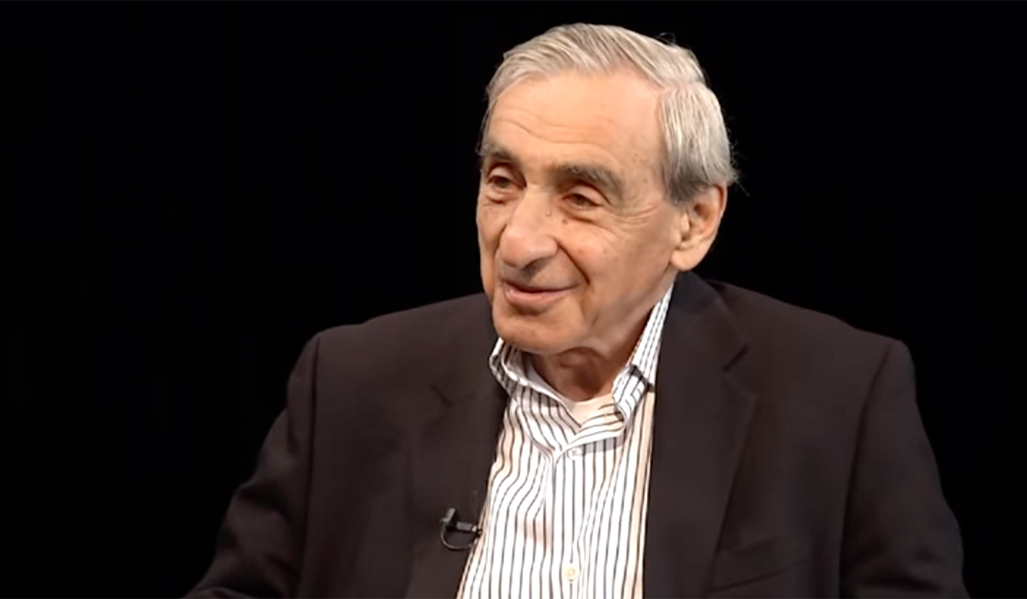
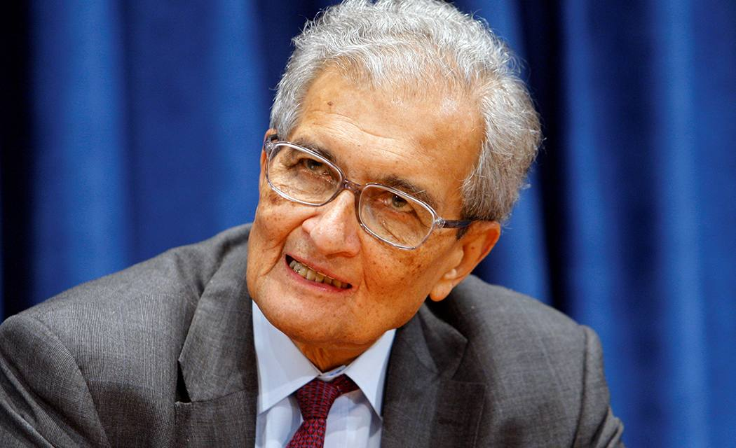
John Rawls
Thomas Nagel
Martha Nussbaum
Ronald Dworkin
Bruce Ackerman
Michael Walzer
Amartya Sen

Slide 5
Conclusion on Liberal Equality
Liberal equality is a foundational principle in liberal political philosophy that seeks to balance individual freedom with social fairness. At its core, it promotes the idea that all individuals should have equal rights, opportunities, and protections under the law, regardless of their social background, wealth, race, or gender. While liberal equality emphasizes individual liberty, it also recognizes that true freedom requires addressing systemic inequalities that limit people’s ability to fully participate in society. Thinkers like John Rawls argue that a just society must ensure not only formal equality (e.g., legal rights) but also fair access to resources and opportunities (e.g., education, healthcare).In conclusion, liberal equality is not just about treating everyone the same—it is about creating the conditions in which everyone has a fair chance to succeed. It remains a vital and evolving concept in modern democracies, continually challenged by real-world disparities and political debates.

Slide 6
THANK YOU

