Slide 1
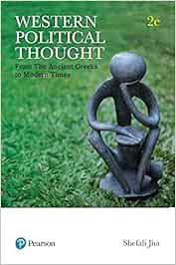
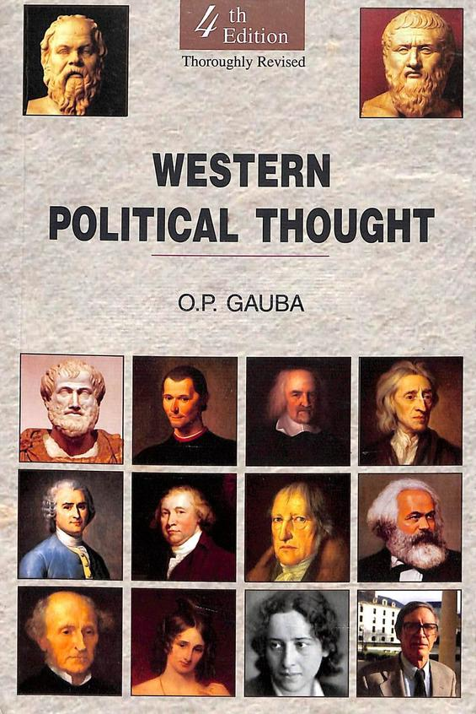
Western Political Thought
Department of political science
Unit : Social Contract Tradition
Presented by Parlina Kalita

Slide 2
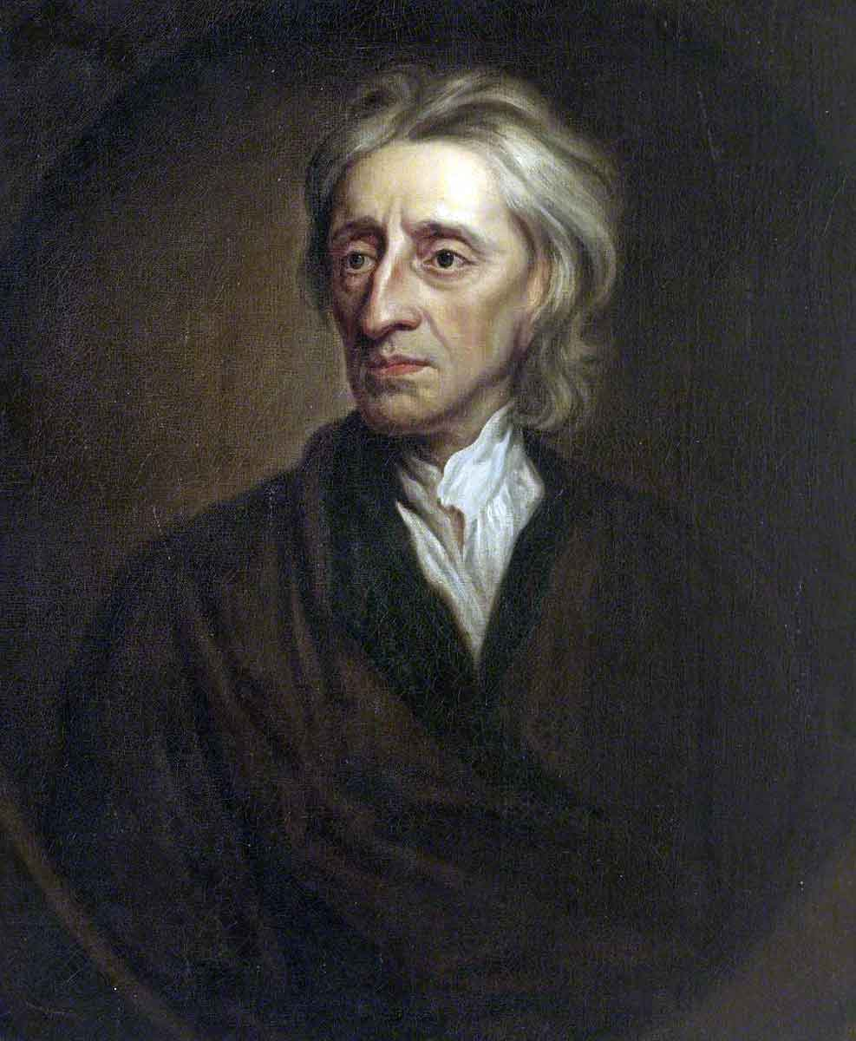
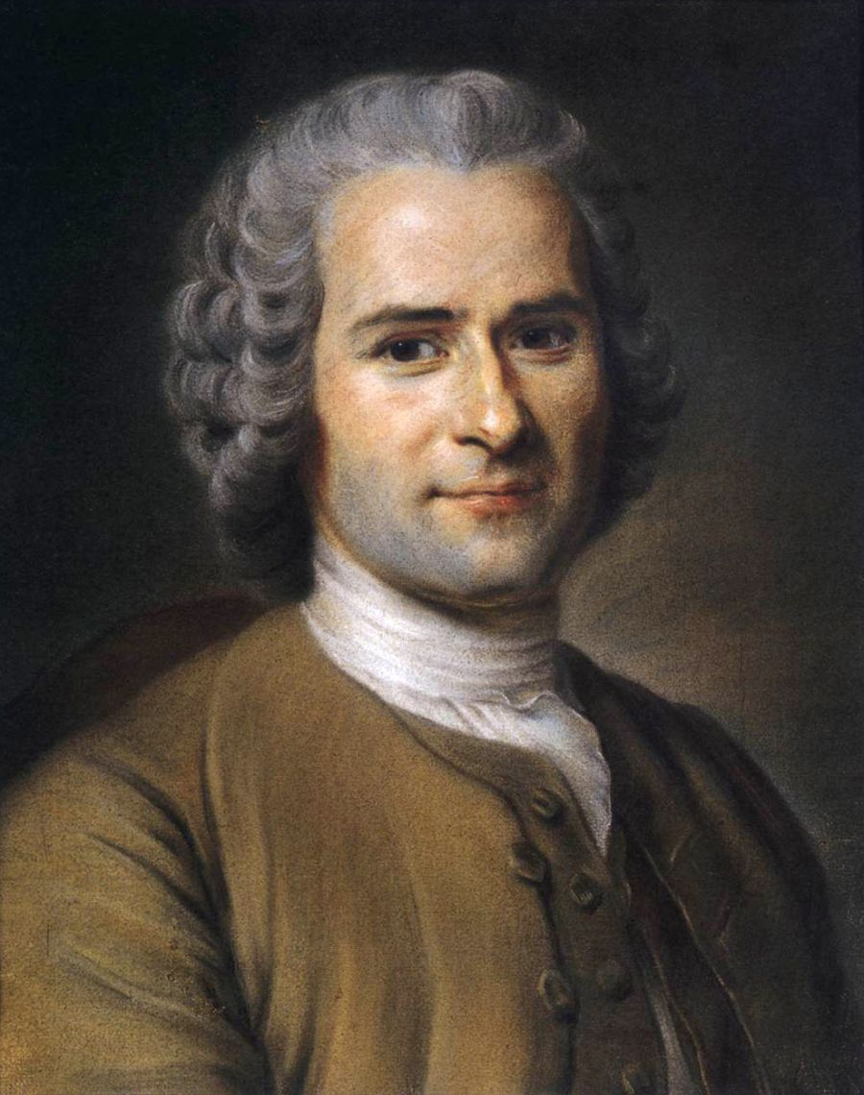
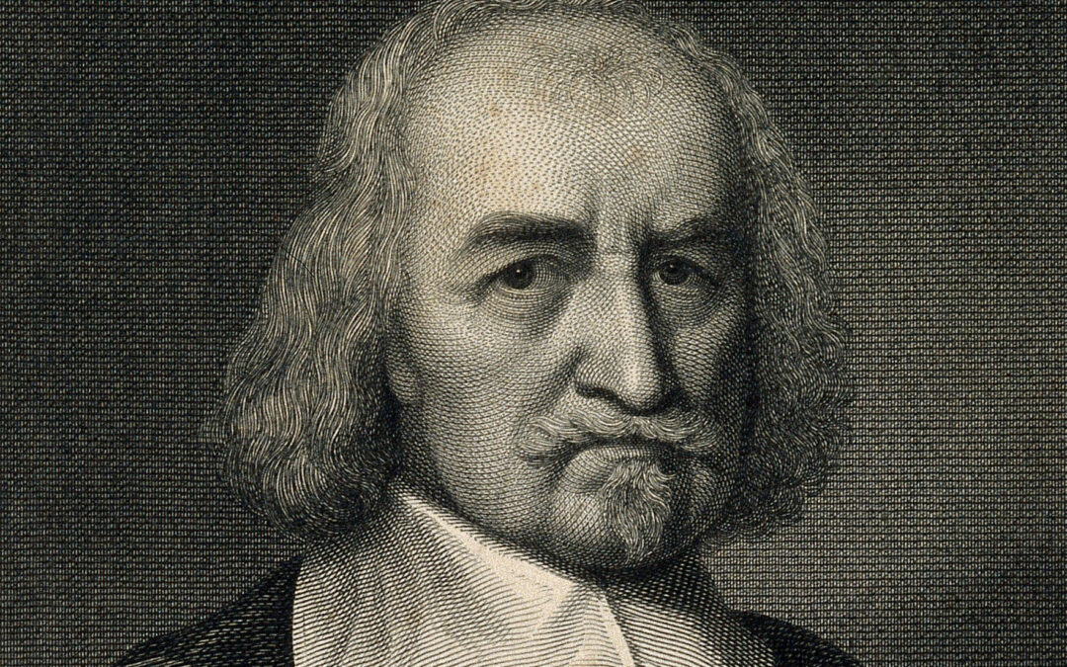
Social Contract Tradition
John Locke
Thomas Hobbes
Jean-Jacques Rousseau
1632-1704
1588–1679
1712 – 1778

Slide 3
Philosophy of THOMAS HOBBES
Thomas Hobbes (1588–1679) was an English philosopher whose ideas were shaped by the unrest of the English Civil War.
Hobbes use to say : “Fear and I were born twins & were ever there after inseparable.” Hobbes throughout lived in turbulent times. Sense of insecurity was the chief characteristic of his life as well as his works.
Witnessing political turmoil, he concluded that human nature, if left free, leads to conflict and insecurity. To maintain order, Hobbes argued for a strong, absolute government with centralized authority.
Influenced by the scientific revolution, he sought to apply rational and systematic methods to politics, creating a “science of governance” that could secure peace, stability, and protect civilization from collapse.
Some of the prominent works of Thomas Hobbes- 1.Leviathan, 2.De Cive , 3.The Elements of Law, Natural and Politic , 4.A Dialogue Between a Philosopher and a Student of the Common Laws of England, 5.Behemoth.

Slide 4
Hobbes State Of Nature
The state of nature is a central concept in Thomas Hobbes’s political philosophy, especially as outlined in his book Leviathan (1651). It represents a hypothetical condition in which humans live without government, laws, or authority.
The state of nature is a pre-political condition—what human life would be like without a state or society. According to Hobbes, it is not a historical era but a theoretical idea used to understand why government is necessary.
Key Characteristics of the State of Nature
Equality of all individuals: All people are naturally equal in the sense that anyone can kill anyone else.
Self-preservation: Humans are driven by fear, self-interest, and the desire to survive.
No morality or justice: In this state, there is no right or wrong, no law or justice, because these only exist under a common authority.
Unlimited freedom: Everyone has the right to do anything to preserve their life—even if it harms others.

Slide 5
Hobbes famously described life in the state of nature as:
“solitary, poor, nasty, brutish, and short.”
This highlights the constant danger, insecurity, and violence that arise when there is no
common power to keep individuals in check.

Slide 6
Causes of Conflict in the State of Nature
Hobbes identifies three main causes of conflict:
Competition – for gain
Diffidence – for safety
Glory – for reputation
These lead to a condition of "war of every man against every man".
Summary
In Hobbes’s view, the state of nature is a state of war, condition of anarchy, fear, and constant war. It shows the need for a strong, central authority (the Leviathan) to enforce laws and ensure peace. Without such authority, human life would be unstable and violent.

Slide 7
Hobbe’s Concept of State
Thomas Hobbes believed that the state is a human-made institution formed through a social contract to escape the violence and insecurity of the state of nature. In the state of nature, there are no laws or authority, and life is full of fear and conflict.
To ensure peace and protection, individuals agree to surrender some of their natural freedoms except Right to life, to a common authority, called the sovereign. This authority could be a monarch or a group, but it must have absolute power to make and enforce laws.
Hobbes called this powerful state the Leviathan—a symbol of unity and strength. For Hobbes, only such a strong, centralized state can maintain order, security, and stability in society.

Slide 8
Hobbes on Social Contract
Thomas Hobbes’ idea of the social contract is a foundational concept in his political philosophy. According to Hobbes:
In the state of nature, life is chaotic and dangerous, with no laws or authority to prevent conflict.
To escape this, individuals agree to a social contract—a mutual agreement to give up some personal freedoms.
By this contract, people transfer their rights to a sovereign authority who has absolute power to enforce laws and maintain peace.
The sovereign is not a party to the contract but is created by it, and its authority must be absolute and undivided to effectively prevent a return to the state of nature.
This contract forms the basis of civil society and justifies the existence of the state.
In short, the social contract is the agreement that establishes the state and absolute sovereignty to ensure security and order.

Slide 9
Hobbes' Concept of Absolute Sovereignty
Thomas Hobbes believed that absolute sovereignty is essential for maintaining peace, security, and order in society. In his work Leviathan (1651), he argues that without a strong central authority, society would fall into chaos and violence—the state of nature.
Key Points:
🔹 Established by Social Contract: People in the state of nature voluntarily give up their individual rights and agree to obey a sovereign, in exchange for protection and stability.
🔹 Undivided and Unlimited Power: The sovereign must have absolute power—not limited by laws, institutions, or the will of the people. Hobbes believed any division of power would lead to conflict and civil war.
🔹 Above the Law: The sovereign is not subject to the social contract; they are the product of it and cannot be lawfully resisted.
🔹 Control Over All Matters: The sovereign decides laws, punishes offenders, makes war and peace, and even regulates religion to prevent division.

Slide 10
For Hobbes, absolute sovereignty is necessary to prevent disorder and ensure the survival of society. Only a ruler with total, unquestioned authority can protect citizens from returning to the anarchy of the state of nature.
Conclusion
Thomas Hobbes was a pioneering political philosopher whose ideas about human nature, the state of nature, and the role of the state continue to influence political thought today. He viewed humans as naturally self-interested and living in a chaotic state without government—“solitary, poor, nasty, brutish, and short.” To escape this, Hobbes argued that people enter into a social contract, surrendering their freedoms to an absolute sovereign. This sovereign, or Leviathan, holds undivided and unlimited power to maintain peace, security, and order. Hobbes’ concept of absolute sovereignty stresses the necessity of a strong, centralized authority to prevent civil conflict and preserve society. His work laid the foundation for modern political philosophy by emphasizing the importance of law, order, and the social contract in the formation of the state.

Slide 11
5 sample questions on Thomas Hobbes that could be asked in a NET (National Eligibility Test) exam
What is Thomas Hobbes' concept of the "state of nature"? a) A peaceful society governed by natural law b) A condition without government characterized by constant fear and conflict c) A state ruled by divine right d) An ideal state of human cooperation
According to Hobbes, why do individuals enter into a social contract? a) To gain absolute freedom b) To escape the dangers of the state of nature c) To establish democracy d) To create economic equality
What does Hobbes mean by the term "Leviathan"? a) A mythical sea creature b) A religious institution c) A form of direct democracy d) powerful sovereign or state with absolute authority

Slide 12
Which of the following best describes Hobbes' view on the power of the sovereign? a) The sovereign’s power should be limited by lawsThe sovereign must have absolute and undivided power b) The sovereign must have absolute and undivided power c) The sovereign is accountable to the people d) Sovereignty should be shared among multiple branches
How does Hobbes describe life in the state of nature? a) “Free, equal, and just” b) “Solitary, poor, nasty, brutish, and short” c) “Peaceful and cooperative” d) “Guided by reason and morality”
Answers : 1) b 2)b 3) d 4)a 5) b

Slide 13
Philosophy of John Locke
John Locke (1632–1704) was a prominent English philosopher and political thinker, often called the Father of Liberalism. His ideas on government, liberty, and human rights have profoundly influenced modern political philosophy and the development of democratic societies. Locke’s philosophy centers on the belief that all individuals are born with natural rights—life, liberty, and property—and that the primary role of government is to protect these rights. Unlike Hobbes, Locke viewed the state of nature as generally peaceful and reasonable but recognized the need for government to resolve conflicts and protect rights.
Some of the prominent works of John Locke
1.Two Treatises of Government ,
2.An Essay Concerning Human Understanding
3.A Letter Concerning Toleration
4.Some Thoughts Concerning Education
5.The Reasonableness of Christianity

Slide 14
Locke’s Concept of State of Nature
John Locke’s state of nature is a theoretical condition where humans live without a government
or political authority, but unlike Hobbes, Locke’s view is more optimistic. He believed that:
People are generally reasonable and moral in this state.
Everyone has natural rights to life, liberty, and property that must be respected.
The state of nature is mostly peaceful, governed by natural law, which teaches people not to harm others or their possessions.
However, because there is no impartial authority to resolve disputes or enforce laws, conflicts can still arise.
To protect their rights better, individuals agree to form a government through a social contract.
In summary, Locke’s state of nature is a state of freedom and equality, but with some inconveniences that lead people to establish a civil government.

Slide 15
Locke’s Concept of Natural Rights
John Locke’s concept of natural rights is central to his political philosophy. He argued that all individuals are born with certain fundamental rights that are innate, universal, and inalienable. These rights exist independently of any government or laws and include:
Right to Life: Every person has the right to live and protect their own life.
Right to Liberty: Individuals have the freedom to act and make choices, as long as they do not harm others.
Right to Property: People have the right to own property and possessions acquired through their labor.
Locke believed that these natural rights are derived from natural law, which governs human behavior in the state of nature. The main purpose of government, according to Locke, is to protect these rights. If a government fails in this duty or violates these rights, citizens have the right to resist or overthrow it.
In essence, Locke’s natural rights theory forms the foundation for modern ideas about individual freedom, human rights, and limited government.

Slide 16
Locke’s Concept of Social Contract
John Locke’s social contract theory explains how individuals come together to form a government to protect their natural rights. According to Locke:
In the state of nature, people have natural rights but face insecurity because there is no impartial authority to enforce laws or resolve disputes.
To overcome these problems, individuals consent to form a government by entering into a social contract.
By this contract, people agree to give limited power to a government whose main role is to protect their natural rights—life, liberty, and property.
Unlike Hobbes, Locke believed that the government’s power is conditional and limited.
If the government fails to protect these rights or becomes tyrannical, the people have the right to revolt and replace it.
The social contract thus creates a civil society based on mutual consent and protection of rights.
Locke’s social contract theory forms the basis for constitutional government and the idea of political legitimacy grounded in the consent of the governed.

Slide 17
Locke’s Concept of Limited Government
John Locke strongly advocated for a limited government, meaning that governmental power should be restrained by law and subject to the will and rights of the people. His idea was a reaction against absolute monarchies, where rulers had unchecked power
Key Features:
Government by Consent: Locke believed that legitimate government is formed only by the consent of the governed through a social contract. People willingly give the government authority but retain ultimate sovereignty.
Protection of Natural Rights: The government’s primary purpose is to protect individuals’ natural rights to life, liberty, and property. These rights are inalienable and cannot be overridden by the state.
Rule of Law: Government must operate within the bounds of established laws. No one, including rulers, is above the law. This ensures fairness and prevents arbitrary rule.

Slide 18
Separation of Powers: To prevent abuse of power, Locke emphasized the need to divide government authority into different branches (legislative, executive, judicial). This system of checks and balances limits the power of any one branch.
Right to Revolution: If the government violates its fundamental duty to protect natural rights or becomes tyrannical, the people have the right to resist, reform, or overthrow it. This is a key safeguard against despotism.
Limited Scope of Government: Locke argued that government should only intervene in matters necessary for maintaining order and protecting rights. It should not interfere unnecessarily in the lives and freedoms of individuals.

Slide 19
Locke’s Concept of Property
John Locke’s concept of property is a key part of his political philosophy and closely tied to his ideas about natural rights and the state of nature.
Key Points:
Property in the State of Nature: Locke believed that in the state of nature, all things are originally held in common by everyone. However, individuals gain ownership by mixing their labor with natural resources. For example, when a person cultivates land or picks fruit, their labor makes these things their property.
Labor Theory of Property: The act of applying one’s labor to something unowned creates private property. Labor gives value and a natural right to the object or land.
Limits on Acquisition: Locke argued that property acquisition is legitimate only if:
There is enough and as good left in common for others (no unfair monopolization).
The property is not wasted or spoiled (you can only take as much as you can use).

Slide 20
Introduction of Money: Locke explained that the invention of money allows people to accumulate wealth beyond immediate use without violating the limits above, because money does not spoil.
Role of Government: The primary role of government is to protect property rights—including life, liberty, and possessions. Secure property rights provide stability and encourage productive labor.
Property and Freedom: Locke saw property as essential to individual freedom and independence, since owning property allows people to control their own lives and resources.
Locke’s ideas on property deeply influenced liberal thought and economic theory, emphasizing personal labor, rights, and the importance of protecting private property in a just society.

Slide 21
Conclusion on John Locke's Philosophy
John Locke’s philosophy laid the groundwork for modern liberal thought, emphasizing the importance of individual rights, limited government, and the rule of law. His belief that people are born with natural rights to life, liberty, and property transformed political theory by grounding authority in the consent of the governed rather than divine right or force.
Locke’s vision of a social contract where government exists to serve and protect its citizens introduced the idea that political power is conditional and accountable. His support for tolerance, private property, and the right to revolt against unjust rulers continues to influence democratic constitutions and human rights frameworks today.
Overall, Locke championed a rational, balanced approach to governance that respects human dignity, freedom, and equality—a vision that remains deeply relevant in the modern world.

Slide 22
5 Sample questions on John Locke that could be asked in a NET (National Eligibility Test) exam
1. According to John Locke, what is the primary purpose of government?
a) To increase economic prosperity b) To establish religious authority c) To protect natural rights d) To expand territory
2. What are the three natural rights identified by John Locke?
a) Equality, justice, freedom b) Life, liberty, property c) Wealth, security, happiness d) Law, order, discipline
3. Which of the following best describes Locke’s state of nature?
a) A violent and chaotic condition b) A peaceful and rational state governed by natural law c) A state ruled by monarchs d) A divine and religious order

Slide 23
4. What justifies the right to revolution in Locke’s theory?
a) Economic failure of the state b) Religious conflict c) Violation of natural rights by the government d) Absence of military strength
5. How does Locke believe private property is originally created?
a) Through inheritance b) Through government grant c) Through mixing one’s labor with nature d) Through divine right
Answers : 1) c 2)b 3) b 4)c 5)c

Slide 24
Philosophy of Jean-Jacques Rousseau
Jean-Jacques Rousseau (1712–1778) was a prominent French-Swiss philosopher, writer, and political theorist who played a key role in the Enlightenment and profoundly influenced modern political and educational thought. His ideas challenged the existing social and political order, promoting concepts like popular sovereignty, general will, and direct democracy.
Rousseau believed that humans were naturally good and lived freely and peacefully in the state of nature. according to him “Man was noble savage” in the state of nature, but got corrupted when civilized. Therefor he quoted “Thinking man is deprived animal”. He emphasized the importance of freedom, equality, and collective decision-making, arguing that legitimate political authority arises from a social contract based on the general will of the people.
His radical views inspired both revolutionary movements and debates in modern political theory, especially regarding democracy, liberty, and individual vs. collective rights.
Some of the prominent works of Jean-Jacques Rousseau
1. Discourse on the Sciences and Arts
2. The Social Contract
3. Émile, or On Education
4. Confessions
5. Reveries of the Solitary Walker

Slide 25
Rousseau’s Concept of State of Nature
The state of nature is a hypothetical condition that predates the formation of society and government. Rousseau used it to explore human nature and the roots of inequality.
Key Features of Rousseau’s State of Nature
Humans Were Solitary but Peaceful
Early humans lived alone or in small, loosely connected groups.
They were simple, self-sufficient, and acted primarily on basic needs (food, shelter, reproduction).
They had no property, laws, or morality in the modern sense.
Guided by Two Principles
Self-preservation (amour de soi): a natural instinct to survive.
Pity or compassion (pitié): an innate aversion to seeing others suffer.
These instincts made early humans non-violent and not inclined to harm each other.
No Inequality or Competition
Since there was no private property or social structure, there was no inequality, pride, or greed.
People did not compare themselves with others — no jealousy, ambition, or vanity

Slide 26
How Society Changed Everything
Rousseau believed that the development of civilization, especially private property, led to:
Social and economic inequality
Pride and vanity (amour-propre, or egotistical self-love)
Competition and conflict
Loss of freedom
His famous quote sums it up:
"The first man who, having enclosed a piece of ground, thought of saying 'This is mine,' and found people simple enough to believe him, was the real founder of civil society."

Slide 27
Rousseau’s concept of Social Contract
Rousseau’s concept of the Social Contract is most clearly expressed in his 1762 work The Social Contract (Du contract social). It is a foundational idea in political philosophy and presents Rousseau’s vision of how a just and free society should be formed.
Rousseau’s Concept of the Social Contract – Key Ideas
1. "Man is born free, and everywhere he is in chains."
Rousseau opens The Social Contract with this famous line to highlight the contradiction between human freedom in nature and the oppression found in modern society.
His goal: restore freedom and equality in civil society.
2. The Social Contract Defined
A voluntary agreement among individuals to form a community and create a collective "general will."
People give up their natural liberty (freedom to do anything) in exchange for civil liberty (freedom under laws they make themselves).

Slide 28
3. The General Will (la volonté générale)
The collective will of the people, aiming at the common good.
It's not just the majority opinion — it's what’s best for all.
Citizens must obey the general will, even if it goes against their individual desires — because this ensures freedom and equality for all.
4.Sovereignty Belongs to the People
Sovereignty (ultimate political power) lies not in a ruler, but in the people as a whole.
It is inalienable (can’t be transferred) and indivisible (can’t be split).
5.Laws Must Reflect the General Will
The laws are valid only if they are made by the people or their representatives and reflect the general will.
6. Freedom Through Obedience to Law
True freedom isn’t doing whatever one wants, but living under laws one has chosen.
“To be forced to be free” — paradoxical, but Rousseau means that individuals are
free only when they follow laws reflecting the general will.
7. Civil Religion
Rousseau supports a minimal set of shared beliefs to maintain unity and moral behavior
(e.g., belief in a supreme being, afterlife).
But he opposes institutional religion controlling the state.

Slide 29
Rousseau’s Concept of
General Will
The General Will (volonté générale) is a central idea in Rousseau’s political philosophy. It refers to the collective will of the people aimed at the common good. It is not simply the sum of individual desires but what is best for the community as a whole.
Key Features:
The General Will seeks the common good and represents the interest of all citizens.
It is distinct from the "will of all," which is just a collection of personal interests.
True laws must reflect the General Will to be legitimate and just.
The General Will is formed through collective participation and direct democracy.
It is binding on all citizens, even if it goes against individual preferences.
It cannot be transferred or represented by any ruler—it belongs to the people alone.
According to Rousseau, individuals are truly free when they obey the General Will, because it expresses their collective interests and ensures equality and justice for all.

Slide 30
Rousseau’s Concept of Democracy
Jean-Jacques Rousseau supported a form of direct democracy, where sovereignty lies entirely with the people. His ideas are mainly found in The Social Contract (1762).
Key Points:
Sovereignty belongs to the people: The people are the ultimate source of political authority and cannot give this power away to a ruler or representative.
Direct participation: Rousseau believed citizens should directly make laws, rather than elect representatives to do it for them.
Law reflects the General Will: Laws are valid only when they express the collective will aimed at the common good.
Freedom through self-rule: People are truly free only when they live under laws they have chosen for themselves.
Small, equal societies: Democracy works best in small, simple societies where citizens can participate equally and directly.
Representative government is not true democracy: Rousseau criticized systems where citizens merely choose rulers, calling such governments elective aristocracies.
In summary, Rousseau’s democracy is based on active citizen participation, equality, and collective decision-making to express the General Will.

Slide 31
Conclusion
Jean-Jacques Rousseau’s political philosophy centers on the idea that human beings are naturally free and equal, but that society and its institutions have corrupted this original state. Through his concepts of the state of nature, social contract, general will, and democracy, Rousseau outlines a vision for a just society where individuals achieve true freedom by participating directly in the formation of laws that reflect the collective good. His belief in direct democracy and the sovereignty of the people highlights the importance of equality, civic responsibility, and moral unity. Overall, Rousseau’s ideas continue to influence modern political thought and debates on freedom, justice, and participatory governance.

Slide 32
5 sample questions on Jean-Jacques Rousseau that could be asked in a UGC-NET (National Eligibility Test) exam
1. Which of the following best describes Rousseau’s concept of the “General Will”?
A) The will of the ruling class B) The sum of individual desires C) The collective will aimed at the common good D) The will of the majority party
2. In Rousseau’s view, which of the following marks the origin of social inequality?
A) Establishment of religion B) Introduction of monarchy C) Formation of armies D) Emergence of private property
3. Which work of Rousseau begins with the line: “Man is born free, and everywhere he is in chains”?
A) Discourse on the Origin of Inequality B) The Social Contract C) Émile, or On Education D) Confessions

Slide 33
4. According to Rousseau, true freedom is achieved when:
A) One follows their personal desires B) One obeys a monarch C) One submits to religious authority D) One obeys laws made by the General Will
5. Which of the following best reflects Rousseau’s view of democracy?
A) Representative democracy is the best form of government B) Only monarchies can ensure freedom C) True democracy requires direct participation by citizens D) Democracy is incompatible with human nature
Answers : 1) c 2)d 3) b 4)d 5)c

Slide 34
🧠 Comparison Chart: Hobbes vs Locke vs Rousseau
Aspect | Thomas Hobbes | John Locke | Jean-Jacques Rousseau
View of Human Nature | Naturally selfish, brutish, and violent | Rational and cooperative but self-interested | Naturally good and peaceful, corrupted by society
State of Nature | “War of all against all”; life is "solitary, poor, nasty, brutish, and short" | People have natural rights (life, liberty, property) | Peaceful and equal, but corrupted by private property
Reason for Government | To impose order and prevent chaos | To protect natural rights | To ensure freedom and equality through collective will
Type of Government | Absolute monarchy or strong centralized power | Limited government with checks and balances | Direct democracy guided by the general will
Social Contract | People give up all rights to a ruler for protection | People consent to government in return for protection of rights | Individuals give up individual will to the general will of the community
Right to Revolt? | No – rebellion leads to chaos | Yes – if the government fails to protect rights | Yes – if the general will is violated
Major Work | Leviathan (1651) | Two Treatises of Government (1689) | The Social Contract (1762)

Slide 35
THANK YOU

