Slide 1
Digital Class MA 3rd Semester Department of Political Science Paschim Guwahati Mahavidyalaya, Dharapur
Course Title: Research Methodology-I Course Code: POL3026
Today's Topic: Explorative Research and Action Research
Date: 2nd September 2025 Class Taken by: Humen Boruah

Slide 2
Exploratory Research
This approach investigates research questions that have not previously been studied in depth. It is often qualitative and primary in nature.
It helps researchers gain insights, identify variables, and frame hypotheses for further study.
It is inductive in nature – moving from observations to ideas.

Slide 3
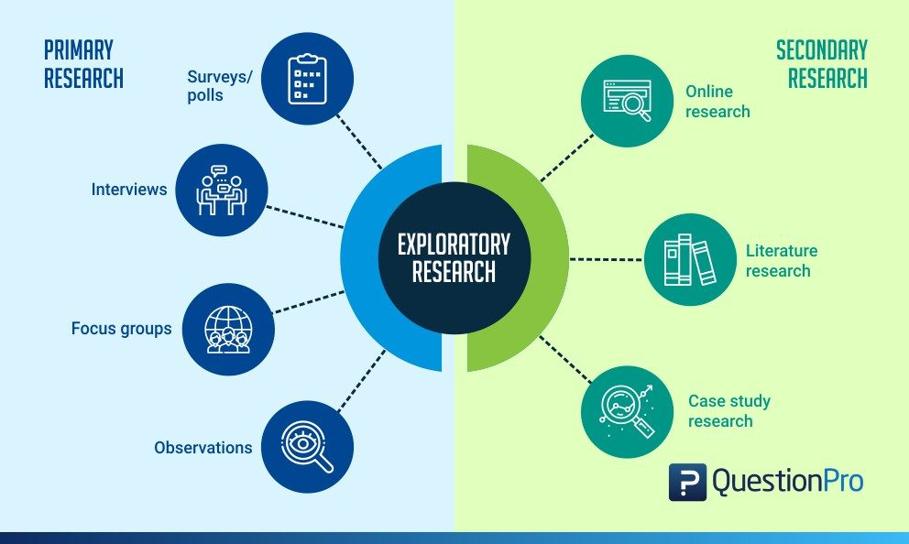

Slide 4
When to Use Exploratory Research
When the research problem is new, unclear, or not well-defined.
When there is little or no existing knowledge, theory, or paradigm on the subject.
When data collection is difficult due to lack of prior studies, tools, or variables.
When you have only a general idea or broad question, and you need to narrow it down into specific hypotheses or research questions.

Slide 5
Case Study Example – Meme Culture & Youth Opinion
Research Problem:
How does meme culture shape youth’s social and political opinions?
Why Exploratory?
New and evolving phenomenon with limited prior research.
Difficult to measure directly using traditional surveys.
Requires open-ended exploration to understand influence.

Slide 6
Possible Methods:
Focus groups/interviews with students about meme consumption.
Content analysis of political/social memes on Instagram, X, Facebook.
Observation of online discussions and meme sharing.
Expected Outcome:
Generate hypotheses such as:
Memes make politics more relatable to youth.
Memes influence how youth discuss and perceive political issues.
Memes can shape voting behavior indirectly.

Slide 7
Action research
Action research is a research method that aims to simultaneously investigate and solve an issue or to improve (ameliorate) a given situation.
In other words, as its name suggests, action research conducts research and takes action at the same time.
It was first coined as a term in 1944 by MIT professor Kurt Lewin.
It aims at improving practices, solving local issues, and generating knowledge at the same time.
Emphasizes “learning by doing”.

Slide 8
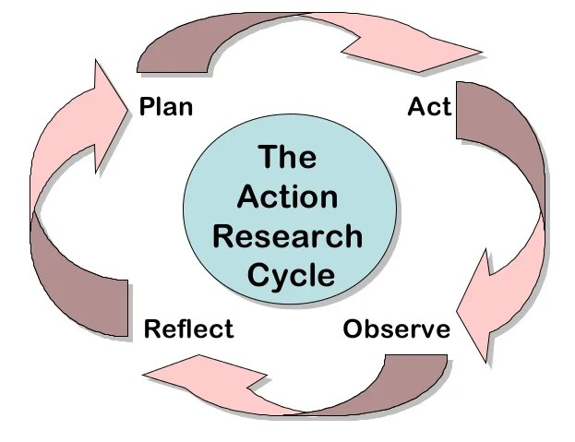
It's a cyclical process that aims to identify problems and create a plan of action. It has four steps such as plan, act, observe, and reflect.
P A O R

Slide 9
?
Which of the following shows the correct sequence in undertaking Action Research based studies?
1. Planning. Acting on the plan. Observing and Reflecting
2. Acting on the plan, Observing. Planning and Reflecting
3. Reflecting. Planning. Acting on the plan and Observing
4. Acting on the plan. Reflecting. Planning and Observing

Slide 10
?
A college teacher plans a research programme in which he/she intends to improve the socio-emotional aspect of his/her classroom climate during teaching. Which one of the following research methods will be considered appropriate in this context?
1. Experimental method
2. Descriptive method
3. Historical method
4. Action research method

Slide 11
?
A university teacher plans to improve the study habits of students in his/her class. Which type of research paradigm will be helpful in this regard?
(1) Evaluative research paradigm
(2) Applied research paradigm
(3) Fundamental research par
(4) Action research paradigm

