Slide 1
Correlation Analysis
Nirmali Borah
Assistant Professor
Dept. of Commerce(Statistics)

Slide 2
correlation
Real-life examples (e.g., height and weight, study hours and exam scores)
The term correlation means relationship between two variables.
The variables are said to be correlated when the value of one variable changes in the value of the other variable.
For example:
Temperature and sale of ice-creams on different days of a month in summer.
Number of workers and time required to complete the work.

Slide 3
Types of Correlation
Positive Correlation: Both variables increase or decrease together
Negative Correlation: One variable increases while the other decreases
No Correlation: No predictable pattern between variables
________________________________________

Slide 4
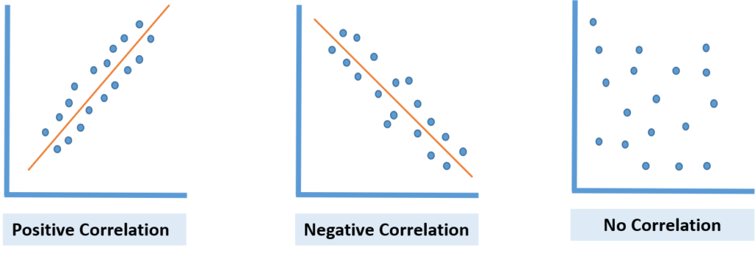
Visual Examples: Simple scatter plots

Slide 5
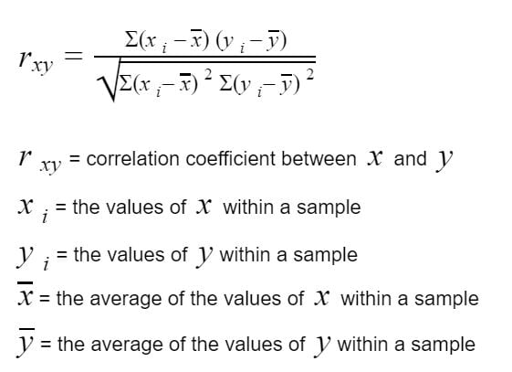
Correlation Coefficient 1. Karl Pearson’s correlation coefficient method

Slide 6
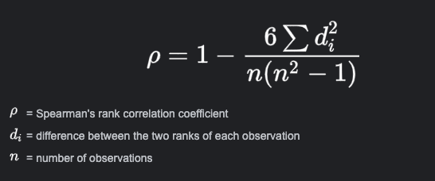
2. spearman’s rank correlation coefficient
In case of unified ranks:

Slide 7
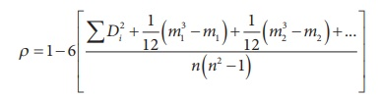
2. spearman’s rank correlation coefficient
In case of tied ranks:

Slide 8
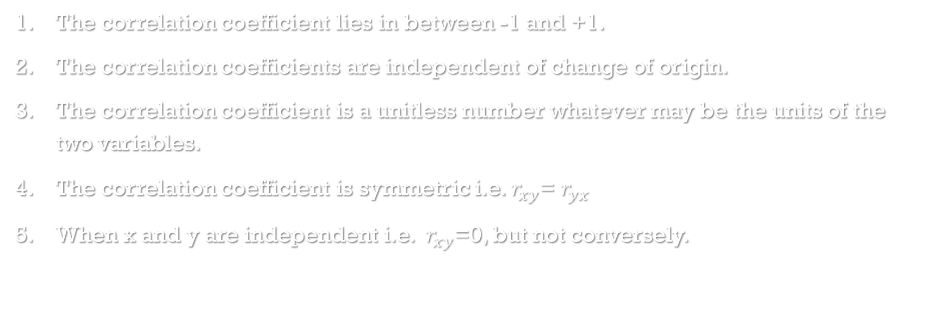
Properties of correlation coefficient
The correlation coefficient lies in between -1 and +1.
The correlation coefficients are independent of change of origin.
The correlation coefficient is a unitless number whatever may be the units of the two variables.
The correlation coefficient is symmetric i.e. $r_{xy}$= $r_{yx}$
When x and y are independent i.e. $r_{xy}$=0, but not conversely.

Slide 9
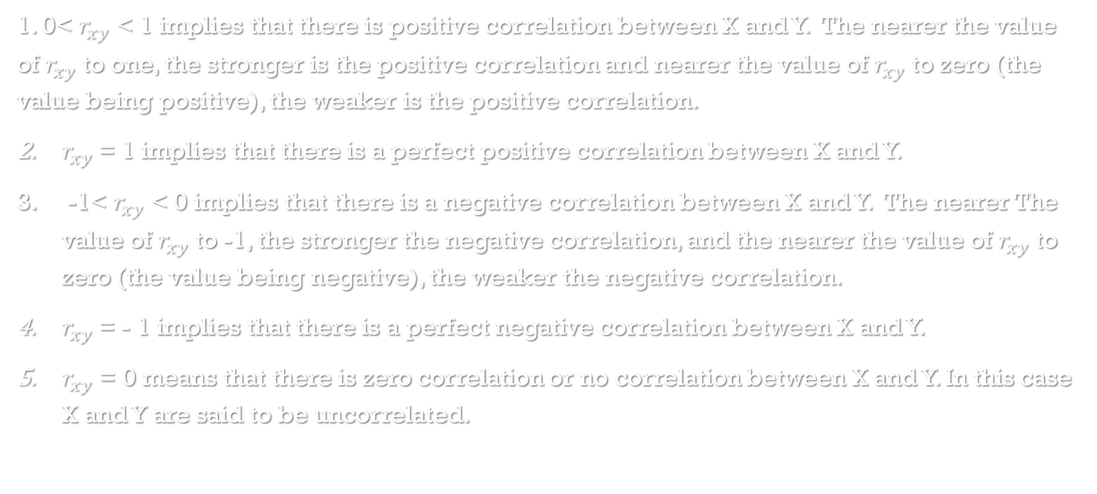
The interpretations of various values of correlation coefficient:
1. 0< $r_{xy}$ < 1 implies that there is positive correlation between X and Y. The nearer the value of $r_{xy}$ to one, the stronger is the positive correlation and nearer the value of $r_{xy}$ to zero (the value being positive), the weaker is the positive correlation.
$r_{xy}$= 1 implies that there is a perfect positive correlation between X and Y.
-1< $r_{xy}$ < 0 implies that there is a negative correlation between X and Y. The nearer The value of $r_{xy}$ to -1, the stronger the negative correlation, and the nearer the value of $r_{xy}$ to zero (the value being negative), the weaker the negative correlation.
$r_{xy}$= - 1 implies that there is a perfect negative correlation between X and Y.
$r_{xy}$ = 0 means that there is zero correlation or no correlation between X and Y. In this case X and Y are said to be uncorrelated.

Slide 10
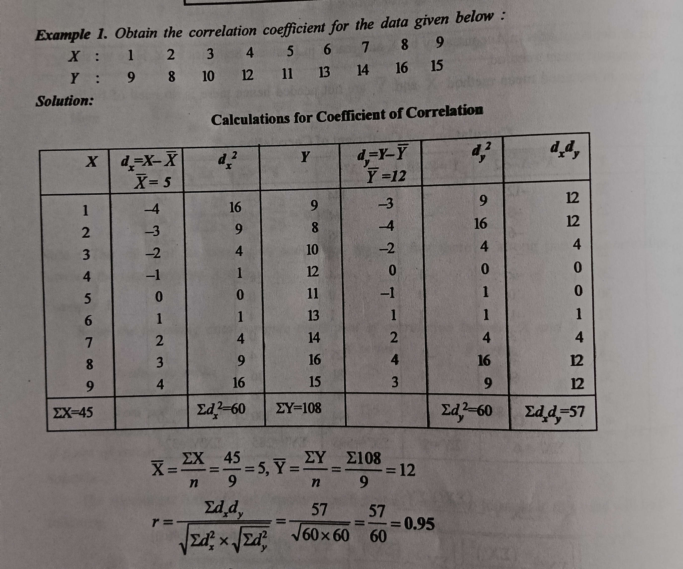
example

Slide 11
Thank you

