Slide 1
Diagrams and Graphs
Ms. Nirmali Borah
Paschim Guwahati Mahavidyalaya
Dharapur, Guwahati-17

Slide 2
Presentation of data
• Diagrams and graphs will catch the eye more easily than tables, which provide an array of figures.
• A glance over a graph or diagram will enable any layman (without statistical knowledge) to get an idea about the essential characteristics of the tabulated data without much strain or effort.

Slide 3
Functions of diagrams and graphs
It will attract the attention of a large number of people.
• They carry a “birds–eye view” impression in the human mind.
• It saves a lot of valuable time if presented in the form of suitable charts & graphs instead of pages of numerical figures.
• To facilitate comparison between two or more sets of data.
• Prediction equations can be represented by graphs and these will be very helpful in forecasting.

Slide 4
Limitations of diagrams and graphs
They are approximate indicators.
Exact and accurate information can be obtained from the original tabular information.
They cannot substitute the tabular information.
They fail to disclose small differences when large figures are involved.

Slide 5
Graphical representation of data
Graphical representation is done when the data are classified in the form of a frequency distribution.
The different graphs are
• Histogram
• Frequency Polygon
• Frequency Curve
• Ogive

Slide 6
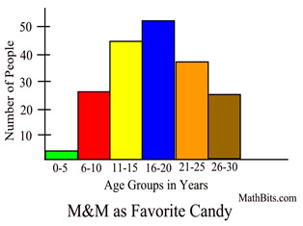
Histogram
It is a vertical bar diagram without a gap between the bars.
• It consists of bars erected over the true class interval, their areas being proportional to the frequencies of the respective classes.
• Since the intervals are of equal width, the height of each bar serves as a measure of the corresponding frequency.
• Draw the two diagonals in the highest modal class rectangles at its top corner to the pre and post-modal rectangle corners, and the x co-ordinate of the point of intersection is the mode.

Slide 7
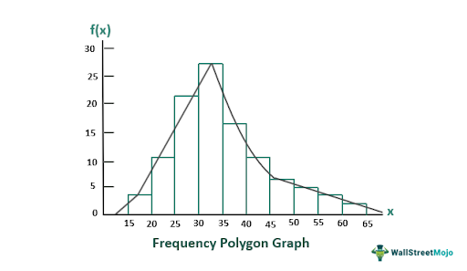
Frequency Polygon
If points are plotted with the x co-ordinate equal to the mid value of the class intervals and the corresponding frequencies as the y co-ordinate and these points are joined by means of a straight line, we obtain frequency polygon.
• These points are the midpoints of the top of the bars in the histogram.

Slide 8
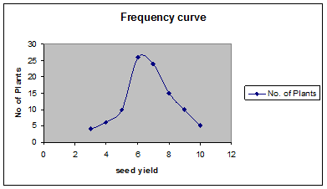
Frequency Curve
If points are plotted with the x co-ordinate equal to the mid value of the class intervals and the corresponding frequencies as the y co-ordinate and these points are joined by means of a smooth curve then we get frequency curve.
A Frequency Curve is a smooth curve which corresponds to the limiting case of a histogram computed for a frequency distribution of a continuous distribution as the number of data points becomes very large.

Slide 9
Difference Between Frequency Curve And Frequency Polygon
The main difference between a frequency polygon and a frequency curve is that a frequency polygon is drawn by connecting points with a straight line, whereas a frequency curve is drawn by connecting points following a curve.

Slide 10
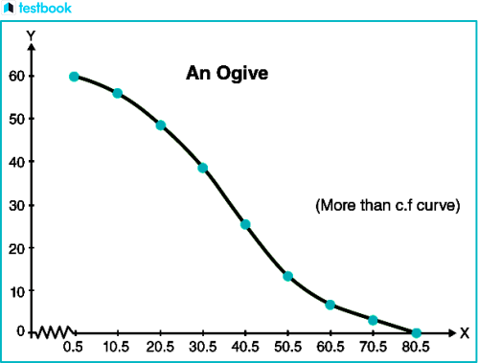
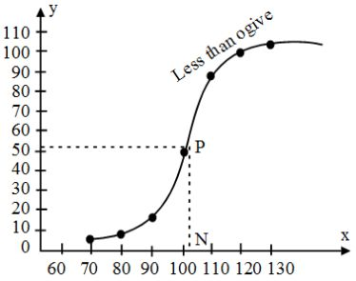
Ogive or Cumulative Frequency curve
This is cumulative frequency curve.
• This curve is obtained by making use of cumulative frequency instead of the simple frequency.

Slide 11
Types of a diagram
• Bar Diagram
Simple Bar Diagram
Multiple Bar Diagram
Sub-divided Bar Diagram
Pie diagram

Slide 12
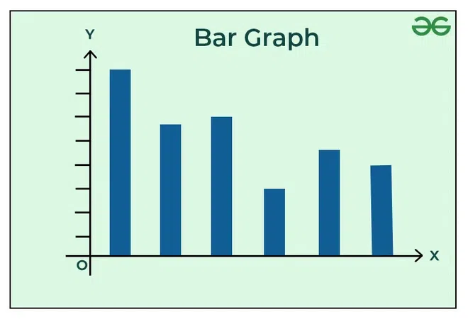
Simple Bar Diagram
A simple bar diagram is constructed for an immediate comparison. It is advisable to arrange the given data set in an ascending or descending order and plot the data variables accordingly.

Slide 13
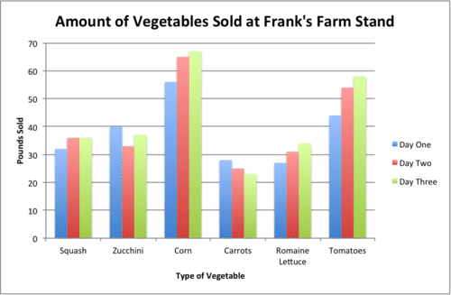
Multiple Bar Diagram
Multiple bar diagrams are constructed to represent two or more variables for comparison. For example, a multiple bar diagram may be constructed to show the proportion of males and females in the total, rural, and urban population or the share of canal, tube well, and well irrigation in the total irrigated area in different states.

Slide 14
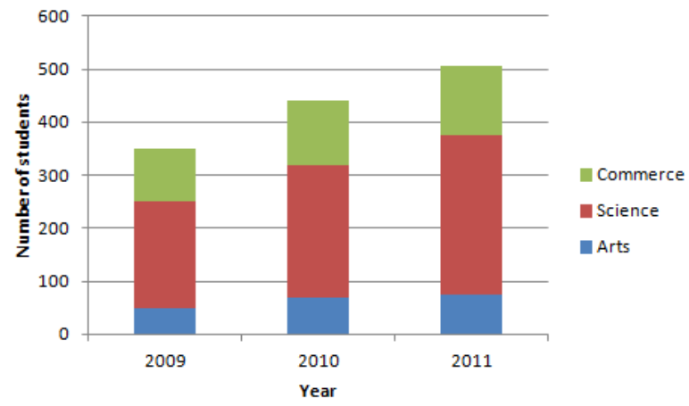
Sub-divided Bar Diagram
A subdivided bar diagram is a way of representing data in which the total magnitude is divided into different segments.

Slide 15
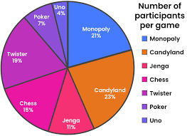
Pie diagram
A pie diagram is another graphical method of representing data. It is drawn to depict the total value of the given attribute using a circle. Dividing the circle into corresponding degrees of angle, then representing the subsets of the data.

