Slide 1
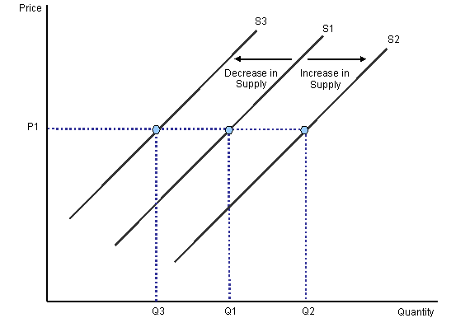
SHIFT IN SUPPLY
CURVE
Presented by-
Sultan Ahmed

Slide 2
INCREASE AND DECREASE IN QUANTITY SUPPLY
Shift in supply curve refers to a situation of increase or decrease in quantity supplied of a commodity even when own price of the commodity remains constant. It is caused by factors, other than own price of the commodity.
Increase in supply is indicated by a forward shift
in supply curve.
Decrease in supply is indicated by a backward shift in supply curve.

Slide 3
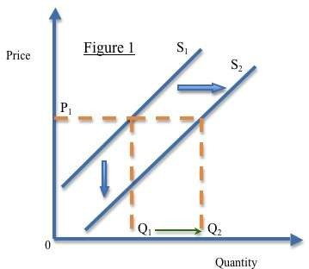
Forward shift in Supply Curve
Initially Q₁ units of the commodity are supplied at the price of P₁ per unit. Due to other factors (generally related to reduction in the cost of production), firms are now willing to supply Q₂ units even when own price of the commodity remains to be P₁ per unit. It implies a forward shift in supply curve i.e. from S₁ to S₂.

Slide 4
Causes of Increase in Supply
Increase in supply may occur due to the following factors:
Improvement in technology leading to a fall in cost of production
and fall in cost of production.
Reduction in factor prices causing a fall in cost of production.
Decrease in the price of a competing product. It prompts the producer to sell more at the existing price.
Increase in number of firms in the industry. It causes increase in market supply even when price of the commodity remains the same.
High business expectations. It prompts the producers to
increase investments. Accordingly, supply increases.
Shifts in goal of the firm to sales maximisation. ‘Clearance Sale’ often leads to higher supplies even when price remains the same.
Decrease in taxation increases sales due to decrease in cost of
production.
vii.

Slide 5
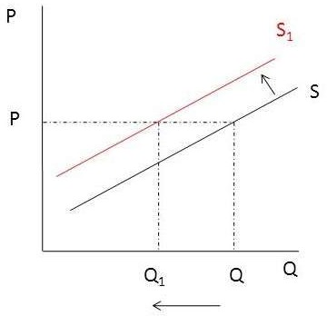
Backward shift in Supply Curve
Initially Q units of the commodity are supplied at the price of P per unit. Due to other factors (generally related to increase in the cost of production), firms are now willing to supply Q₁ units even when own price of the commodity remains to be P per unit. It implies a backward shift in supply curve i.e. from S to S₁.

Slide 6
Causes of Decrease in Supply
Decrease in supply occurs due to the following reasons:
Use of outdated technology, causing a fall in efficiency
and rise in cost of production.
Increase in factor prices, causing increase in cost of production.
Increase in price of a competing product. It prompt the producers to restrict their supplies at the prevailing price.
Decrease in number of firms in the industry. This decreases market supply of the product even when price remains constant.
Low business expectations. It prompts the producers to reduce investment. Accordingly, supply reduces.
Shift in goal of the firm to profit maximisation. When the focus is on profit maximisation, firms often restricts sale of their product.
Increase in taxation decreases sales due to increase in
cost of production.
iii.
vii.

Slide 7
THANK YOU

