Slide 1

Indifference Curve Analysis
Sultan Ahmed

Slide 2
Introduction
Indifference curve analysis is a new way to analyse consumer’s behaviour.
geometrical
This approach was propounded by Hicks & Allen.
It measures utility ordinally.
It explains consumer behaviour in terms of his preferences or rankings for different combinations of two goods, say X and Y.
An indifference Curve is drawn on the from the indifferent schedule of the consumer.

Slide 3
Indifference schedule
An indifference schedule is a list of combinations of two commodities that yields equal satisfaction.
Combination | Good x | Good y
L | 1 | 18
M | 2 | 13
N | 3 | 9
O | 4 | 6
Q | 5 | 4
R | 6 | 3

Slide 4
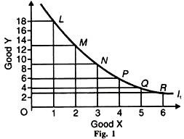
Indifference Curve
Indifference Curve is a Diagrammatic Representation of Indifference Schedule.
I1 is an Indifference
curve.
It is a line that shows all possible combinations of Two Goods between which a person is Indifferent

Slide 5
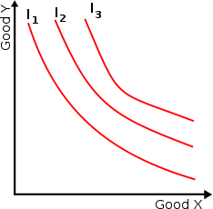
Indifference Map
An Indifference Map is a Group of Indifference Curves each of which represents a given level of Satisfaction.
If an Indifference curve Shifts to Right, the Level of Satisfaction goes on Increasing.
From the Point of View of Satisfaction I1<I2<I3

Slide 6
Assumptions of Indifference Curve
Consumer acts rationally so as to maximise satisfaction.
There are two goods X and Y.
Utility is measured ordinally.
It is based on the axim of diminishing marginal rate of substitution.
The consumer is consistent in his choice, that is, if in one time he chooses bundle A over B, he will not choose B over A in another time if both bundles are available to him. If A>B , then B> A
Consumer’s choices are characterized by Transitivity . It means that if a Consumer prefers A to B & B to C, he must prefer A to C.

Slide 7
Marginal Rate of Substitution (MRS)
The marginal rate of substitution is the rate of exchange between some units of goods X and Y which are equally preferred. The marginal rate of substitution of X for Y (MRS)_{xy} is the amount of Y that will be given up for obtaining each additional unit of
X. This rate is explained below in the following indifference schedule.
Combin ation | Good x | Good y | MRS of X for Y
L | 1 | 18 | -
M | 2 | 13 | 5:1
N | 3 | 9 | 4:1
O | 4 | 6 | 3:1
P | 5 | 4 | 2:1
Q | 6 | 3 | 1:1

Slide 8
To have the combination M and yet to be at the same level of satisfaction, the consumer is prepared to forgo 5 units of Y for obtaining an extra unit of X. The marginal rate of substitution of X for Y is 5:1. The rate of substitution will then be the number of units of Y for which one unit of X is a substitute. As the consumer proceeds to have additional units of X, he is willing to give away less and less units of Y so that the marginal rate of substitution falls from 5:1 to 1:1 in the sixth combination (Col. 4). In Fig. 8.4 above at point M on the indifference curve I₁, the consumer is willing to give up 5 units of Y to get an additional unit of X.As he moves along the curve form M to R, the consumer acquires more of X and less of Y. The amount of Y he is prepared to give up to get additional units of X becomes smaller and smaller. This behaviour of the consumer is known as the principle of diminishing marginal rate of substitution.

Slide 9
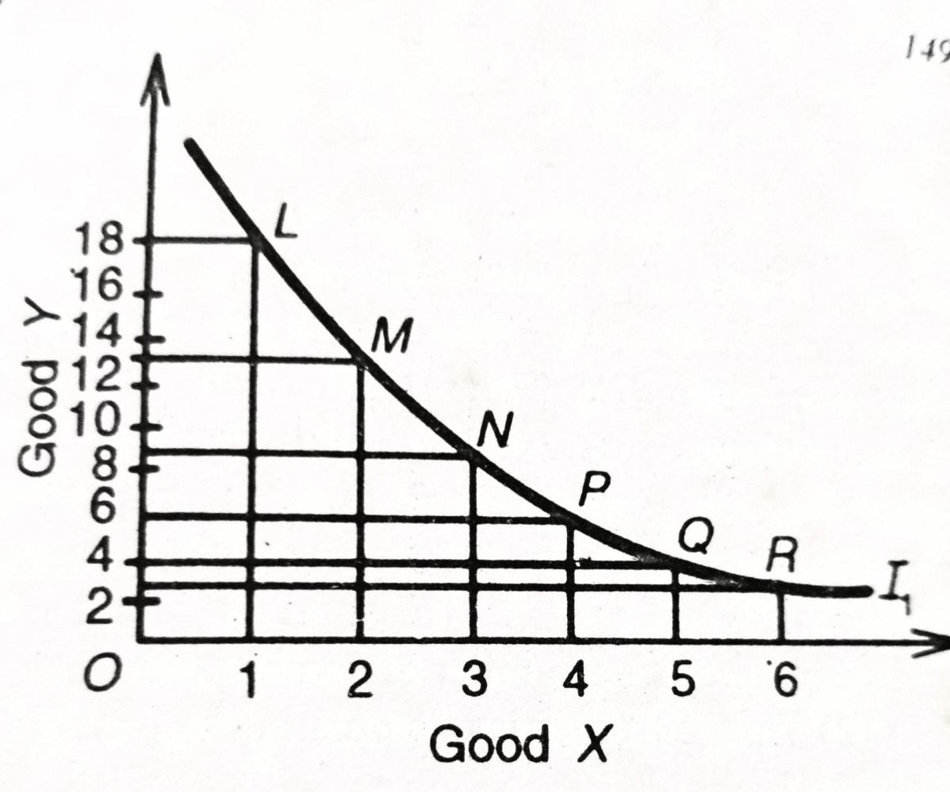
The marginal rate of substitution is in fact the slope of the curve at a point on the indifference curve. Thus, M.R.S. _{x y} = Δ Y / Δ X, on any point on the indifference curve. MRS Keeps on Declining since Consumer has more & more units of one Good, he gives up Less Units of Other Good

Slide 10
Properties of Indifference Curve
1. An Indifference Curve has a negative slope. It denotes that if the quantity of one commodity (y) decreases, the quantity of the other (X) increases, if the consumer is to stay on the same level of satisfaction. If the quantity of good X is increased in the combination, while the quantity of good Y remains unchanged, the new combination will be preferable to the original one and the two combinations will not therefore lie on the same indifference curve provided more of a commodity gives more satisfaction.

Slide 11
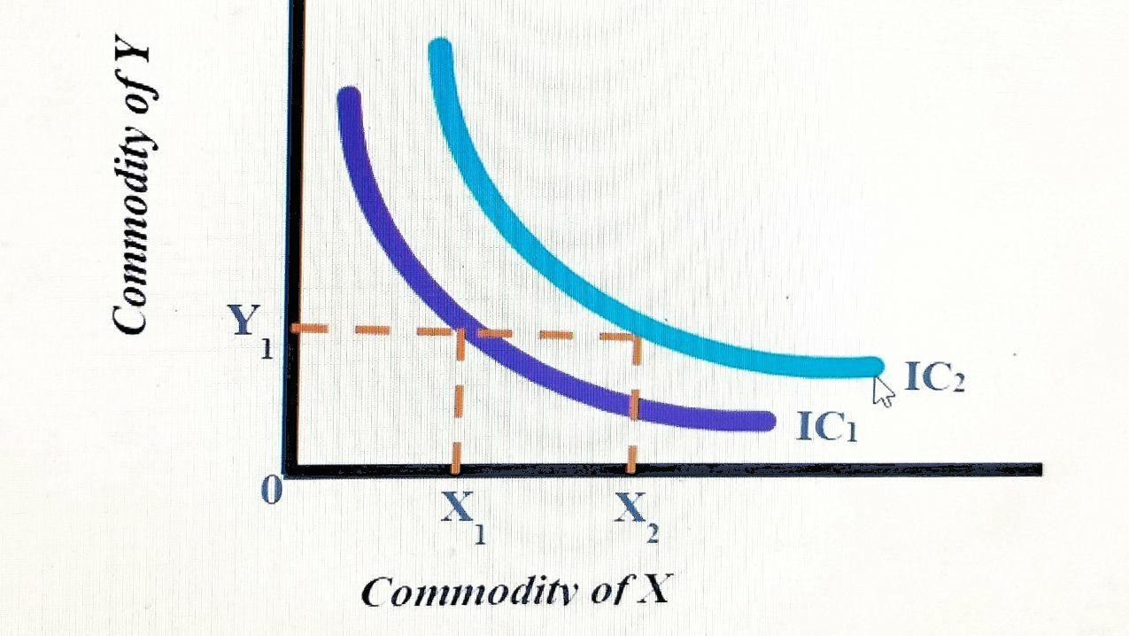
2. A higher indifference Curve to the right of another represents a higher level of satisfaction. Here in the fig, IC2gives more level of satisfaction than IC1
. This is because IC2 contains more units of at least one commodity

Slide 12
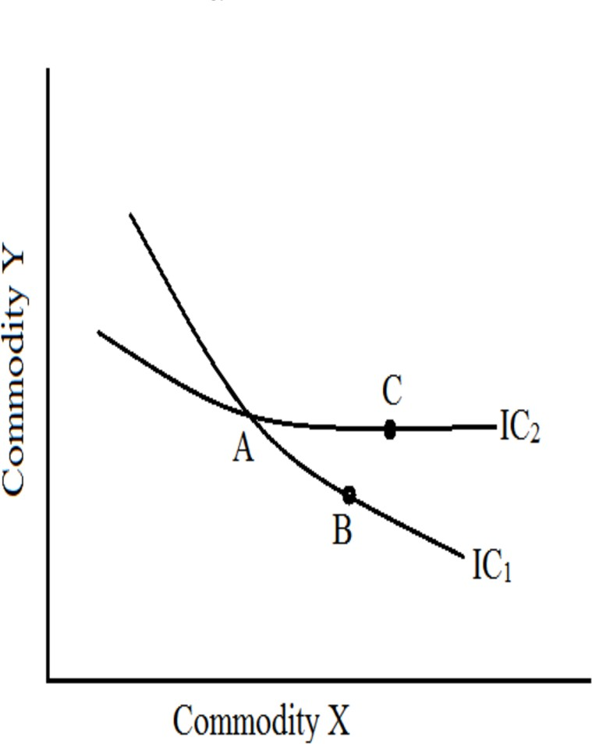
3.Indifference curves do not intersect. If they did, the point of intersection would imply two different level of satisfaction, which is impossible. Suppose two Ics intersects at point A, then A=C (lies on the same IC2) A=B (lies on the same IC1)
∴ B=C(because of transitivity assumption). But it is impossible because point C gives higher level of satisfaction than point B.

Slide 13
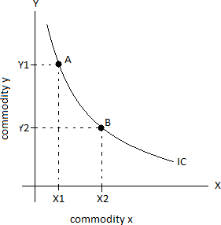
4. Indifference Curves are convex to the point of Origin due to diminishing the marginal rate of substitution of commodities.This implies that as the consumer gets more and more of X he is ready to sacrifice less and less of Y.

Slide 14



5. An indifference curve cannot touch either axis. If it touches-X axis as in Fig. at M, the consumer will be having OM quantity of good X and none of Y. Similarly, if it touches Y axis at L, the consumer
Y
L
will have only OL of Y
good and none of X. This is against the assumption
M
X
of consumer consumes combination of two goods

Slide 15
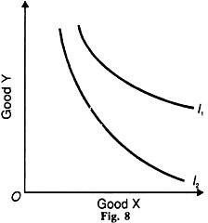
6. Indifference
curves are not necessarily parallel to each other. This is because MRS may differ for different indifference curves. If MRS differs the slope of indifference curves also differs.

Slide 16
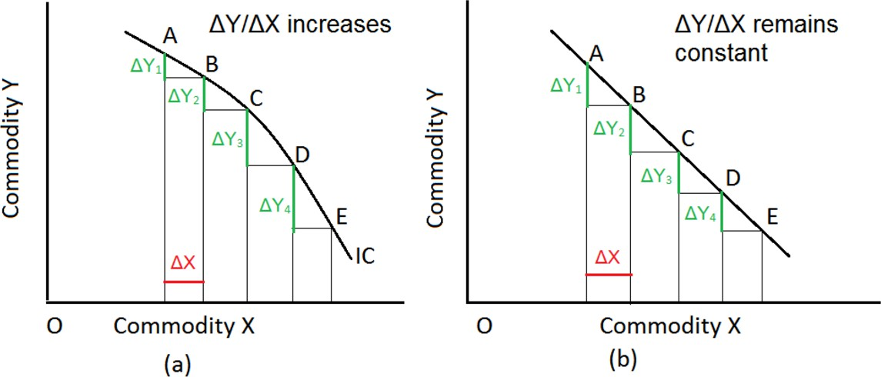
Exceptions of Indifference Curve
Exception:1 If MRS of X for Y or Y for X is constant, the indifference Curve will be a straight line sloping downwards to the right at 45° angle to either axis as shown in fig. If MRS of X for Y or Y for X is increases, instead of diminishes, the indifference curve will be a concave curve.

Slide 17
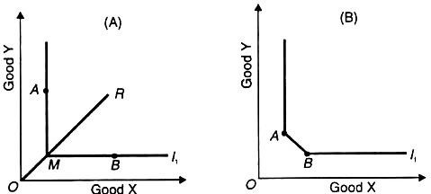
Exception:2 Perfect Complementary Goods have L-shaped Indifference
Curves
Indifference curve of perfect complements, as shown in Fig. A is L-shaped (Right Angle). Perfect complementary goods are those which are used simultaneously in the definite ratio for instance, right shoe and left shoe are perfect complement because one is useless without the other. When consumer has its minimum number then there is no rate at which one shoe be substituted for another. In case of ordinary complementaries which have a low rate of substitution on or near the curvature of the curve as shown in fig B

Slide 18
Exception 3: Horizontal
Indifference Curve – Goods that give zero satisfaction: When any product yields zero satisfaction then the consumer will not want to sacrifice even the last quantity of the other product to get a single unit of that product. For
Y
IC
instance, indifference curve of cigarettes for a non-smoker, as shown in Fig., will be a straight line. Indifference curve of that product which yields zero
satisfaction, will be parallel to OX (at which product yielding zero satisfaction is shown).
O
X

Slide 19

Exception 4: U-Shaped Indifference Curve Goods that give Negative utility: If consumption of any product
y
will result in negative utility after a certain limit, then its indifference curve, as shown in Fig. will be U shaped. For instance, at point Q, the consumer gets the quantity of goods which are needed.
After point Q, slope of indifference curve becomes positive.
Ic
o
x

Slide 20
Budget Line
A budget line is a line which shows all combinations of two goods that a consumer can afford with a given income and prices of commodities It is also known as price line, consumption possibility line, and line of attainable combinations.
Example of Budget Line
Suppose a consumer has an income of Rs.50, and it will be used to buy commodities X andY. To derive maximum utility from the said income, only the following options are available.

Slide 21
Combination | Goods X (Rs 10 each) | Goods Y (Rs 5 each) | Income (budget allocation)
A | 0 | 10 | (10×0)+(5×10)=50
B | 1 | 8 | (10×1)+(5×8)=50
C | 2 | 6 | (10×2)+(5×6)=50
D | 3 | 4 | (10×3)+(5×4)=50
E | 4 | 2 | (10×4)+(5×2)=50
F | 5 | 0 | (10×5)+(5×0)=50

Slide 22
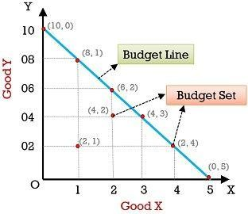
The
budget line is obtained by
plotting the above
against
required
budget
the
following graph. In the graph, the X-axis represents commodity X, and Y-axis represents commodity Y.

Slide 23
Features of Budget Line
Negative slope: It has a negative slope.
Straight line: It indicates a continuous market rate of exchange in individual combinations.
Real income line: It denotes the income and the spending amount of a customer.
Tangent to indifference curve: It is the point when the indifference curve meets the budget line. This point is known as the consumer’s equilibrium.

Slide 24
Consumer’s Equilibrium
A consumer is in equilibrium when he maximizes his utility with his given income and the market prices.Two conditions must be fulfilled for the consumer to be in equilibrium.
MRS_{xy} =MUx/MUy= P_{x}/Py. It means MRS be equal to the ratio of commodity prices.
This is a necessary but not sufficient condition for equilibrium.
The indifference curves be convex to the origin. This condition is fulfilled by the axiom of diminishing MRSxy which states that the slope of the indifference curve decreases as we move along the curve from the downwards to the right.

Slide 25
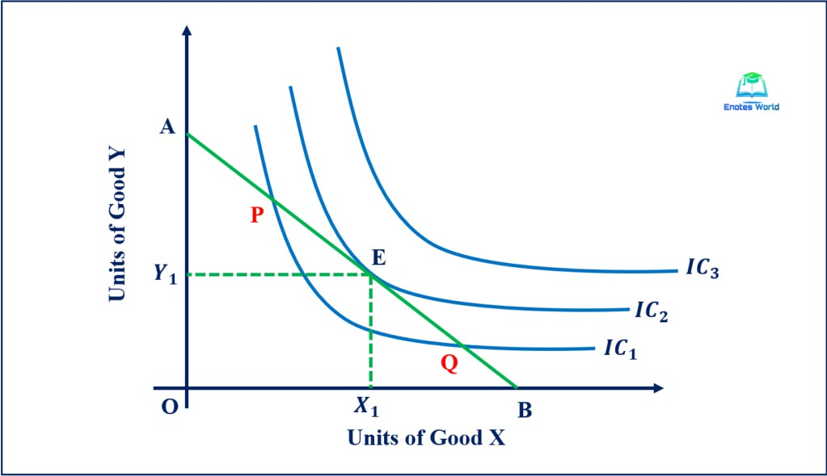
Graphical Presentation
Given the indifference map of the consumer and his budget line, the equilibrium is defined by the point of tangency of the budget line with the highest possible indifference curve (point E in the fig.)
At the point of tangency the slope of the budget line (Px/Py) and MRSxy= MUx/MUy are equal. The first order condition is fulfilled by the point of tangency of the two relevent curves. The second order condition is implied by the convex shape of the indifference curves.

Slide 26


