Slide 1
Hecksher-Ohlin theory of International Trade
Sultan Ahmed
Assistant Professor
Dept. Of Economics
Paschim Guwahati Mahavidyalaya,
Dharapur, Ghy-17

Slide 2
Contents
Who are Hecksher and Ohlin ?
Background of the theory
Definition of the theory.
Explanation of the theory
Factor endowmment
Factor intensity
Real world examples
Criticisms.

Slide 3
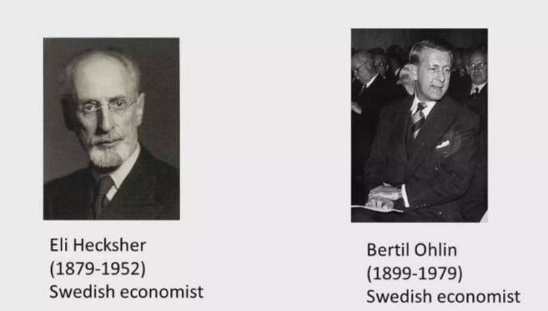
Introduction
The theory was developed by Swedish economist
Bertil Ohlin on the basis of the work by his teacher
Swedish economist Eli Hecksher.
Ohlin was awarded Nobel Prize for economics.
Bertil Ohlin’s classic work, Interregional and
International Trade (1933)

Slide 4
Background of the theory
Adam smith’s absolute cost advantage
A country has an absolute advantage in the production of that good, which it can produce in greater quantity with the same quantity of resources than another country.
David Ricardo’s comparative cost advantage
Comparative advantage is an economy's ability to produce a particular good or service at a lower opportunity cost than its trading partners
Hecksher-Ohlin theory
The above two trade theories were based on the differences in productivity of labour, but they doesn’t explain the reason for the differences . But H-O theory provided the explanation of the differences.

Slide 5
DEFINITION OF THE THEORY
According to H-O theory, countries which are rich in labour will export labour intensive goods and countries rich in capital will export capital intsensive goods.
On what basis a country is labour/capital rich and a good is capital/labour intensive ?
On the basis of relative factor endowments, countries may be categorized as capital rich or labour rich countries.
Similarly on the basis of relative factor intensities, goods may be grouped as capital intensive or labour intensive or land intensive goods

Slide 6
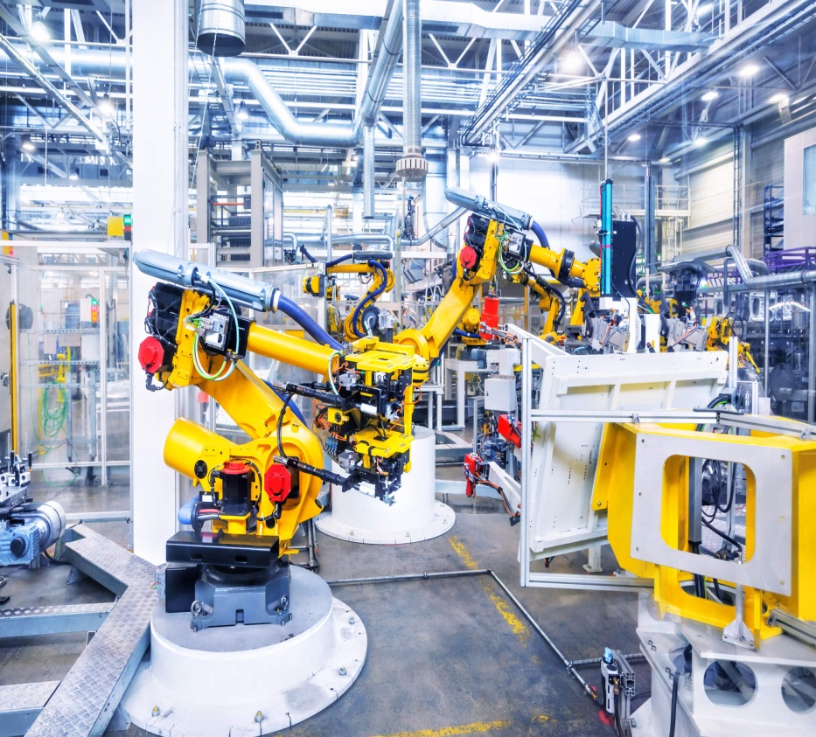
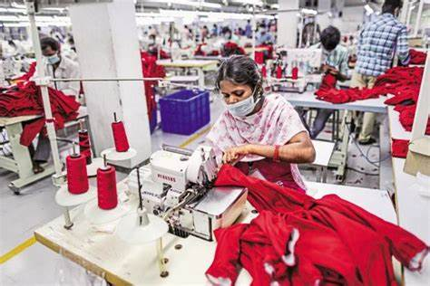
Example of capital and labour intensive goods
machine (capital intensive)
Cloth ( labour intensive)

Slide 7
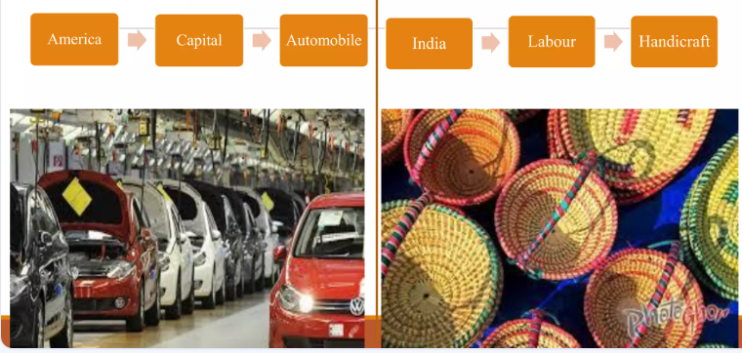
Capital & labour rich countries

Slide 8
Explanation of the theory
The H-O theory states that countries which are rich in labour will export labour intensive goods and countries rich in capital will export capital intsensive goods.
Assumptions :
2 X 2 X 2 theory
Factor of production mobile within country, but immobile between countries
Perfect competition.
Full employment
Free and unrestricted trade
Transport cost nil
Incomplete specialisation.

Slide 9
Explanation of the theory
The H-O theory based on two elements.
Relative factor endowment
Relative factor intensity
Relative factor endowment : Countries are differ from one another in availability of factors. Relative factor endowment is measured by comparing the factor (capital & labour) ratios of the two countries- country A & country B.
Country A will be relatively capital rich if-
K_{A} /L_{A} > K_{B}/L_{B}
Country B will be relatively labour rich if-
L_{B}/ K_{B} > L_{A} / K_{A}

Slide 10
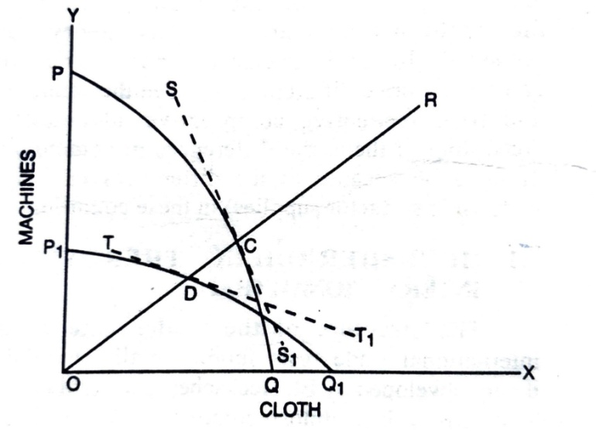
Explanation of the theory
Diagramatic explanation :
In the diagram-
PQ & P1Q1 are the PPC of country A & B respectivly
country A & B are producing at C & D
SS1 and TT1 are slope of PPC of country A & B
Slope of PPC of country A is more steeper at C than the slope of PPC of country B at D
This means cost of producing cloth is high in country A than country B. so, country A produces max amount of machine more cheaply.
Similarly country B can produce max cloth more cheaply
so country A is capital rich and country B is labour rich and they will export machine and cloth respectively.

Slide 11
Explanation of the theory
Relative Factor intensities : It compares the relative proportions of different factor of production used in producing goods and services.
On the basis of relative factor intensities, goods may be grouped as capital intensive or labour intensive.

Slide 12
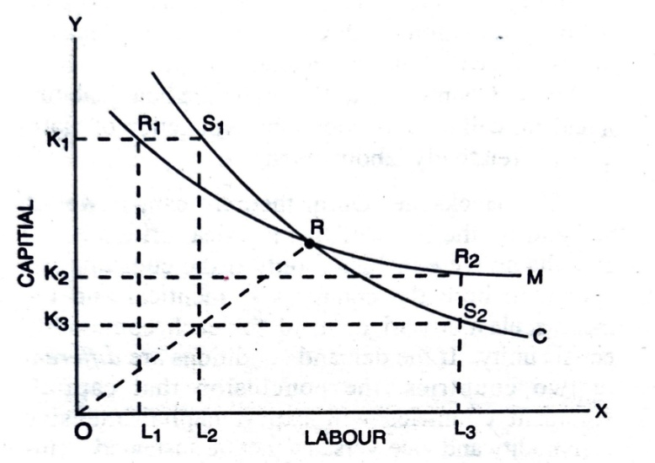
Explanation of the theory
Diagramatic explanation :
C & M are isoquants of cloth & machine
At point R equal factor needed to produce machine and cloth
To the left of R more capital needed and to the right of R more labour need.
To produce 1 unit of machine needs = OK1 capital & OL1 labour at point R1
To produce 1 unit of cloth needs = same capital with extra OL2 labour at S1
So, machine is capital intensive.
Similarly cloth is labour intensive.
Hence, > country A will produce and export machine as it is capital intensive
> country B will produce and export cloth as it is labour intensive

Slide 13
Real world examples
India, Bagladesh large population → large labour→ specialise in labour intensive goods like textiles, clothing, consumer products etc.
Nations like Saudi Arabia and Russia, with abundant natural resources like oil, specialise in the production and export of petroleum products
Brazil is a land-abundant country, so it exports agricultural products, such as soybeans and coffee
Germany and Switzerland specialise in capital-intensive manufacturing, such as precision machinery and automobiles

Slide 14
Limitation of the theory
Partial equilibrium analysis
Unrealistic assumptions
Ignores technological changes
Static analysis

Slide 15
Thank you
THE END….

