Slide 1
ECONOMIC INTEGRATION
Sultan ahmed

Slide 2
INTRODUCTION
Economic integration is an arrangement between different regions that often includes the reduction or elimination of trade barriers, and the coordination of monetary and fiscal policies .
The aim of economic integration is to reduce costs for both consumers and producers and to increase trade between the countries involved in the agreement.

Slide 3
ADVANTAGES
Trade benefits: member countries have;
Wider selection of goods and services.
Acquire goods and services at a lower cost.
Encourages more trade among member countries .
Political cooperation.
Employment opportunities.

Slide 4
DISADVANTAGES
Creation of trade blocks.
Trade diversion.
National sovereignty.

Slide 5
LEVELS OF ECONOMIC INTEGRATION
Preferential trade area.
Free trade area.
Customs union.
Common market.
Economic and monetary union.
Complete economic integration.

Slide 6
PREFERENTIAL TRADE AREA
Preferential Trade agreements provide lower barriers on trade among participating nations than on trade with non member nations.
Lower tariffs on import from each others.
Loosest form of economic integration.
Example – agreement between EU and the African, Caribbean and pacific (ACP) group states.

Slide 7
FREE TRADE AREA (FTA)
An agreement between two or more countries to remove all trade barriers among themselves.
Free trade area occurs when a group of countries agree to eliminate tariffs between themselves, but maintain their own external tariffs on import from rest of the world.
Example – North American Free Trade Agreement(NAFTA) and Association of South East Asian Nations (ASEAN).

Slide 8
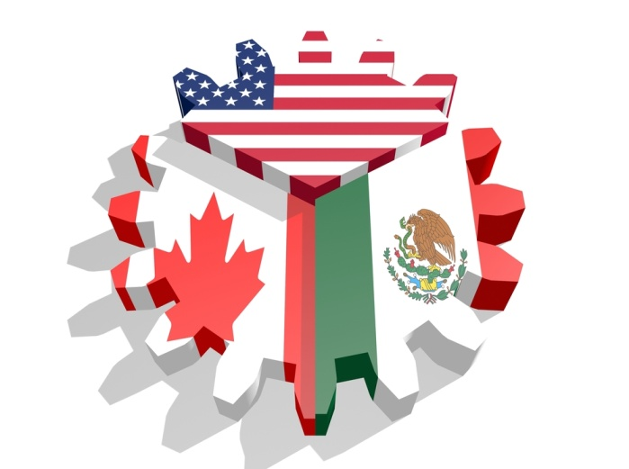
NAFTA
FREE TRADE
AREA FREE TRADE
IMPOSES TARIFFS
AMERICA
CANADA
MEXICO
Country D

Slide 9

ASEAN
Formed in July 31, 1961
Members:
Brunei Darussalam
Cambodia
Indonesia
Laos
Malaysia
Myanmar
Philippines
Singapore
Thailand
Vietnam

Slide 10
CUSTOMS UNION
An agreement between two or more countries to remove tariffs between themselves and set a common external tariffs on imports from non member countries.
All common markets and economic unions are also customs union.
Example – European Union Customs Union (EUCU).

Slide 11
Free trade
Customs union
Country A
Country B
common
extern co common External tarrifs
Country C
Country D

Slide 12
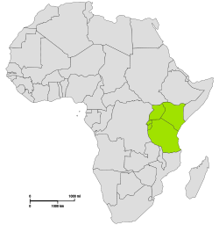
COMMON MARKET
A common market is a customs union with common policies on product regulation and free movement of goods, services, capital and labour.
Harmonize trade policies by having common external tariffs against non-members.
Example – East African community
[Established by Kenya, Uganda,
and Tanzania]

Slide 13
ECONOMIC & MONETARY UNION
An economic and monetary union is a common market with a common currency and a common central bank.
Integration is more intense in an economic union than in a common market, as member countries are required to harmonize their tax, monetary, and fiscal policies and to create a common currency.
Example – The EU, that has adopted the euro as its common currency and European Central Bank (ECB) as their central bank.

Slide 14

EUROPEAN UNION
Established in 1957.
EU has developed an internal single market through standardised system of law.
Free movement of people, goods, services and capital.
28 member states.
Currency – Euro.
Capital – Brussels.
GDP - 18.8 trillion.

Slide 15
COMPLETE ECONOMIC INTEGRATION
The final stage of economic integration.
Under complete economic integration the individual countries involved would have no control of economic policies, full monetary union, and complete harmonization of fiscal policy.
European union is moving towards complete economic integration.

Slide 16


