Slide 1
Foreign Exchange
Sultan Ahmed

Slide 2

Meaning of Foreign Exchange
In general terms, foreign exchange means foreign currency. For example, in context of india, Dollar, Pound sterling, Franc etc. constitute the foreign exchange.
But in Economics, it is used in broader sense. Here foreign exchange(Forex) is the conversion of one country’s currency into another. And these currencies are traded at a specific rate, called Foreign exchange rate. For example:
1 US Dollar = 73.23 Indian rupee

Slide 3
Foreign Exchange Market
It is a market where exchange of different currencies takes place. It is a global online network where traders buy and sell currencies. It has no physical location and operates 24 hours a day. It is the largest and most liquid market in the world.
Example: if an Indian importer imports goods from US and has to make payments in USD, it will approach foreign exchange market to buy USD for INR.
In foreign Exchange market, foreign exchange rates are determined

Slide 4
Exchange rate
Exchange rate is the rate at which one unit of currency of a country can be exchanged for the number of units of currency of another country.
It is the price paid in domestic currency in order to get one unit of foreign currency.
1 USD = 73.23 INR
It expresses the ratio of exchange between the currencies of two countries.
A rise in the exchange rate of a currency is called appreciation and fall in the exchange rate is called depreciation of that currency.

Slide 5
Fixed Exchange Rate
A fixed exchange rate – also known as a pegged exchange rate – is a system of currency exchange in which the value of one currency is tied to another currency or gold by the government or monetary authority.
By pegging one currency to another, there is less fluctuation when exchanging money or trading between countries. Currencies with fixed exchange rates are therefore more stable and less influenced by market conditions than currencies with floating exchange rates.
Currencies with fixed exchange rates are usually pegged to a more stable or globally prominent currency, such as the euro or the US dollar. For example, the Danish krone (DKK) is pegged to the euro at a central rate of 746.038 kroner per 100 euro, with a 'fluctuation band' of +/- 2.25 per cent.

Slide 6
Arguments in Favour of Fixed exchange Rate:
Encouragement to International trade.
Economic Development.
End of speculation and hedging.
Internal stability.
Encouragement to Capital formation.

Slide 7
Arguments against Fixed Exchange rate system:
Relatively Less conducive to International trade
Not a real rate of Exchange
International crisis

Slide 8
Determination of Fixed exchange rate
A fixed exchange rate system is one where the value of the exchange rate is fixed to another currency. This means that the government have to intervene in the foreign exchange market to maintain the fixed rate. The equilibrium exchange rate may be either above or below the fixed rate.
Prior to 1930, in the era of Gold standard, rate of exchange depended on the quantity of gold contained in the standard money of the country. For example: if American govt. fixed the price of 1 dollar as equal to 1 gram of gold and govt. of England fixed the price of one pound as equal to 4 grams of gold, then the rate of exchange would be:
1 pound =4 dollars
1 dollar= ¼ pound
Since 1977, most of the countries have abandoned fixed exchange rate system and adopted the system of floating exchange rate.

Slide 9
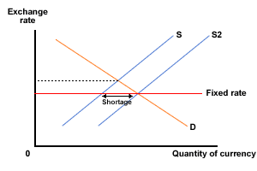
In Figure 1 below, the equilibrium is above the fixed rate. There is a shortage of the national currency at the fixed rate. This would normally force the equilibrium exchange rate upwards, but the rate is fixed and so cannot be allowed to move. To keep the exchange rate at the fixed rate the government will need to intervene. They will need to sell their own currency from their foreign exchange reserves and buy overseas currencies instead. This has the effect of shifting the supply curve to S2 and as a result, their foreign currency holdings will rise.

Slide 10
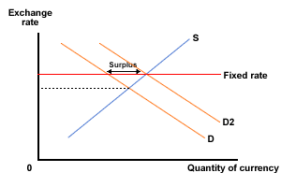
In Figure 2, the opposite is true - the equilibrium rate is below the fixed rate. This means that there is a surplus of the national currency. The government will need to buy this surplus if they are to prevent the currency from falling - in other words keep it at the fixed rate. When they buy the currency they will be selling from their foreign currency reserves and so these will fall, but the demand for domestic currency will rise.

Slide 11
Flexible Exchange Rate system
Flexible exchange rates can be defined as exchange rates determined by global supply and demand of currency. In other words, they are prices of foreign exchange determined by the market, that can rapidly change due to supply and demand, and are not pegged nor controlled by central banks.
For example, one U.S. dollar might buy 73 INR today, but it might only buy 70 INR tomorrow. The value "floats."

Slide 12
Arguments in favour of flexible Exchange rate:
Balance of payments stability
No restrictions on foreign exchange and capital flows
Helpful in making monetary policy effective
No need to keep large foreign currency reserves
Protection against imported inflation

Slide 13
Arguments against floating exchange rate:
High level of exposure to exchange rate volatility
Lack of currency control can curtail economic recovery or growth
It encourages speculation
It does not impart stability to the process of international trade
It is a threat to Internal stability

Slide 14
Determination of Floating exchange rate
Where the exchange rate is floating (as are all major currencies in the world), it will be determined by market forces - that is supply and demand. As in any other market, the rate will change constantly to reflect how much of the currency is being traded. However, what determines the supply and demand for the currency? Let's take the rupee (the Indian currency) as an example and look at the factors that affect supply and demand and therefore the equilibrium exchange rate.

Slide 15
Demand for rupee:
The people who demand rupee are those who have bought goods and services from India and need to pay in rupee. To do this they need to sell (supply) their currency and buy (demand) rupee in exchange. So, the demand for rupee is partly determined by the level of exports - the higher the level of exports, the higher the demand for rupee. However, people may also demand rupee simply because they want to invest in india or because they are speculating to make a profit, as they believe that exchange rates will change. So the demand for sterling arises from:
Exports
Inflows of funds into India
Speculation

Slide 16
Supply of rupee:
The supply of rupee comes from people who are selling rupee to buy other currencies. We all do that when we travel overseas - we sell rupee and buy Euros, $, Yen or whatever. However, we, as tourists, are only a very small part of overall supply of rupee. Much of it will come from firms who buy goods and services from overseas (imports), but there may also be outflows of funds and perhaps speculative flows as well. So, the supply of rupee arises from:
Imports
Outflows of funds from India
Speculation

Slide 17
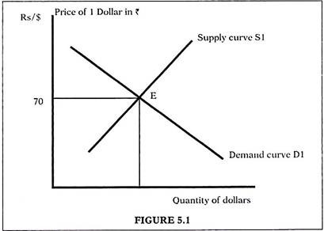
The flexible exchange rate is dictated purely by demand and supply considerations. Economic and financial factors can affect exchange rate only through demand and supply forces.

Slide 18
Depreciation and Appreciation
Depreciation of domestic currency refers to an increase in the domestic price of foreign exchange.
Appreciation of domestic currency refers to a fall in the domestic price of foreign exchange.
Start at a point where $ 1 = Rs.70. Consider another rate where $ 1 = Rs.75 now, so that we can compare the two points. This means that every dollar now gets you Rs.5 more.
Earlier we got 1/70 = 0.014286 dollars per Re. In the new equilibrium we end up with 1/75 = 0.01333 dollars per Rupee. Since we end up with lesser dollars this is depreciation of the Rupee
In the same way an appreciation of rupee will mean that we get more dollars per Rupee.

Slide 19
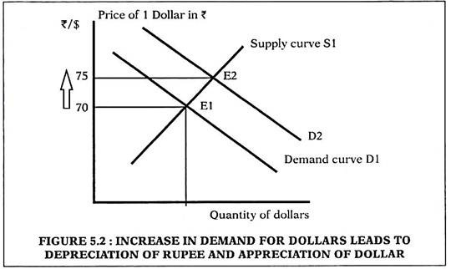
Increase in demand for dollars: Let us start at equilibrium at point E1 where demand = supply of foreign exchange and equilibrium exchange rate is 1 $ = Rs.70 in figure 5.2. A rise in demand for dollars is shown as a rightward shift of demand curve from D1 to D2. The new equilibrium is now at E2, where exchange rate is Rs.75 for $ 1. This may happen when imports rise and importers need dollars to pay for goods bought from abroad. This change is also called depreciation of the Rupee.

Slide 20
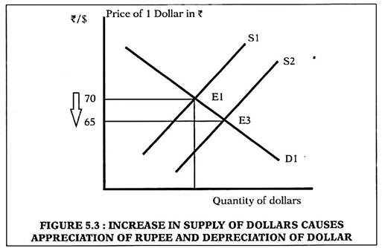
Increase in supply of dollars: Let us start again at equilibrium at point E1 where demand = supply of foreign exchange and equilibrium exchange rate is 1 $ = Rs.70 in figure 5.3. An increase in supply of dollars is shown as a rightward shift of supply curve from SI to S2. The new equilibrium is now at E3, where exchange rate is Rs.65 for $1. This may happen when exports rise and sellers from abroad need to pay Indian exporters in Rupee terms. To do so they must supply more foreign ex­change to Indian banks in return for Rupees. This change from Rs.70 to Rs.65 is also called appreciation of the Rupee.

Slide 21
Factors influencing the Rates of exchange:
Increase in export prices:
Export prices ↑ ⇒ more demand for domestic currency (if demand for product is inelastic) ⇒ appreciation of domestic currency.
Exactly the opposite happen if the price elasticity of demand for domestic product is high in foreign market.
Increase in import prices:
import prices ↑ ⇒ less supply of domestic currency (if the demand for foreign product is highly elastic) ⇒ appreciation of domestic currency.
Exactly the opposite happen if the price elasticity of demand for foreign product is inelastic.

Slide 22
Factors influencing the Rates of exchange:
Changes in price level:
inflation in domestic country ⇒ domestic goods are relatively costlier(foreign good are relatively cheaper) ⇒ foreign demand for domestic currency decreases ⇒ depreciation of domestic currency.
in case of fall in price, appreciation of currency takes place.
Inflow and outflow of capital:
inflow of foreign capital ⇒ supply of domestic currency reduces ⇒ appreciation of domestic currency
outflow of foreign capital ⇒ supply of domestic currency increases ⇒ depreciation of domestic currency.

Slide 23
Factors influencing the Rates of exchange
Structural changes
Interest rate
Interest rate high ⇒ attract investment from abroad ⇒ inflow of capital ⇒ appreciation of currency
Economic conditions (protection policy, war or peace, fiscal policy)
Monetary policy:
tight monetary policy ⇒ high rate of interest ⇒ more inflow of capital ⇒ demand for domestic currency increases ⇒ appreciation of currency.
Cheap monetary policy ⇒ depreciation of domestic currency

Slide 24
Thank you….

