Slide 1
MARKETING ENVIRONMENT
CONCEPT, IMPORTANCE AND COMPONENTS

Slide 2
MEANING
Marketing environment includes the study of customers, suppliers, competitors and demographic, political, economic. Social and technological forces that exist inside and outside the business firm. Marketing environment also greatly influences the marketing operations of a firm.

Slide 3
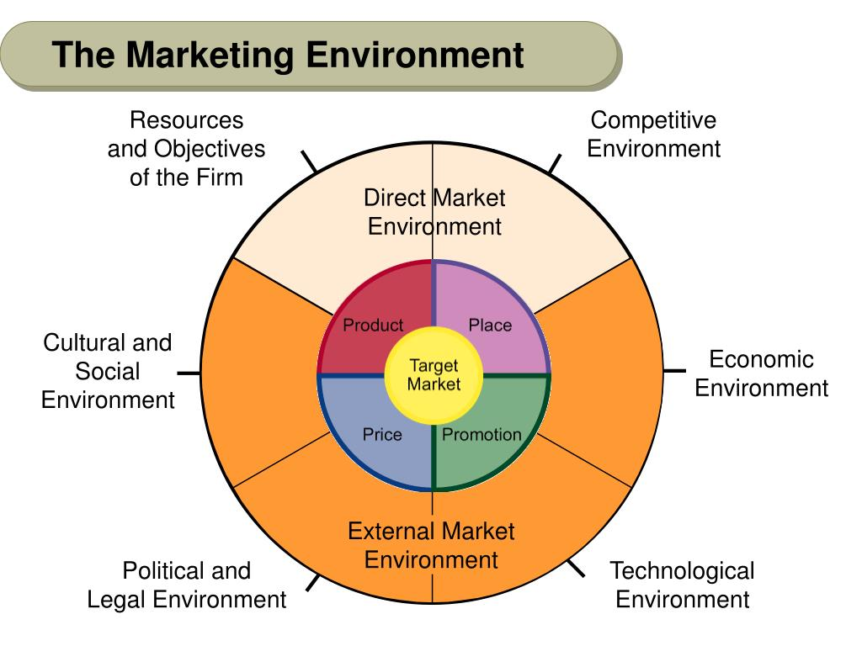
Components of marketing environment

Slide 4
Features of Marketing Environment
1. COMPLEXITY
2.DYNAMIC
3. RELATIVE
4. UNCERTAINITY
5. STORE OF OPPORTUNITIES
6. VARIETY OF FACTORS

Slide 5
Types of Marketing environment
The marketing environment can be broadly classified into internal and external environments. Some of these factors are controllable, while some are uncontrollable. Further, they require business operations to change accordingly. The marketing environment is classified into internal and external environment

Slide 6
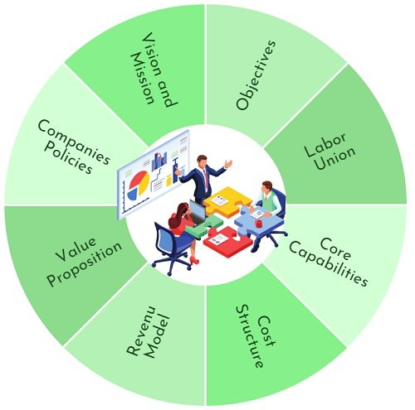
Internal Environment
It is all about those marketing factors that take place within the firm. They affect the overall business operations. These factors include:
These are a part of the organization. Further, they affect the marketing decision and its relationship with the customers. These factors are under the control of the firm.

Slide 7
External Environment
It is concerned with everything that takes place outside the firm. The external environment of the firm has two further divisions:
Micro Environment
It includes all factors closely associated with the operations and influences its functioning.These factors are controllable to some extent.

Slide 8
Customers: Every business revolves around fulfilling the customer’s needs and wants. Thus, each marketing strategy is customer oriented. It focuses on understanding the need of the customers and offering the best product that fulfils their needs.
Employees: They are the lifeblood of a business. This is because they contribute significantly to its success. They are the ones who can make or break the company. Thus, Training & Development is crucial to impart marketing skills to an individual.
Suppliers: They are the party from whom the firm purchases material. Using the material, the firm produces finished goods. Hence, they are very important for the organization. It is pertinent to identify the suppliers existing in the market and choose the best that fulfils the firm’s requirements.
Channel partners: Retailers and distributors are important to the success of marketing operations. As they are in touch with customers, they can give suggestions about customers’ demand for a product and its services. Also, they are the ones who remain updated about the increase or decrease in sales.

Slide 9
5.Competitors: We all know that competition leads to success. Keeping a close watch on competitors enables a company to design its marketing strategy accordingly.
6.Shareholders: They are the owners of the company. Every firm has an objective of maximizing its shareholder’s wealth. Thus, marketing activities should be undertaken keeping in mind the returns to shareholders.
7.General public: The business has some social responsibility towards the society in which it is operating. Thus, all marketing activities should be designed to increase society’s welfare as a whole.

Slide 10
Macro Environment
It includes all those factors that exist outside the organization. Hence, they can not be controlled. These factors majorly include Social, Economic, Technological Forces, and Political and Legal Influences. These are also called as PESTLE framework.

Slide 11
Political and Legal Factors: With the change in political parties, several changes are seen in the market. They can be in terms of trade, taxes, duties, codes and practices, market regulations, etc. So the firm has to follow all these changes. Further, the violation of this could penalize its business operations.
Economic Factors: Every business operates in the economy. Therefore, it is affected by the different phases it is undergoing. In the case of a recession, the marketing practices should be different from what is followed during the inflation period.
Social Factors: Since a business operates in a society and so, it has some responsibility. It must follow marketing practices that do not harm the sentiments of people. Also, companies must invest in the welfare of the general people. They can do so by constructing public conveniences and parks, sponsoring education, etc.
Technological Factors: Technology is everchanging. So, the firms have to keep themselves updated so customers’ needs can be met more precisely. The company can also integrate state-of-the-art technology in the production of goods. This will lead to a reduction in the cost

Slide 12
. Demographic factors :It has a wide range of implications, including the physical characteristics of the targeted region’s population (size, age, gender, occupation, density), population growth rate, migration trends (inter-migration or intra-migration), changes in demographic structure, and the nature and characteristics of communities, among others.A thorough awareness of all such qualities provides a clear picture of the region’s overall demographic composition, allowing marketers to identify the most viable audience segment within that region as their primary target.
Ecological factors:The macro environment’s physical setting is also essential. Location, ecology, biodiversity, natural resources, temperature, weather, climate, and seasons are included. Marketers can determine where to sell certain products by studying these factors.Although equatorial and tropical regions are extensively populated, heaters and electric blankets will never work there. Again, temperate Westerners will never want air conditioners or coolers.

