Slide 1
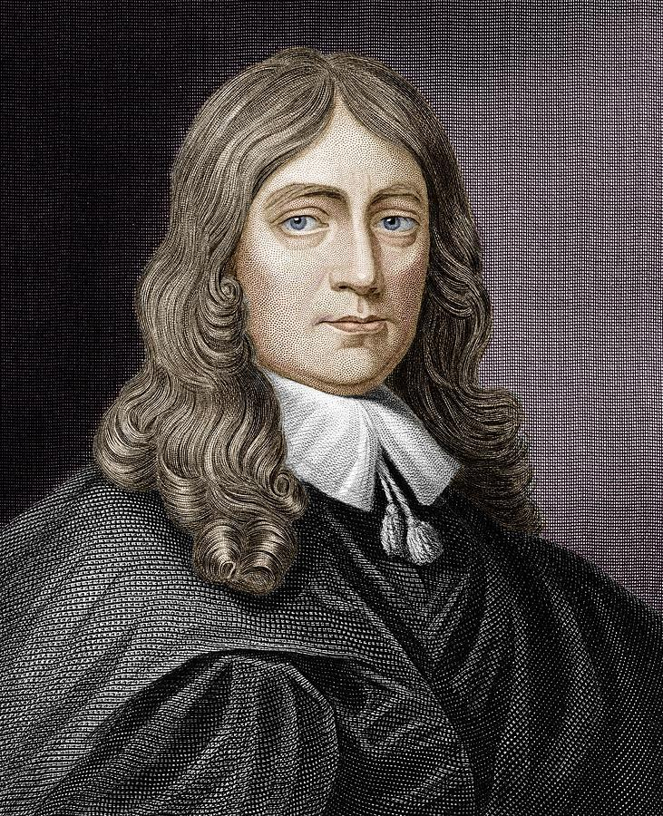
On His Blindness
By John Milton
Prepared by Dr Marie Kalita
HOD, Dept of English

Slide 2
About the poem
Written around 1655 after Milton became completely blind .
A sonnet (14 line poem) written in petrarchan form .
Reflects Milton's internal struggle with losing losing sight and his purpose in serving God .

Slide 3
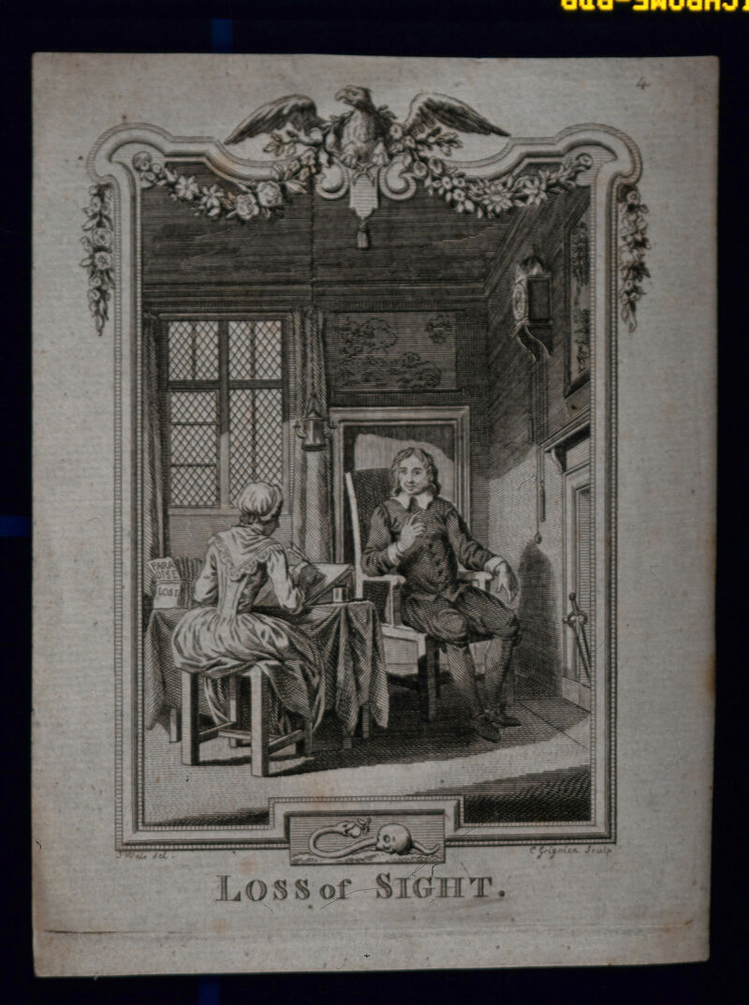
Central Theme
The tension between human limitations and divine expectations.
Accepting personal suffering while trusting in God's greater plan .

Slide 4
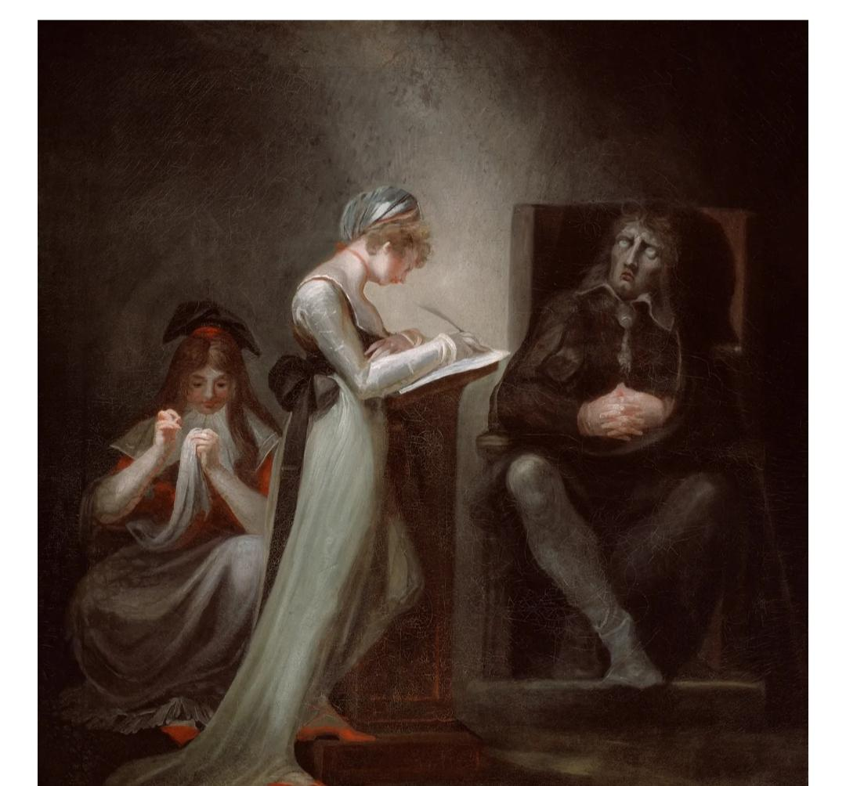
“They only serve who only stand and wait “.
This line emphasizes that active service is not the only form of devotion.

Slide 5
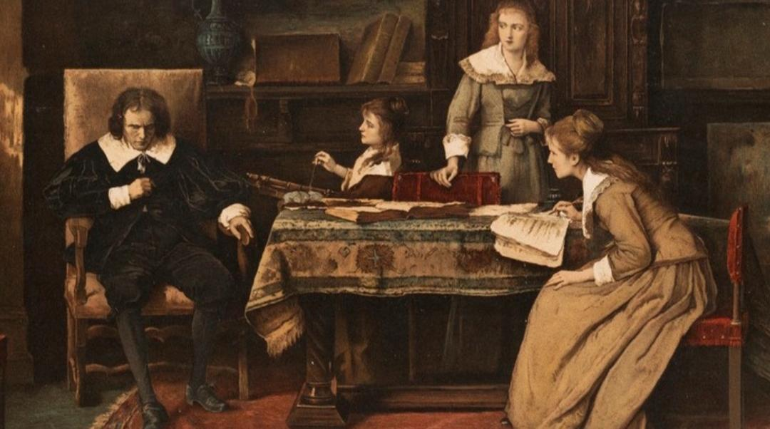
Message
Even is disability or perceived inactivity , one can fulfil a divine role .
Patience and faith are also forms of service to God .

Slide 6
Conclusion
God doesn't need human work or gifts; patience and faith are valued forms of service.
The poem resolves with the idea that even passive patience can be a form of service to God.

