Slide 1
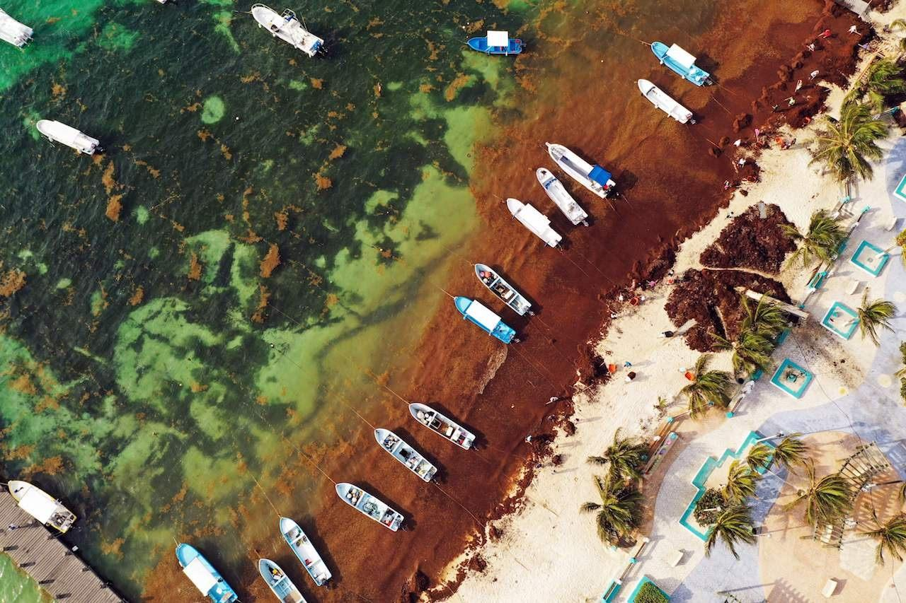
Wide Sargasso Sea by Jean Rhys
Presented by
Dr Marie Kalita
HOD ,Dept. Of English

Slide 2
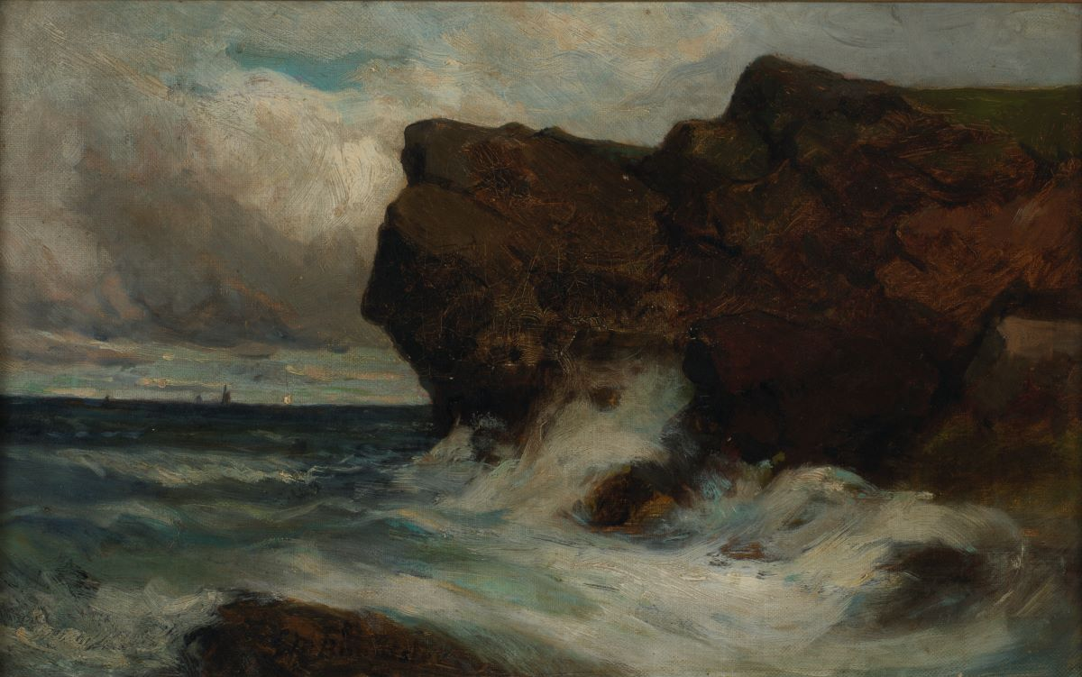
Introduction to the novel
Wide Sargasso sea(1966) is a prequel to Jane Eyre by Charlotte Bronte .
Set in post emancipation Jamaica and Dominica.
Explores the life of Antoinette Cosway,the woman who becomes Bertha Mason.
Themes of identity,race , colonialism and madness dominate.

Slide 3

Themes
Identity and alienation
Central to Antoinette’s life and struggle .
Raised between two cultures: white Creole and Black Caribbean.
Rejected by both - not fully accepted in either world
‘There is always the other side, always’ .

Slide 4

Cultural displacement
Antoinette is neither fully European nor accepted as Jamaican .
Post colonial identity crisis.
The loss of home ,name,and language isolates her .
‘I often wonder who I am and where is my country and where do I belong andwhy was I .’

Slide 5

Madness as a result of identity
Antoinette's descent into “madness” is tied to her loss of identity and control.
Rochester renamed her ‘Bertha’ -erasing her identity.
Patriarchal and colonial power structures silence her .

Slide 6

Gender and Power
Female identity is opressed and controlled by mamale character.
Rochester dominates Antoinette emotionally and mentally.
Marriage becomes a tool of colonization.

Slide 7
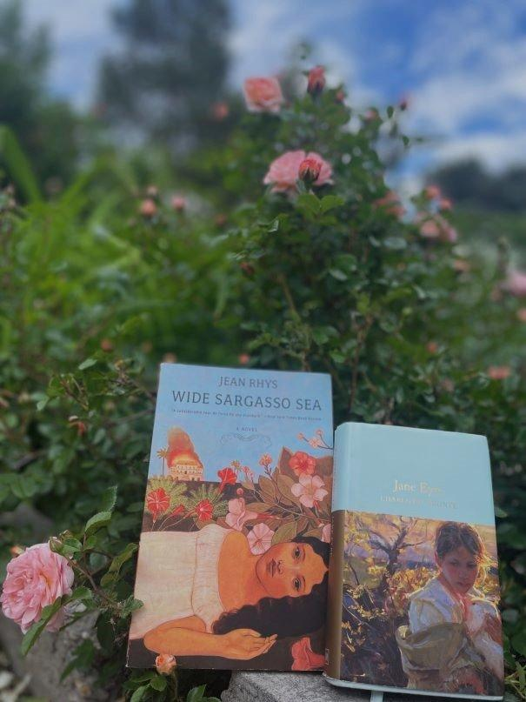
Connection to Jane Eyre
Rhys reclaims the silenced voice of Bertha Mason .
Offers a Post colonial and feminist revision of Jane Eyre .
Challenges the “madwoman the attic” trope.

Slide 8

Conclusion
Wide Sargasso Sea explores:
Fragmented identity.
Racial and cultural Alienation.
Madness as a product of colonial and gender oppression.
Rhys humanizes a literary figure who was previously voiceless.

