Slide 1
Keynesian Theory of Income Determination
Mrinmoyee bhattacharyya
HoD, department of economics

Slide 2
Criticism of Classical Theory
John Maynard Keynes was the main critic of the Classical Macro Economics
His book “General Theory of Employment,Interest and Money” rejected the Say’s Law of Market that”Supply creates its own demand”
Keynesian Theory of Income and Employment emphasizes that the Full Employment is a special case. The equilibrium can be below or above the level of employment

Slide 3
Assumptions of Keynesian Theory
Short period
Closed economy
Perfect Competition
Ignores the role of Government as a spender and taxer
Diminishing Marginal Productivity
Labour is the only factor of production
Labour has money illusion
Money acts as a store of value
No time lag
Underemployment equilibrium
Interest is a monetary phenomenon

Slide 4
Keynesian Theory and Effective Demand
In the short period,level of national income and employment is determined by the Aggregate Demand and Aggregate Supply in the country. The equilibrium occurs when AD=AS. This equilibrium is also called Effective Demand
Effective Demand is the equilibrium between AD(C+I) and AS(C+S)
This equilibrium position indicates that the entrepreneurs neither have a tendency to increase production nor a tendency to decrease production

Slide 5
Determinants of Income
Aggregate Demand(C+I)
It refers to the total demand for final goods and services in the economy at a given time
The Aggregate Demand Price is the amount of money which the entrepreneurs actually expect to receive as a result of the sale of output produced by the employment of certain number of workers

Slide 6
Determinants of Income
Aggregate Supply(C+S)
It refers to the flow of output produced by the employment of workers in an economy during a short period
The Aggregate Supply Price is the minimum amount of money which the entrepreneurs must expect to receive to cover the costs of output produced by the employment of certain number of workers

Slide 7
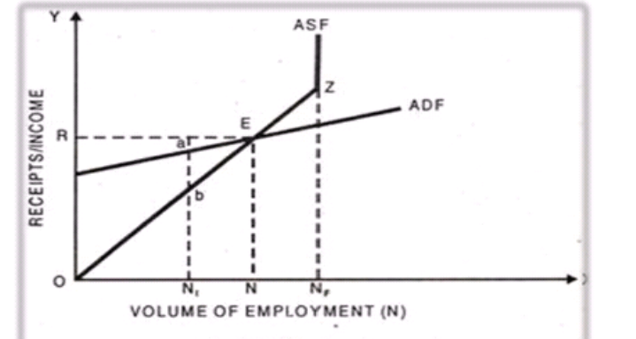
Effective Demand Curve

Slide 8
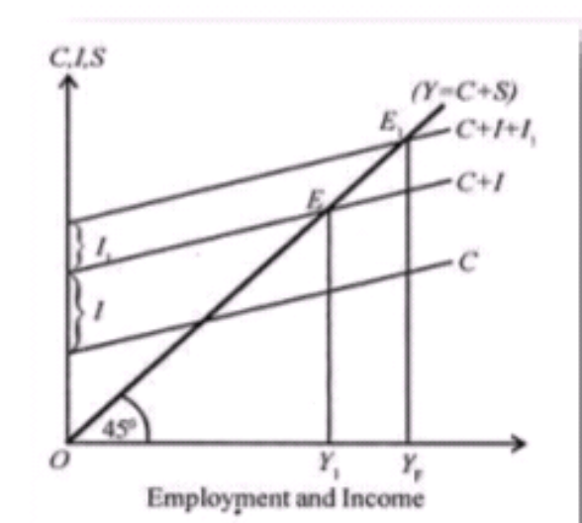
Achievement of Full Employment
In an economy even with unemployment and achieving full employment it is essential to increase AD,it is an underemployment equilibrium

Slide 9
Keynesian Theory VS Classical Theory
According to Classical Economists,Money is demanded for transaction motive alone.On the contrary Keynes said that money is demanded for transaction as well as speculative motive
According to Classicals, Supply of labourers depends on real wage, Whereas Keynes believes that it depends on money wage
In Classical Theory, Saving is the function of Rate of Interest and Keynes is of the view that saving is the function of income
Classicals emphasizes on full employment situation whereas Keynes emphasizes that full employment is a special case. The equilibrium can be below or above the level of Full Employment

Slide 10
Criticism of keynes Theory
Concept of equilibrium is self contradictory
It has ignored the long period equilibrium
Unrealistic assumption of perfect competition
It is not a general theory
Based on assumption of closed economy
Use of labour unit as major of employment is not scientific
Economics of Depression
Keynes analysis is not so emperical

Slide 11
Thank You

