Slide 1
Social welfare Function
Presented by- Sultan ahmed,
Assistant prof. Dept. of economics
Paschim guwahati mahavidyalaya, dharapur

Slide 2
Contents
Introduction
Classical Social Welfare function
Bergson-Samuelson Social welfare function
Properties/Features
Grand utility possibility frontier
Constraint Bliss
How maximum social welfare is determined ?
Limitation
Conclusion

Slide 3
Introduction
The concept of social welfare function was propounded by A. Bergson in his article "A reformulation of Certain Aspects of Welfare Economics" (1938). Later it was popularized by Paul Samuelson
Prior to it various concepts of social welfare function had been given by different welfare economists but they failed to provide a satisfactory solution to the problem of maximization of social welfare.

Slide 4
Classical social welfare function
According to classical economists Bentham, Pigou and Marshall, social welfare is the sum of cardinal utilities obtained by all members of the society.
W= U1+ U2+ U3+ …………. + U_{n}
Where , W= Social Welfare
U1, U2, U3, …., U_{n} = Cardinal utilities of individual member of the society
Maximization of social welfare is achieved only with the equal distribution of income.

Slide 5
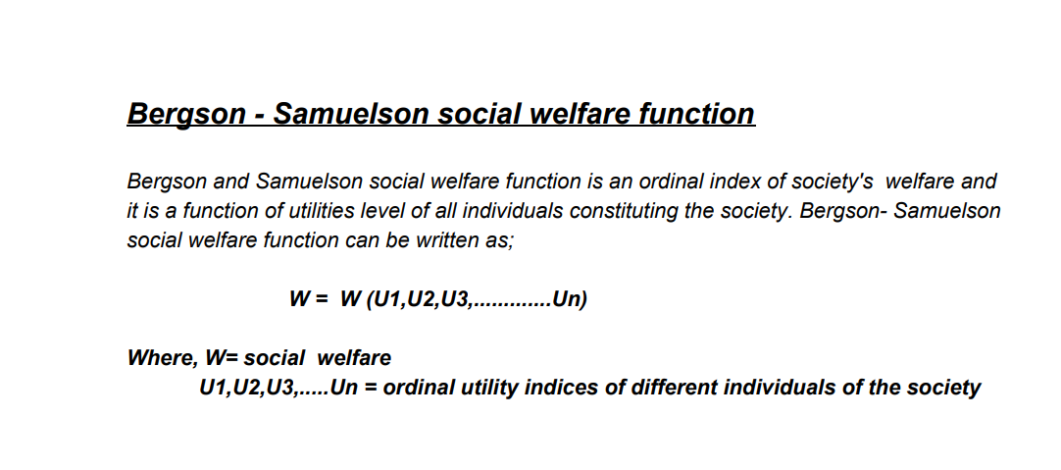
Bergson-Samuelson Social welfare function

Slide 6
Properties/Features
Social welfare function involves the inter-personal comparisons of utility and the explicit value judgment
It’s a generalization of the Marshal-Pigou formulation of welfare.
Utilities are measured in ordinal terms

Slide 7
Grand utility possibility frontier
The Grand Utility Possibility Frontier (GUPF) is a concept in welfare economics that shows the maximum combinations of utility levels that different individuals in a society can achieve, given the economy’s resources, technology, and efficiency constraints.

Slide 8
Constraint Bliss
The Constrained Bliss Point is the point on the Grand Utility Possibility Frontier where the Social Welfare Function (SWF) is maximized.
It's the best possible allocation of utility for society, given resource constraints and efficiency in the social welfare function.

Slide 9
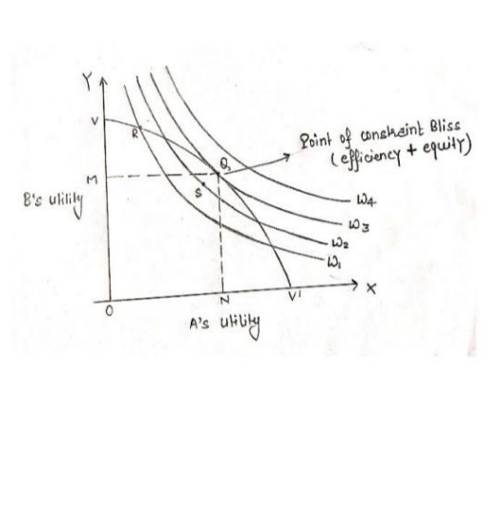
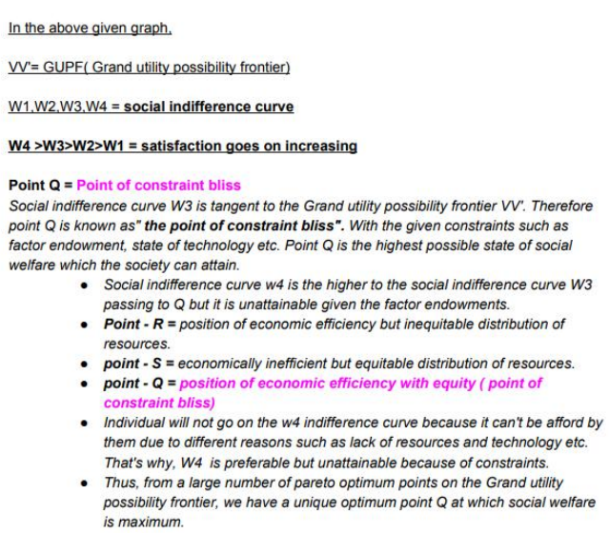
How maximum social welfare is determined ?

Slide 10
Limitation
It is impossible to construct a social welfare function from individual preferences.
Bergson and Samuelson's social welfare function is individualistic in nature.
Amartya K. Sen also criticised that Utility is not true indicator of welfare.

