Slide 1
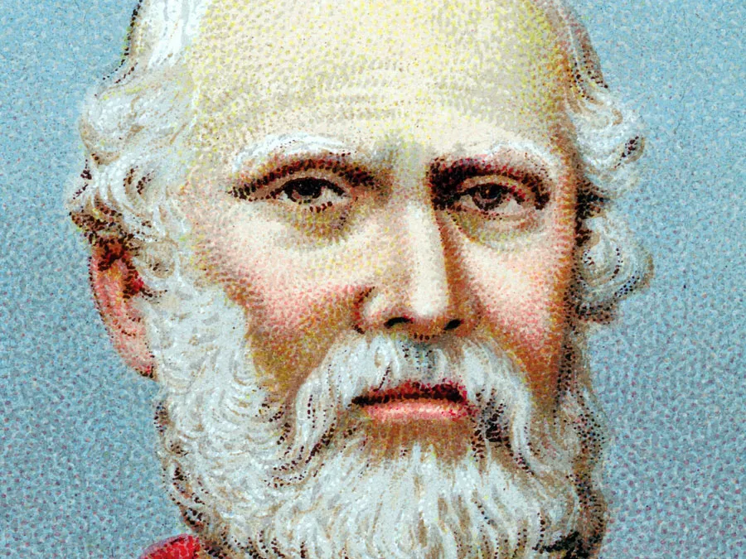
Longinus ,1st Century AD On the Sublime, that was for long attributed to the 3rd-century Greek philosopher Cassius Longinus but now believed to have been written in the 1st century ad by an unknown writer frequently designated Pseudo-Longinus.

Slide 2
Longinus’s Concept of Sublimity. Introduction to the first "Romantic" critic and his groundbreaking work On the Sublime
Dr. Madhuleema Chaliha

Slide 3
Definition :
Longinus defines the sublime as "elevation" or "loftiness" that gives writing distinction.
The author of the treatise defines sublimity as “excellence in language,” the “expression of a great spirit,” and the power to provoke “ecstasy.” Departing from traditional classical criticism, which sought to attribute the success of literary works to their balance of certain technical elements—diction, thought, metaphor, music, etc.—he saw the source of the sublime in the moral, emotional, and imaginative depth of the writer and its expression in the flare-up of genius that rules alone could not produce.

Slide 4
Five Components of On the Sublime :
grandeur of thought,
strong emotion,
appropriate figures of speech,
noble diction,
and dignified composition.

Slide 5
1: Grandeur of Thought
Longinus's "Grandeur of Thought" is the primary source of the sublime in literature, meaning truly great writing springs from a great soul with lofty, majestic ideas, as sublime words naturally flow from noble concepts, making it an "echo of a great soul" that elevates the reader's spirit beyond the mundane. This innate power to form great conceptions, linked to a writer's moral and intellectual depth, allows them to express profound themes that resonate eternally, unlike petty thoughts that yield fleeting or false sublimity, emphasizing the connection between a magnificent mind and magnificent art.

Slide 6
2: Strong Emotion
The second source of the sublime is vehement and inspired passion. Longinus asserts that nothing contributes soar to loftiness of tone in writing than genuine emotion.

Slide 7
3: Appropriate figure of Speech

